Slide 1





Switching Fundamentals
& LAN Communications
A Comprehensive Seminar for Computer Networking Students
Switching Technology
Network Devices
Ethernet Basics
Engr: Abduwahid Mohamed Ali

Slide 2
Session 1 Overview
16:00 – 16:20
Introduction to Switching Technology
1
What is a switch? Why switches? Enterprise roles.
16:20 – 16:40
Network Devices Comparison
2
Hub vs Switch vs Router, OSI Layer devices.
16:40 – 16:50
Ethernet Basics
3
Ethernet frames, MAC addresses, standards.

Slide 3




What is a Switch?
A network switch is a hardware device that connects multiple devices on a computer network, using MAC addresses to forward data to the correct destination — unlike a hub, which broadcasts to all ports.
Intelligent Forwarding
Layer 2 Device
Full-Duplex Support
Uses MAC address table to send data only to the intended device — not all devices.
Operates at the Data Link Layer (Layer 2) of the OSI model by default.
Allows simultaneous sending & receiving — greatly boosting network throughput.

Slide 4


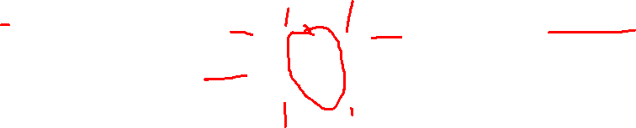
Why Switches are Used in LANs
PC A
PC C
SWITCH
PC B
PC D

Slide 5

Why Switches are Used in LANs
01
Dedicated Bandwidth
02
Intelligent Forwarding
03
Collision Elimination
Each port gets its own dedicated bandwidth, eliminating competition between devices.
Data is sent only to the destination device, reducing unnecessary traffic on the network.
Each port is a separate collision domain, eliminating packet collisions in the LAN.
04
Full-Duplex Support
05
Scalability
06
VLAN Support
Devices can send and receive data simultaneously, doubling effective throughput.
Easily expand the network by adding more switch ports or stacking multiple switches.
Managed switches support VLANs for logical network segmentation and security.

Slide 6

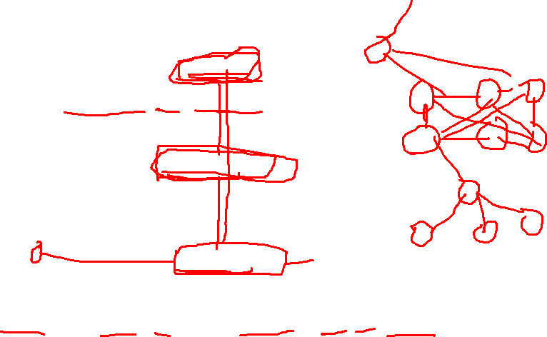
Role of Switches in Enterprise Networks
Core Layer
High-speed backbone; connects distribution switches; handles massive traffic.
Distribution Layer
Aggregates access-layer switches; applies routing and policies between floors/buildings.
Access Layer
End-user devices (PCs, phones, printers) connect here; port security, VLANs.
Core switches operate at Layer 3 with routing capabilities, distributing at Layer 2–3, and access at Layer 2.

Slide 7



Hub vs Switch vs Router
HUB
SWITCH
ROUTER
Layer 1 (Physical)
Broadcasts to ALL ports
No MAC table
Half-duplex only
Creates collisions
Low cost, obsolete
Layer 2 (Data Link)
Forwards to TARGET port
Maintains MAC table
Full & half-duplex
Eliminates collisions
Used everywhere in LANs
Layer 3 (Network)
Routes between networks
Uses IP routing table
Connects LANs to WAN
Performs NAT/firewall
Connects to the Internet

Slide 8




Layer 1, 2 & 3 — OSI Model & Network Devices
7
Application
-
6
Presentation
-
5
Session
-
4
Transport
Firewall, Load Balancer
3
Network
Router, L3 Switch
2
Data Link
Switch, Bridge
1
Physical
Hub, Repeater, Cables
Switches operate at Layer 2. Layer 3 switches also handle routing (IP).

Slide 9


What is Ethernet?
Ethernet is the most widely used wired LAN technology, defined by IEEE 802.3. It standardizes how data is transmitted across cables using frames, enabling device communication in a network.
Invented
Standards
Media
Bob Metcalfe at Xerox PARC, 1973. Now the global LAN standard.
IEEE 802.3: 10 Mbps → 10 Gbps → 400 Gbps in modern data centers.
Twisted-pair cable (Cat5e/Cat6/Cat6a), fiber optic, coaxial.
Ethernet Speed Evolution
10BASE-T
100BASE-TX
1000BASE-T
10GBASE-T
40G / 400G
10 Mbps
100 Mbps
1 Gbps
10 Gbps
400 Gbps
1990
1995
1999
2006
2017+

Slide 10





Ethernet Frame Structure
Preamble
SFD
Dest MAC
Src MAC
EtherType/Len
Payload/Data
FCS
7 B
1 B
6 B
6 B
2 B
46–1500B
4 B
Destination MAC
Source MAC
Payload / Data
FCS (CRC)
6-byte (48-bit) address identifying the receiving device. Written as: AA:BB:CC:DD:EE:FF. The switch reads this to decide which port to forward the frame.
6-byte address of the sending device. The switch learns and stores this in its MAC address table to build forwarding intelligence.
The actual user data (46–1500 bytes). If less than 46 bytes, padding is added. Maximum frame size = 1518 bytes (MTU).
4-byte checksum. Receiver recalculates and compares — if mismatch, frame is dropped (error detection).

Slide 11


Source & Destination MAC Addresses
Example MAC Address: AA : BB : CC : DD : EE : FF
← OUI (Manufacturer, 3 bytes) → ← NIC Specific (3 bytes) →
Source MAC Address
Destination MAC Address
The MAC address of the SENDING device
Helps the switch learn which device is on which port
Switch stores it in the MAC Address Table (CAM table)
Example: Your PC's NIC address when sending an email
The MAC address of the RECEIVING device
Switch looks it up in its MAC table to find the right port
If unknown → switch floods to all ports (except source)
FF:FF:FF:FF:FF:FF = Broadcast (sent to ALL devices)

Slide 12



Key Takeaways
A switch intelligently forwards frames using MAC addresses — only to the intended device.
Ethernet (IEEE 802.3) is the dominant LAN standard; frames carry MAC src/dest, data & FCS.
Switches operate at Layer 2; Layer 3 switches add routing (IP) capability.
MAC address = 48-bit unique hardware identifier; first 3 bytes = manufacturer (OUI).
Hub → broadcasts; Switch → unicasts; Router → routes between networks.
Enterprise networks use a 3-tier switch hierarchy: Core, Distribution, Access.

Slide 13

Session 2 Overview
16:50 – 17:00
MAC Addressing
1
What is a MAC address? MAC vs IP. LAN communication.
17:00 – 17:15
How Switches Learn MAC Addresses
2
MAC address table, dynamic learning, aging timers.
17:15 – 17:30
Switch Forwarding Decisions
3
Forwarding, flooding, filtering, unicast & broadcast.

Slide 14





What is a MAC Address?
A MAC (Media Access Control) address is a unique 48-bit hardware identifier permanently assigned to a Network Interface Card (NIC) by its manufacturer. It identifies devices at Layer 2 of the OSI model.
Anatomy of a MAC Address:
AA
:
BB
:
CC
:
DD
:
EE
:
FF
OUI — Manufacturer ID (3 bytes)
NIC-Specific (Device ID) (3 bytes)
Hardware Address
Layer 2 Identity
Flat Structure
Burned into the NIC at factory. Sometimes called BIA (Burned-In Address). Cannot be changed by software.
Used by switches at the Data Link Layer (Layer 2) to identify devices within a LAN segment.
Unlike IP addresses, MACs have no hierarchical structure. They don't indicate location — just identity.

Slide 15


MAC Address vs IP Address
Feature
MAC Address
IP Address
Full Name
Media Access Control
Internet Protocol
Layer
Layer 2 — Data Link
Layer 3 — Network
Length
48 bits (6 bytes)
32 bits (IPv4) / 128 bits (IPv6)
Format
AA:BB:CC:DD:EE:FF (hex)
192.168.1.1 (dotted decimal)
Assigned by
Manufacturer (burned-in)
Network admin / DHCP (logical)
Changes?
Permanent (usually)
Changes with network
Scope
Local LAN only
Global (routable)
Used for
Device identification in LAN
Routing between networks
Analogy: MAC address = your permanent National ID (who you are). IP address = your postal address (where you live — can change).

Slide 16


How Devices Use MAC Addresses in LAN Communication
PC-A wants to send data to PC-B
PC-A checks ARP cache for PC-B's MAC
1
2
If unknown → ARP Broadcast (FF:FF:FF:FF:FF:FF)
PC-B replies with its MAC address
3
4
PC-A builds Ethernet frame with dest MAC of PC-B
Switch reads dest MAC → forwards only to PC-B's port
5
6
ARP (Address Resolution Protocol) maps IP addresses to MAC addresses automatically within a LAN.

Slide 17


The MAC Address Table (CAM Table)
The MAC address table (also called CAM table) is a database inside a switch that maps MAC addresses to the physical ports they are connected to. It allows the switch to forward frames intelligently.
Network Diagram
MAC Address Table
MAC Address
Port
VLAN
PC-A
PC-C
Fa0/1
Fa0/3
Switch
AA:BB:CC:11:22:33
Fa0/1
1
Fa0/2
Fa0/4
AA:BB:CC:44:55:66
Fa0/2
1
AA:BB:CC:77:88:99
Fa0/3
1
PC-B
PC-D
AA:BB:CC:AA:BB:CC
Fa0/4
1
The switch builds this table by observing SOURCE MAC addresses of incoming frames.

Slide 18


Dynamic MAC Address Learning
1
2
3
4
Frame Arrives
Table Check
Learn / Update
Forward
A frame arrives on a switch port. The switch reads the SOURCE MAC address from the frame header.
The switch checks if this MAC + port combination already exists in its MAC address table.
If MAC is NEW → add it to the table with the incoming port number and start the aging timer.
Switch checks the DESTINATION MAC and forwards the frame to the correct port (or floods if unknown).
MAC Address Aging Timer
Default aging time = 300 seconds (5 minutes). If no frame is received from a MAC within this period, the entry is removed. This prevents the table from filling with stale entries.

Slide 19




MAC Address Table — States & Management
Learned automatically by observing frames. Ages out after 300s if unused. Most common.
Dynamic
Manually configured by admin. Never ages out. Used for security-critical devices.
Static
Set via Port Security feature. Limits number of MACs per port — prevents MAC flooding attacks.
Secure
$ show mac address-table
→ Cisco IOS command to display the current MAC address table on a switch

Slide 20
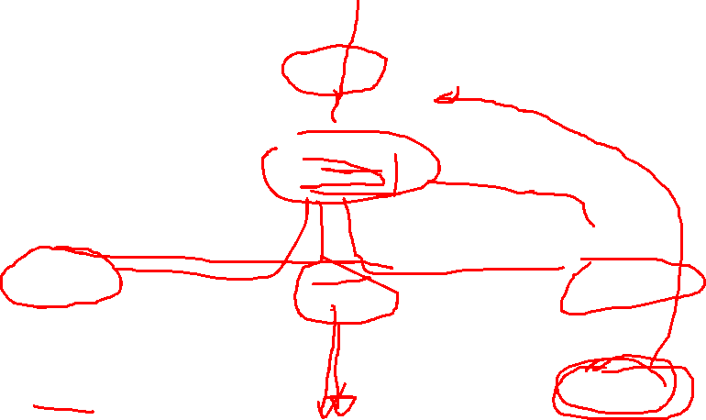
Switch Forwarding Decisions — Overview
Frame Arrives
at Switch
Lookup Dest MAC
in MAC Table
KNOWN
(Same Port)
KNOWN
(Diff Port)
UNKNOWN
or Broadcast
FILTER
(Drop)
FORWARD
(Target Port)
FLOOD
(All Ports)

Slide 21




Forwarding · Flooding · Filtering — Explained
When:
Destination MAC is KNOWN in MAC table & on a DIFFERENT port
What:
Switch sends the frame out ONLY through the correct destination port.
e.g.:
PC-A sends to PC-B. Switch knows PC-B is on Port 2 → frame exits only Port 2.
FORWARDING
When:
Destination MAC is UNKNOWN, or it's a BROADCAST (FF:FF:FF:FF:FF:FF)
What:
Switch sends the frame out ALL ports except the port it arrived on.
e.g.:
PC-A sends ARP request → switch floods to all ports so PC-B can respond.
FLOODING
When:
Destination MAC is KNOWN but on the SAME port the frame arrived on
What:
Switch DROPS the frame — no forwarding needed since source & dest are on same segment.
e.g.:
Two PCs on a hub share Port 1. Switch filters — doesn't flood entire network.
FILTERING
A switch always reads the SOURCE MAC first (to learn), then checks the DESTINATION MAC (to decide where to send).

Slide 22


Unknown Unicast & Broadcast Traffic
Unknown Unicast
Broadcast Traffic
Flood
Always Flood
The destination MAC is NOT in the MAC address table
Switch does NOT know which port the device is on
Action: FLOOD — send frame out ALL ports (except incoming)
Once the destination replies, switch learns its MAC and port
Future frames to this MAC will be FORWARDED (not flooded)
Destination MAC = FF:FF:FF:FF:FF:FF (broadcast address)
Intended for ALL devices in the LAN segment
Switch ALWAYS floods broadcast frames to all ports
Common example: ARP requests, DHCP Discovery
Excessive broadcasts can slow down a network (broadcast storm)
Switches use VLANs to limit broadcast domains — keeping broadcasts contained to smaller groups of devices.

Slide 23





Key Takeaways
MAC address = unique 48-bit hardware ID (OUI + device). Written as AA:BB:CC:DD:EE:FF.
MAC ≠ IP: MAC is Layer 2 (permanent, local); IP is Layer 3 (logical, routable, changes).
ARP maps IP → MAC within a LAN so devices can build Ethernet frames correctly.
Switch builds its MAC table dynamically by reading SOURCE MAC of every incoming frame.
MAC aging timer (default 300s) removes unused entries to keep the table fresh and accurate.
Forwarding = known MAC, different port. Flooding = unknown/broadcast. Filtering = same port.
Convener: Mr Abduwahid Darmad | Mr ABDULLAHI Darmad

Slide 24



Session 3 Overview
17:30 – 17:40
17:40 – 17:50
Part 1: Collision Domains
Part 2: Switch Ports & CLI
Understand collision and broadcast domains, hub problems, switch ports, ARP & DHCP examples
Access/uplink ports, speed/duplex, interface status, Cisco CLI verification commands

Slide 25

What is a Collision Domain?
Definition
Hub = ONE Collision Domain
A collision domain is a network segment where data packets can collide with each other when being sent on a shared medium.
When two devices transmit simultaneously, a collision occurs — corrupting both packets.
All devices must re-transmit after a collision (CSMA/CD protocol).
PC 1
PC 3
HUB
PC 2
PC 4
⚡ COLLISION!
All devices share one collision domain — if any two talk at once, collision occurs!

Slide 26
Each Switch Port = Separate Collision Domain
❌ HUB — 1 Collision Domain
✅ SWITCH — Separate Domains
HUB
SWITCH
PC A
PC B
PC C
PC X
PC Y
PC Z
D1
D2
D3
All PCs share one domain.
If PC A and PC B send simultaneously → COLLISION!
All must wait and retransmit.
Each port = isolated collision domain.
PCs can send simultaneously — NO collision!
Full-duplex communication enabled.

Slide 27

Broadcast Domains
📡 A broadcast domain is a network area where a broadcast sent by any device reaches ALL other devices in that segment.
ARP Broadcast Example
DHCP Broadcast Example
ARP (Address Resolution Protocol) discovers MAC addresses:
1. PC sends: "Who has IP 192.168.1.5?"
→ Destination: FF:FF:FF:FF:FF:FF (broadcast)
2. ALL devices in the domain receive it
3. Device with 192.168.1.5 replies with its MAC
4. Sender caches the MAC address
DHCP (Dynamic Host Config Protocol) assigns IPs:
1. New PC sends DHCP Discover broadcast
→ "I need an IP address!"
2. ALL devices receive it
3. DHCP server responds with an IP offer
4. PC accepts and gets configured

Slide 28

Broadcast Domain in Default VLAN
Default VLAN (VLAN 1)
• By default, all switch ports belong to VLAN 1
• All ports in VLAN 1 share ONE broadcast domain
• Broadcasts flood every port in VLAN 1
VLANs Segment Broadcast Domains:
• Each VLAN = separate broadcast domain
• VLAN 10 broadcasts DON'T reach VLAN 20
• Router needed to communicate between VLANs
VLAN 1 (Default) — ONE Broadcast Domain
P1
P2
P3
P4
← Broadcast reaches all 4 ports →
With VLANs:
VLAN 10
VLAN 20
P1
P2
P3
P4
Own broadcast
domain
Own broadcast
domain

Slide 29


Basic Switch Ports & Interfaces
Access Ports
Uplink (Trunk) Ports
Purpose: Connect end devices (PCs, printers, phones)
Characteristics:
• Belongs to exactly ONE VLAN
• Sends/receives untagged frames
• Device is unaware of VLANs
Example config:
interface Fa0/1
switchport mode access
switchport access vlan 10
Purpose: Connect switches to other switches/routers
Characteristics:
• Carries MULTIPLE VLANs
• Uses 802.1Q VLAN tagging
• Interconnects network devices
Example config:
interface Gi0/1
switchport mode trunk
switchport trunk allowed vlan all

Slide 30

Speed, Duplex & Interface Status
⚡ Speed
🔄 Duplex
🔌 Interface Status
10 Mbps
Ethernet
Half Duplex
up / up
Port up, protocol up
→ Fully working!
Send OR receive at a time
(like walkie-talkie)
Hub-based networks
100 Mbps
Fast Ethernet
up / down
Connected but
protocol issue
1 Gbps
Gigabit
Full Duplex ✅
down / down
No cable or
device connected
Send AND receive simultaneously
(like phone call)
Switch-based, preferred
10 Gbps
10G Ethernet
administratively
down
Manually
shut down
Use: interface Fa0/1
speed 100
duplex full / duplex auto

Slide 31

Accessing the Cisco Switch CLI
🔌 Console Port
📡 Telnet (Remote)
🔒 SSH (Secure Shell)
Direct physical connection
using console/rollover cable
RS-232 or USB → PC
Remote access over network
Port 23, unencrypted
Requires IP configured
Encrypted remote access
Port 22, secure protocol
Requires crypto config
When to use:
When to use:
When to use:
Initial setup, password recovery
Legacy; NOT recommended
Best practice for remote access
CLI Modes:
CLI Modes:
CLI Modes:
> User EXEC
# Privileged EXEC
(config)# Global Config
> User EXEC
# Privileged EXEC
(config)# Global Config
> User EXEC
# Privileged EXEC
(config)# Global Config

Slide 32

Switch Verification Commands
show mac address-table
show interfaces status
show running-config
Displays the MAC address table showing which MAC addresses are learned on which ports and VLANs.
Shows all interface statuses: connected/not-connected, speed, duplex, VLAN assignments.
Displays the active configuration currently in memory — all interface settings, VLANs, etc.
Use: Troubleshoot connectivity, find device locations
Use: Quick overview of all ports at once
Use: Verify configuration changes
show vlan brief
show interfaces fa0/1
Lists all VLANs, their names, status, and which ports are assigned to each VLAN.
Detailed info about a specific interface: speed, duplex, errors, input/output stats.
Use: Verify VLAN assignments
Use: Deep troubleshoot a single port

Slide 33
CLI Output Examples
● ● ● show mac address-table
● ● ● show interfaces status
Switch# show mac address-table
Vlan Mac Address Type Ports
---- --------------- ------ -----
1 0050.7966.6800 DYNAMIC Fa0/1
1 0050.7966.6801 DYNAMIC Fa0/2
10 aabb.cc00.1100 DYNAMIC Fa0/3
20 aabb.cc00.2200 DYNAMIC Gi0/1
Switch# show interfaces status
Port Name Status Vlan Duplex Speed
Fa0/1 connected 1 a-full 100
Fa0/2 connected 10 a-full 100
Fa0/3 notconnect 1 auto auto
Fa0/4 connected 20 a-full 1000
Gi0/1 connected trunk a-full 1000

Slide 34
CLI Output — VLAN & Interface Details
● ● ● show vlan brief
● ● ● show interfaces fa0/1
Switch# show vlan brief
VLAN Name Status Ports
---- ---------- ------ -----
1 default active Fa0/5, Fa0/6
10 SALES active Fa0/1, Fa0/2
20 MANAGEMENT active Fa0/3, Fa0/4
1002 fddi-default act/unsup
1003 token-ring act/unsup
Switch# show interfaces fa0/1
FastEthernet0/1 is up, line protocol is up
Hardware: Fast Ethernet, address: aabb.cc00.0101
MTU 1500 bytes, BW 100000 Kbit/sec
Full-duplex, 100Mb/s
Input queue: 0/75/0/0 (size/max/drops/flushes)
5 min input rate 1000 bits/sec, 1 packets/sec
5 min output rate 500 bits/sec, 0 packets/sec
1234 packets input, 456789 bytes
0 input errors, 0 CRC

Slide 35

💥
Collision Domain
Segment where collisions occur. Hubs = 1 domain. Each switch port = separate domain.
📡
Broadcast Domain
Where broadcasts reach. Switches don't break them — routers/VLANs do.
Key
Takeaways
🔌
Port Types
Access ports for end devices (1 VLAN). Uplink/trunk ports for switch interconnects (multiple VLANs).
Networking Fundamentals
⚡
Speed & Duplex
Match settings on both ends. Full-duplex = simultaneous send/receive. Auto is common.
💻
CLI Commands
show mac-address-table | show interfaces status | show vlan brief | show running-config

