Slide 1
Welcome to SS Track
Day 1
Track 2: Systems and Services
Jazeera University Main Campus

Slide 2

Workshop Overview
What is the Systems and Services Track?
Focus on Linux/Unix system administration and its applications in managing Internet services.
Topics covered include DNS, Web Servers, Email Services, Monitoring, Authentication, and more.
Designed for those interested in building and maintaining robust, large-scale Internet infrastructures.
Practical, hands-on training sessions with real-world applications.

Slide 3
Meet Your Instructors
Track 2 Facilitators:
Abdirahim Mohamed – Central Bank
Ismail Mumin – Tabarak ICT
Mohamed Bile – SomaliREN
Abdifatah Mohamed - Somtel
Omar Adan – NIRA
Nuh Ali – Prime Tech

Slide 4

Let’s Play a Game

Slide 5
How about you…?
Introduce yourself:
  Name
  Work
  Hobbies

Slide 6
Who Should Attend?
Target Audience:
  System Administrators, Network Engineers, and IT Professionals
  University graduates looking to advance their skills in system management and server administration
  Anyone interested in learning about Linux-based internet services and server configurations.

Slide 7
Workshop Methodology
Learning Approach:
  Theory followed by practice: a blend of conceptual explanations and hands-on exercises.
  Hands-on Labs: Work directly with Ubuntu 24.04 Virtual Machines.
  Interactive Sessions: Raise your hand for help, ask questions, and share experiences.
Your Virtual Environment:
  Each participant gets access to a virtual machine running Ubuntu 24.04 (Noble Numbat)
  Access through SSH for remote command execution.

Slide 8
Course Content Overview
Core Topics Covered:
  DNS Resolver and Authoritative DNS
  Network Security: Firewalls and IPtables
  Mail Services: Setting up email servers
  Web Hosting: Apache Web Server configuration
  Automation: Introduction to Ansible
  Authentication: Centralized systems with RADIUS & LDAP
  Virtualization: Building and managing virtual servers.

Slide 9
Workshop Schedule
Session Timings:
  08:00 AM – 10:00 AM: Morning Session
  10:00 AM – 10:30 AM: Tea Break
  10:30 AM – 12:30 PM: Second Session
  12:30 PM – 01:30 PM: Prayer & Lunch Break
  01:30 PM – 03:30 PM: Afternoon Session
  03:30 PM – 04:00 PM: Tea Break
  04:00 PM – 05:30 PM: Closing Session

Slide 10

Workshop Requirements
What You Need:
  Laptop: Please bring your own laptop for virtual machine access
  Tools: Pre-installed SSH client (e.g., Putty or MobaXterm for Windows users)
  Network Access: Use SomNOG8 Track 2 WiFi
  Active Participation: Be ready for interactive sessions and practical labs.

Slide 11
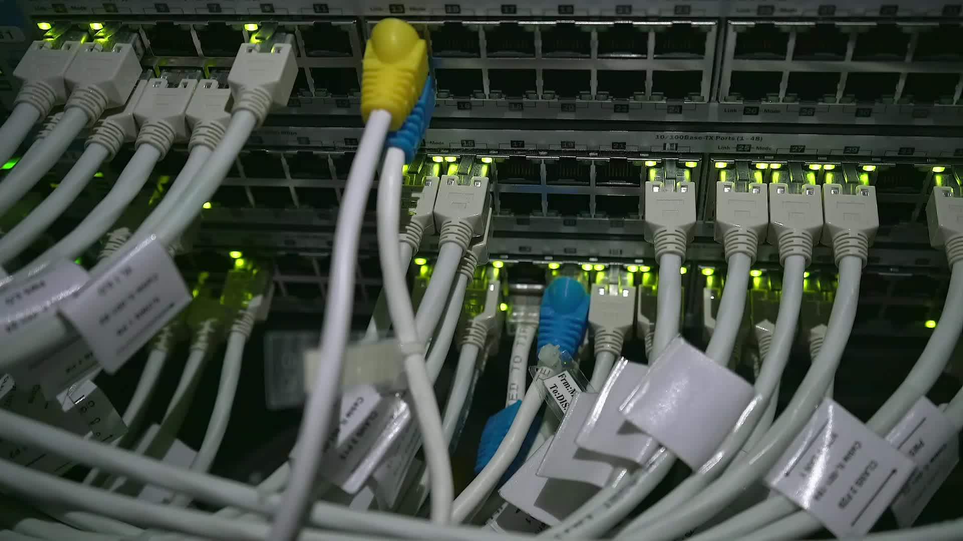
Connectivity & Access
Accessing Virtual Machines:
  Use SSH (e.g., Putty) to connect to your assigned virtual server (e.g., ssh somnog@pcX.somnog.so)
Network Connection
  Connect to the Track 2 SSID using the password: SomNOGSuccess

Slide 12

Important Information
Prayer Places are available on the ground floor:
  Male Prayer Area: Enter the gate and go left.
  Female Prayer Area: Enter the gate, walk straight, then turn right.
Lunch & Refreshments:
  Refreshments and lunch will be served at Room 403.
  Each participant will receive a lunch coupon.
Toilets:
  Male Toilets: Located on the left side of the 4th and 5th floors.
  Female Toilets: Located on the right side of the 4th and 5th floors.

Slide 13
Important Information
What You Will Receive:
  Name badge
  Notebook
  Pen
Important: Please wear your name badge at all times throughout the workshop.

Slide 14
We’re excited to have you at SomNOG8 Track 2!
Let’s dive into the world of Linux system administration and Internet services!
For any questions or assistance, feel free to approach your instructors.
Looking forward to an engaging and productive session!
Any Questions?

