Slide 1

File Management in Linux
Speaker : Abdirahim M.

Slide 2

Linux File Management: Effortlessly Master Your Files & Directories

Slide 3
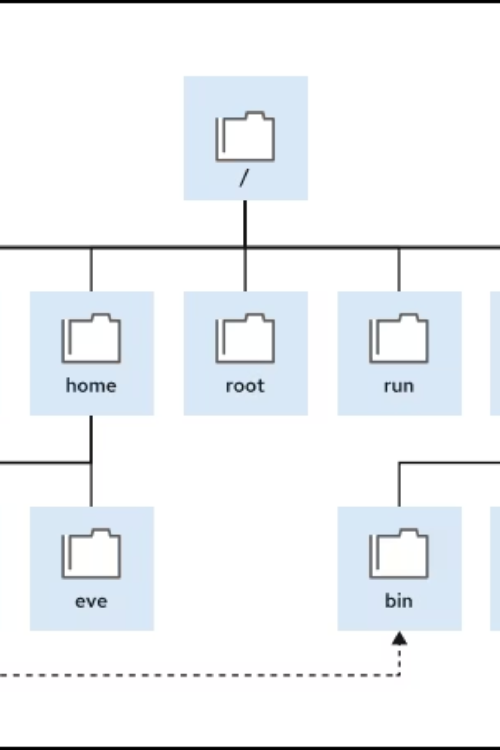
Mastering Linux: Files, Directories, and Fundamental Concepts
What is a File System
The File-system Hierarchy
A file system is the method by which an operating system organizes and stores files on a disk. It defines:- How files and directories are stored- How files are named and accessed- How metadata (e.g., permissions) is handled.In Linux, everything is treated as a file, including regular files, directories, devices, sockets, and more.
The Linux system stores all files on file systems, which are organized into a single inverted tree known as a file-system hierarchy. This hierarchy is an inverted tree because the tree root is at the top, and the branches of directories and subdirectories stretch below the root.
The / directory is the root directory at the top of the file-system hierarchy. The / character is also used as a directory separator in file names. For example, if etc is a subdirectory of the / directory, then refer to that directory as /etc. Likewise, if the /etc directory contains a file that is named issue, then refer to that file as /etc/issue. Subdirectories of / are used for standardized purposes to organize files by type and purpose to make it easier to find files. For example, in the root directory, the /boot subdirectory is used for storing files to boot the system.

Slide 4
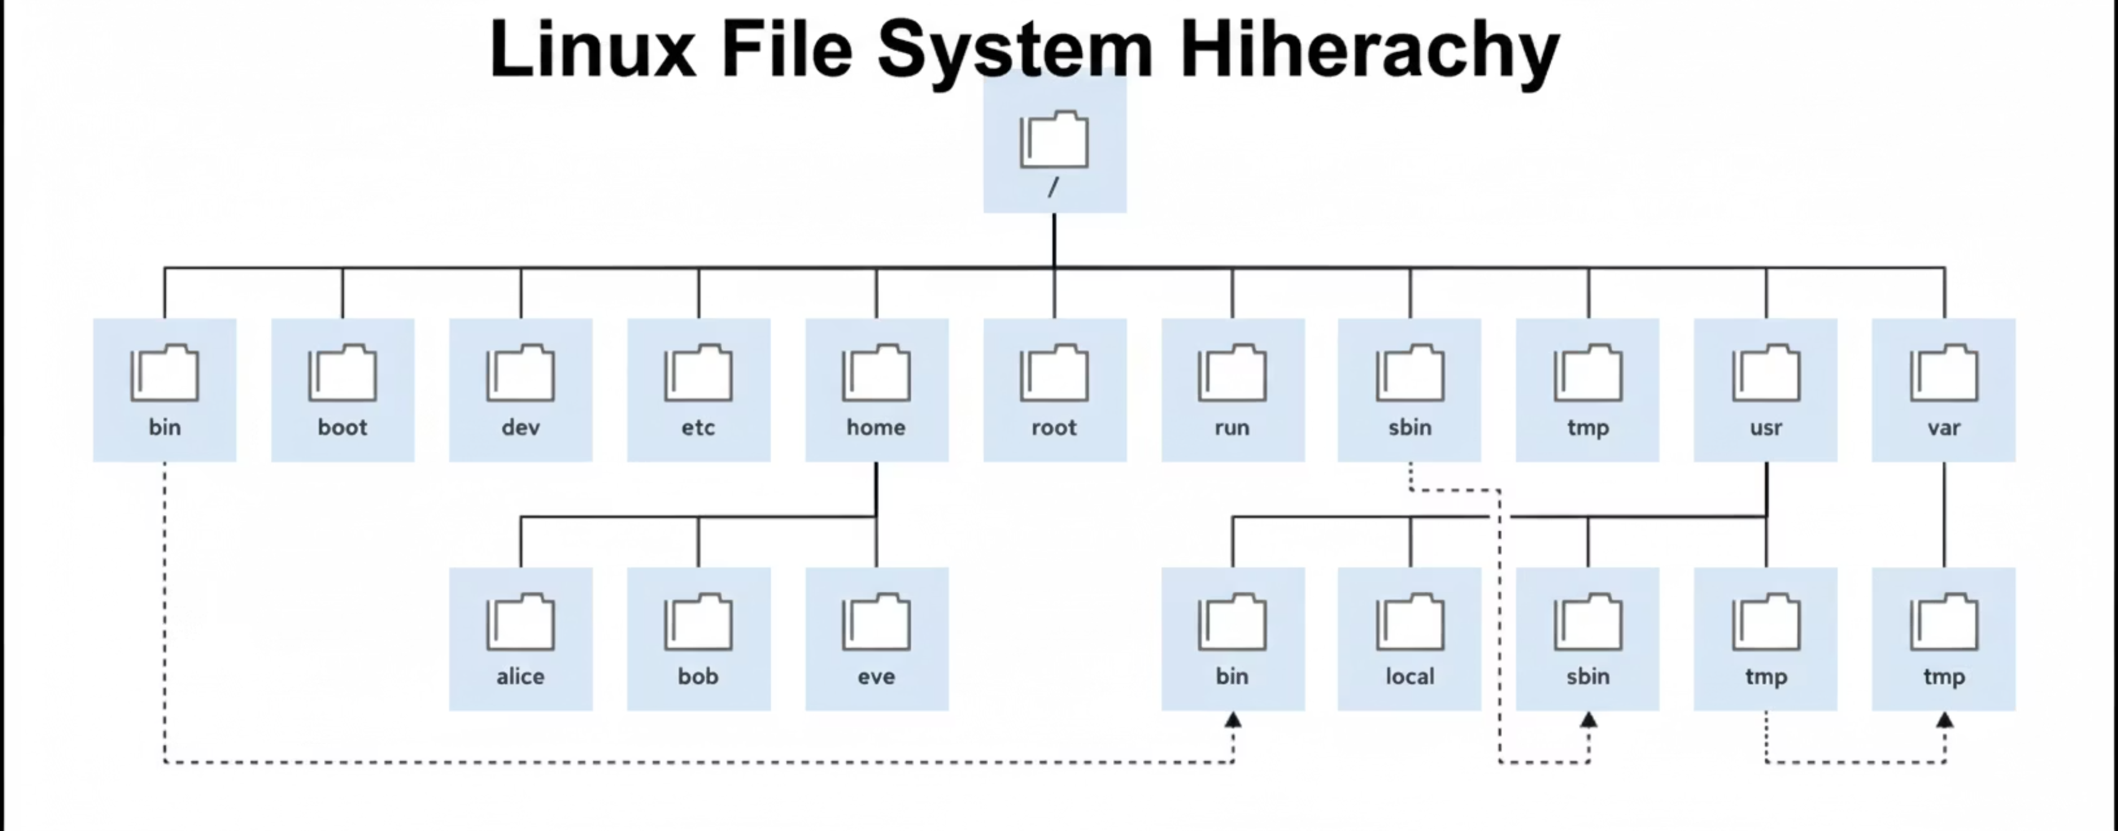
Significant file-system directories in Linux

Slide 5

Understanding the Linux File System Hierarchy
The Linux file system is organized in a logical, tree-like structure, stemming from the root directory /. This hierarchical design provides a consistent and predictable location for system files, user data, and external devices, crucial for system stability and efficient management.
System & user
/boot /dev /etc /home /opt /proc /root /sys /tmp /usr /var
Essential dirs
/bin /sbin /lib core system binaries
/ (root)
Top of the filesystem tree
/ (Root Directory)
/home
/etc
The primary hierarchy root of the entire file system, containing all other directories and files.
Contains personal directories for regular users, storing documents, settings, and other user-specific data.
Holds system-wide configuration files and scripts. Think of it as the control panel for your Linux system.
/var
/usr
Stores variable data, such as logs, mail queues, print spool files, and temporary files that can grow in size.
Contains user programs, libraries, documentation, and various read-only data, similar to 'Program Files' in Windows.

Slide 6
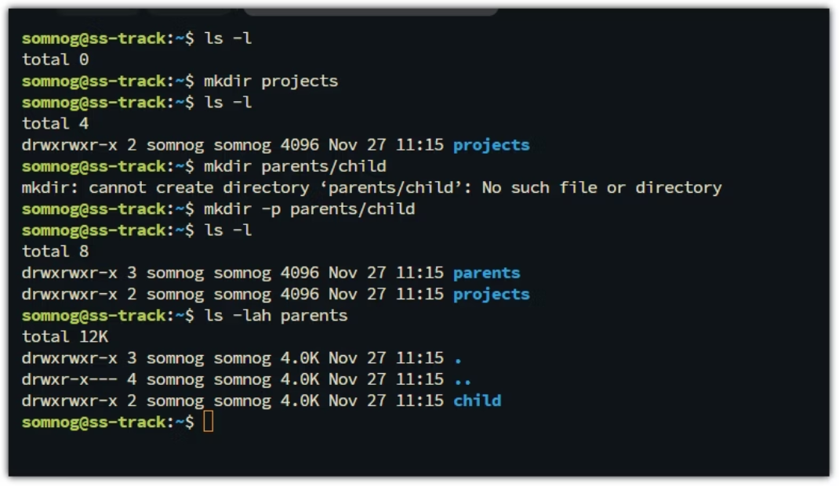
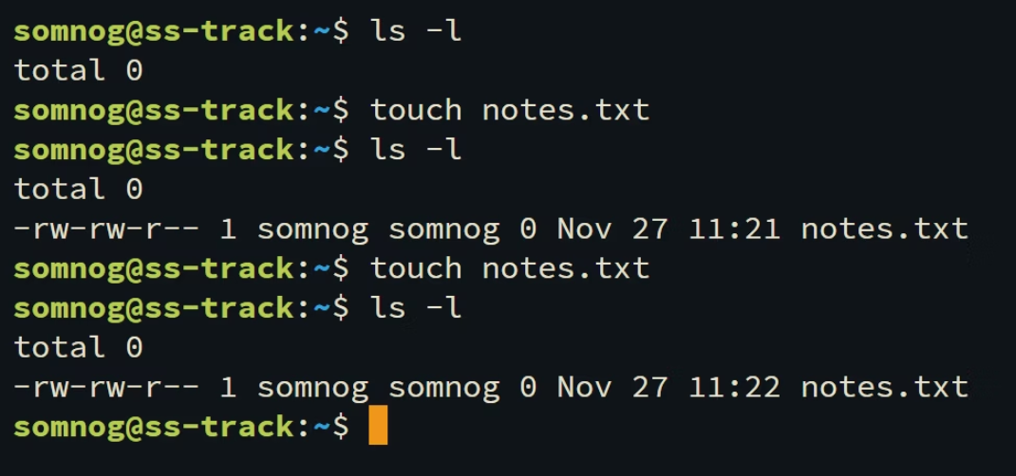
Creating Directories and Files
Creating Directories with mkdir
Creating Files with touch
The mkdir command is your essential tool for structuring your Linux file system, allowing you to instantly forge new directories.
Leverage the versatile touch command to swiftly generate new, empty files or refresh the access and modification timestamps of existing ones.
Single Directory: Use mkdir projects to establish a new directory named 'projects'.
Empty File Creation: Execute touch notes.txt to instantly create a new, empty file named 'notes.txt'.
Nested Structure: Employ mkdir -p parent/child to efficiently create 'parent' and all its subdirectories, such as 'child', in one go. If 'parent' already exists, it proceeds without error.
Timestamp Refresh: If notes.txt already exists, touch updates its last modified timestamp without altering its content, proving useful for build systems or script triggers.

Slide 7
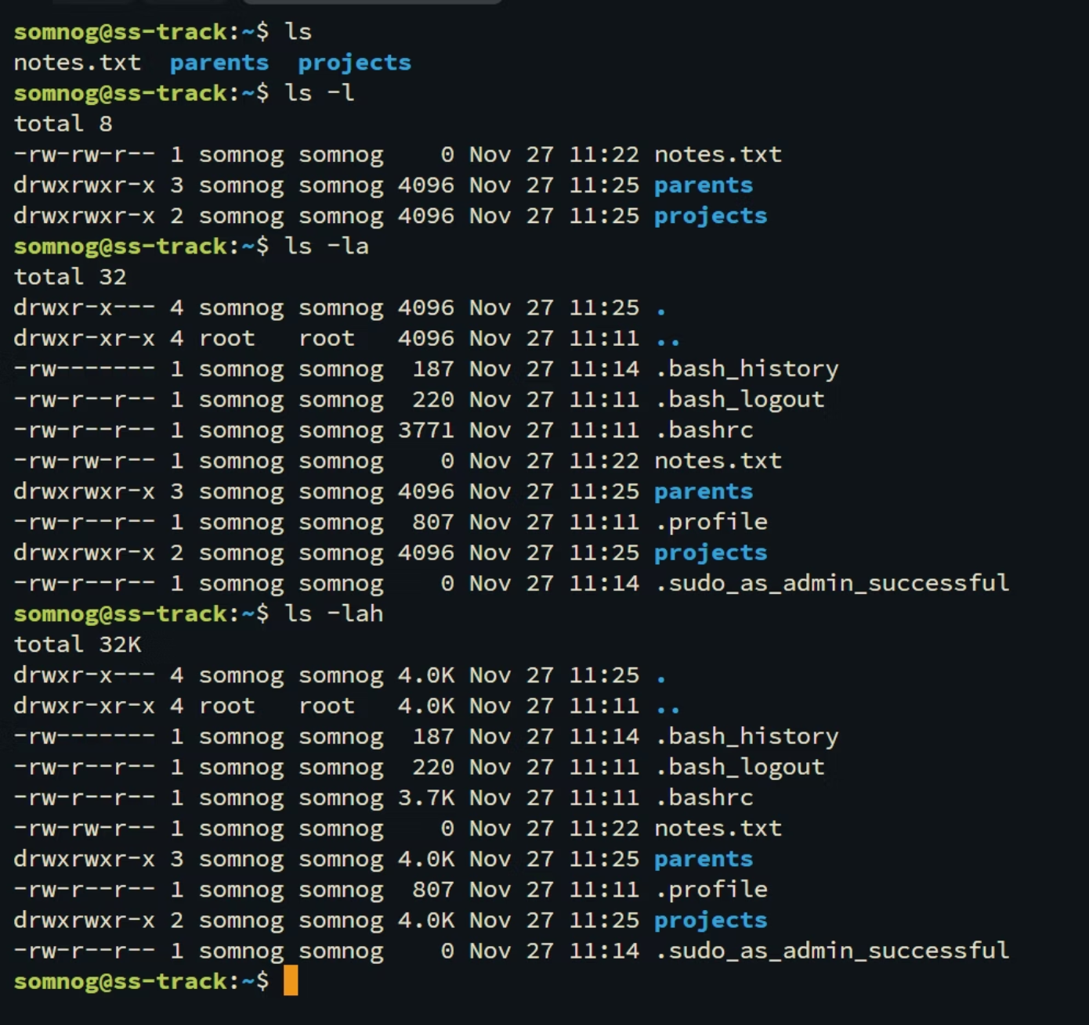
Explore Your File System: Listing Contents
Mastering the ls Command
The ls command is your essential utility for navigating and inspecting the contents of any directory, providing immediate insights into your file structure.
Simple View: Use ls to effortlessly display the files and subdirectories within your current location.
Comprehensive Details: Employ ls -l to uncover extensive information, including file permissions, ownership, size, and crucial modification timestamps.
Uncover Hidden Files: Execute ls -a to reveal all files, even those typically hidden (those prefixed with a dot), giving you a complete overview.
All-Inclusive & Readable: Leverage the powerful ls -lah combination for a detailed, human-friendly listing of *all* files, presenting sizes in easily understandable units.

Slide 8






Viewing File Contents in Linux
cat
less
Concatenate and display entire file content. Ideal for quick review of small files.
View large files page-by-page. Use keyboard for navigation (e.g., space for next page).
head
tail
Display the beginning of a file (default 10 lines). Use -n # for a specific number.
Show the end of a file (default 10 lines). Use -f to monitor real-time changes.
grep
Search for specific text patterns within files. Essential for filtering log output or code.

Slide 9




Efficiently Renaming and Moving Files & Directories
Mastering the mv Command
Renaming with Precision
Seamless File Relocation
The powerful mv command serves a dual purpose: it allows you to both rename files and directories, and relocate them to new destinations with ease.
Use mv oldname.txt newname.txt to instantly change a file's name within its current directory. This provides a quick and direct way to update file identifiers.
Execute mv report.txt /home/user/documents/ to move report.txt to the specified target directory. This command effectively transfers the file, removing it from its original path.

Slide 10

Copying Files and Directories
The cp Command
Master the cp command to efficiently duplicate files and entire directories, preserving original content while enabling new versions or backups.
File Duplication: Use cp config.conf config_backup.conf to instantly create config_backup.conf, a precise duplicate of your original configuration file.
Recursive Directory Copy: For directories, the -r (recursive) option is essential: cp -r dir1 dir2. This meticulously copies dir1 and all its contents into dir2, ensuring comprehensive data transfer.
Efficient file copying is fundamental for robust data management. Leverage cp to secure your work with critical backups, streamline new projects with template duplication, and safely share information without altering original sources.

Slide 11

Deleting Files and Directories
1
Removing Individual Files
The rm command is your primary tool for efficiently removing individual files. For example, use rm document.txt to delete a specific file.
2
Deleting Empty Directories
To remove an empty directory, utilize `rmdir [directory_name]`. This command is effective only when the specified directory contains no files or subdirectories.
3
Recursive Directory Deletion
For comprehensive deletion, `rm -r [directory_name]` removes a directory along with all its contents (files and subdirectories) recursively.
4
Forceful Deletion: Exercise Extreme Caution
WARNING: The command `rm -rf [directory_name]` executes a forceful, recursive deletion, bypassing all confirmation prompts. This action is irreversible and results in permanent data loss; use with utmost caution.

Slide 12
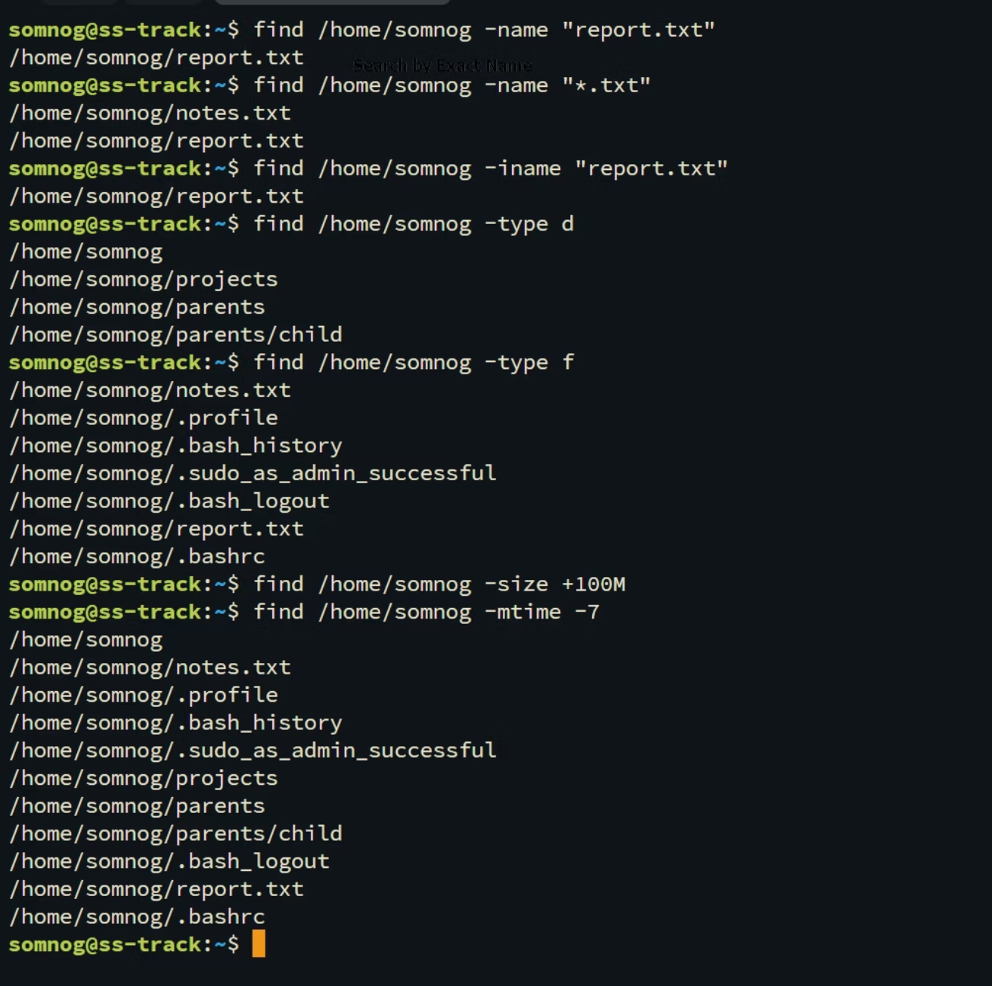
Finding Files Quickly
The find Command
Mastering the find command empowers you to efficiently locate files and directories across your system, using diverse criteria.
Search by Name: Pinpoint files by their exact name or pattern using: find [path] -name [filename].
Example: To retrieve a file named report.txt within /home/user or its subdirectories, execute: find /home/user -name "report.txt".
The find command is indispensable for swiftly recovering misplaced files or identifying content in unfamiliar locations.

Slide 13
Practical Example: Organizing a Project Folder
01
02
03
Establish Your Project Structure
Initialize Your README File
Consolidate Source Files
Run touch project/README.md to create an essential, empty README file directly within your new 'project' directory, ready for documentation.
Execute mv *.c project/src/ to precisely move all files ending with .c into the designated project/src/ directory, keeping your code organized.
Use mkdir -p project/{docs,src,bin} to efficiently create a 'project' directory, complete with 'docs', 'src', and 'bin' subdirectories for organized content.
04
05
Conduct a Recursive Listing
Locate Specific Markdown Files
Employ ls -R project/ to comprehensively display all files and subdirectories nested within your 'project' folder, offering a complete overview.
Utilize find project/ -name "*.md" to quickly pinpoint all markdown files situated anywhere within the 'project' directory hierarchy.

Slide 14

Summary & Next Steps
1
Master Core Commands
2
Consistent Practice
Achieving mastery in these fundamental Linux commands is essential for optimizing your file and directory management.
Solidify your understanding through consistent practice with crucial file operations: creating, moving, copying, deleting, and finding files.
3
Explore Advanced Utilities
4
Maximize Linux Efficiency
Expand your capabilities by delving into powerful command-line utilities such as grep for advanced text searching, chmod for precise permission control, and symbolic links for dynamic file referencing.
Harness the power of command-line file management to gain unparalleled control and significantly boost efficiency in your Linux environment.

