Slide 1
Linux package management
Day 1
Track 2: Systems and Services
Jazeera University Main Campus

Slide 2

Introduction to Package Management
What Is a Package?
Compressed files containing binaries, libraries, configurations, and metadata
Repository
Centralized storage locations for software packages
Dependencies
Package Manager
Automatic resolution of required software components
Tools like APT that handle installation, removal, updates, and dependencies

Slide 3

What Is a Package?
A package is a compressed file that contains everything needed to install and run software on your Linux system. Ubuntu uses the .deb package format, which is the standard for Debian-based distributions.
Package Components
Binary executables and compiled programs
Shared libraries and dependencies
Configuration files and settings
Metadata including version and author information

Slide 4
What Is a Package Manager?
APT (Advanced Package Tool) is Ubuntu's primary package management system. It streamlines software management by handling complex operations automatically, making it easy to maintain your system.
01
02
03
Install Software
Remove Software
Update System
Download and install packages from repositories
Cleanly uninstall packages and their configurations
Keep all installed packages current with latest versions
04
05
Manage Dependencies
Handle Repositories
Automatically resolve and install required components
Configure and maintain software sources

Slide 5
Ubuntu Repository Structure
Ubuntu organizes software into four main repositories, each serving different purposes based on licensing and support levels.
Main
Universe
Free and open-source software officially supported by Ubuntu. Includes core system components and popular applications with full security updates.
Community-maintained free and open-source software. Extensive collection of packages maintained by the Ubuntu community with limited official support.
Restricted
Multiverse
Proprietary drivers and firmware for hardware support. Includes closed-source software necessary for certain devices to function properly.
Software restricted by copyright or legal issues. Contains packages that may have licensing restrictions or patent concerns in certain jurisdictions.

Slide 6

Dependency Management
Automatic Resolution
APT automatically resolves dependencies, ensuring all required software components are installed together. When you install a package, APT analyzes its requirements and installs any missing dependencies without manual intervention.
This intelligent system prevents broken installations and ensures software runs correctly by maintaining a complete dependency tree for every package on your system.

Slide 7
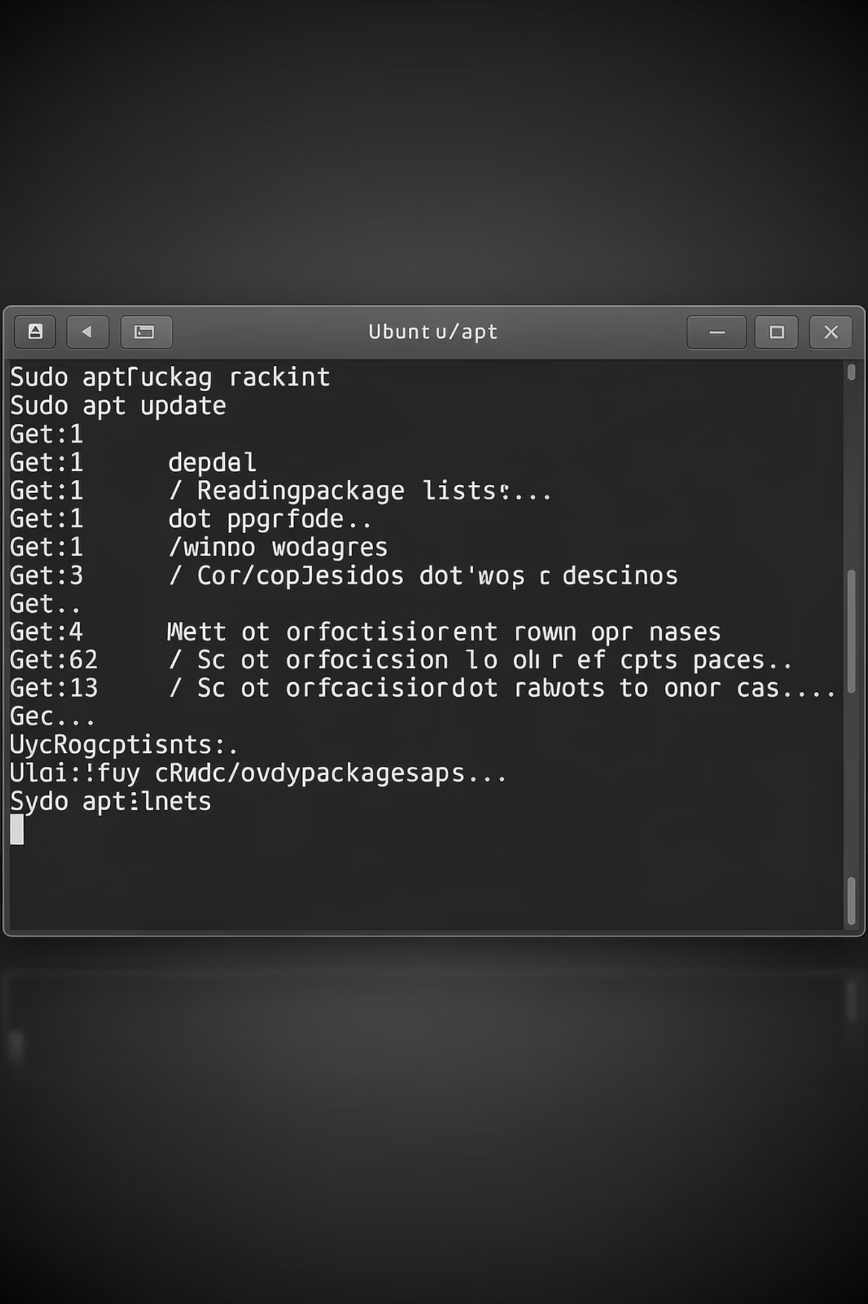
APT Package Management
Ubuntu's Core Tool
APT is the primary package management system for Ubuntu, providing powerful commands to maintain your system efficiently.

Slide 8




Updating Your System
Update Package Index
Upgrade Packages
Full Upgrade
sudo apt update
sudo apt upgrade
sudo apt full-upgrade
Refreshes the list of available packages and their versions from repositories
Installs newer versions of installed packages without removing any
Performs upgrades and handles dependency changes, may remove packages if needed
Best Practice: Always run sudo apt update before upgrading to ensure you have the latest package information.

Slide 9

Installing and Removing Software
Installation Commands
Removal Commands
Remove package but keep configs:
Install a single package:
sudo apt remove nginx
sudo apt install nginx
Remove package and all configs:
Install multiple packages at once:
sudo apt purge nginx
sudo apt install curl git vim
Remove unused dependencies:
sudo apt autoremove

Slide 10
Searching and Listing Packages
Search for Packages
List Installed Packages
Check for Updates
apt search docker
apt list --installed
apt list --upgradable
Find packages matching your search term across all available repositories
Display all packages currently installed on your system
Show packages that have newer versions available for upgrade

Slide 11
Package Information and Dependencies
Show Package Details
View Dependencies
Reverse Dependencies
apt show nginx
apt depends nginx
apt rdepends nginx
Displays comprehensive information including version, size, description, and maintainer details
Lists all packages that the specified package requires to function properly
Shows which packages depend on the specified package, useful before removal

Slide 12
System Maintenance and Troubleshooting
Cleaning Your System
sudo apt clean
sudo apt autoremove
Removes downloaded package files from cache to free disk space
Removes packages that were automatically installed as dependencies but are no longer needed
Fixing Common Issues
1
Fix Broken Dependencies
2
Reconfigure Packages
3
Remove Lock Files
sudo apt --fix-broken install
sudo dpkg --configure -a
sudo rm /var/lib/dpkg/lock-frontend

Slide 13
Other Linux Package Managers
While Ubuntu uses APT, other Linux distributions employ different package management systems.
Understanding these alternatives helps when working across different Linux environments.
DNF/YUM (RHEL/Fedora)
Zypper (openSUSE)
sudo dnf install httpd
sudo zypper install vim
Used by Red Hat Enterprise Linux, Fedora, and CentOS
for RPM package management
openSUSE's package manager with powerful dependency resolution and rollback features

Slide 14
Universal Package Managers
Modern Linux distributions support universal package formats that work across different distributions, offering sandboxed applications with bundled dependencies.
1
Snap Packages
sudo snap install core
Canonical's universal package format with automatic updates and strict confinement for security
2
Flatpak
sudo apt install flatpakflatpak install flathub org.mozilla.firefox
Cross-distribution package system with sandboxing, popular for desktop applications
3
AppImage
chmod +x app.AppImage
Portable applications that run without installation, containing all dependencies in a single file

Slide 15
Security, Troubleshooting & Best Practices
Package Security
Troubleshooting
Best Practices
List repository keys:
Fix broken installations:
Update system regularly
Avoid unsafe PPAs
apt-key list
sudo apt --fix-broken install
Clean system monthly
Backup before major changes
Verify package authenticity through GPG keys to ensure software integrity
Resolves dependency issues and repairs interrupted installations
Final Exam Tasks
Update your system using apt update and apt upgrade
Install and remove Nginx web server
Install a Flatpak application from Flathub
Add and remove a PPA repository
Fix APT issues using troubleshooting commands

