Slide 1

Users & Groups Management in Linux
Speaker : Abdirahim M.

Slide 2

Mastering Linux User Management
User management is a critical aspect of Linux system administration, controlling system access, enforcing security, and ensuring users have the correct privileges for their tasks. This presentation will guide you through the essential concepts and commands for efficient user management in Linux.

Slide 3

Understanding Users and Groups
What are Groups?
Groups are collections of users. They simplify permission management by allowing administrators to assign access rights to a group instead of individual users. This ensures that all members of a group inherit the same access to files and resources.
What are Users?
Users are individual accounts allowing access to the system. Each user has a unique ID (UID) and their own home directory, shell, and preferences. They authenticate to the system and are granted specific permissions based on their identity.
Effective user and group management is fundamental for security, access control, and operational efficiency on any Ubuntu server environment. It helps prevent unauthorized access and ensures that system resources are used appropriately.

Slide 4






Why Efficient User Management Matters
System Security
Role Segregation
Accountability
Protects the system from unauthorized access and potential breaches.
Ensures users can perform their roles without interfering with others' work or critical system processes.
Facilitates auditing and tracking of user activity, crucial for compliance and troubleshooting.
Linux's multi-user environment makes it ideal for a wide range of applications, from personal workstations to large enterprise servers. Proper user management is the bedrock of a stable and secure Linux system.

Slide 5
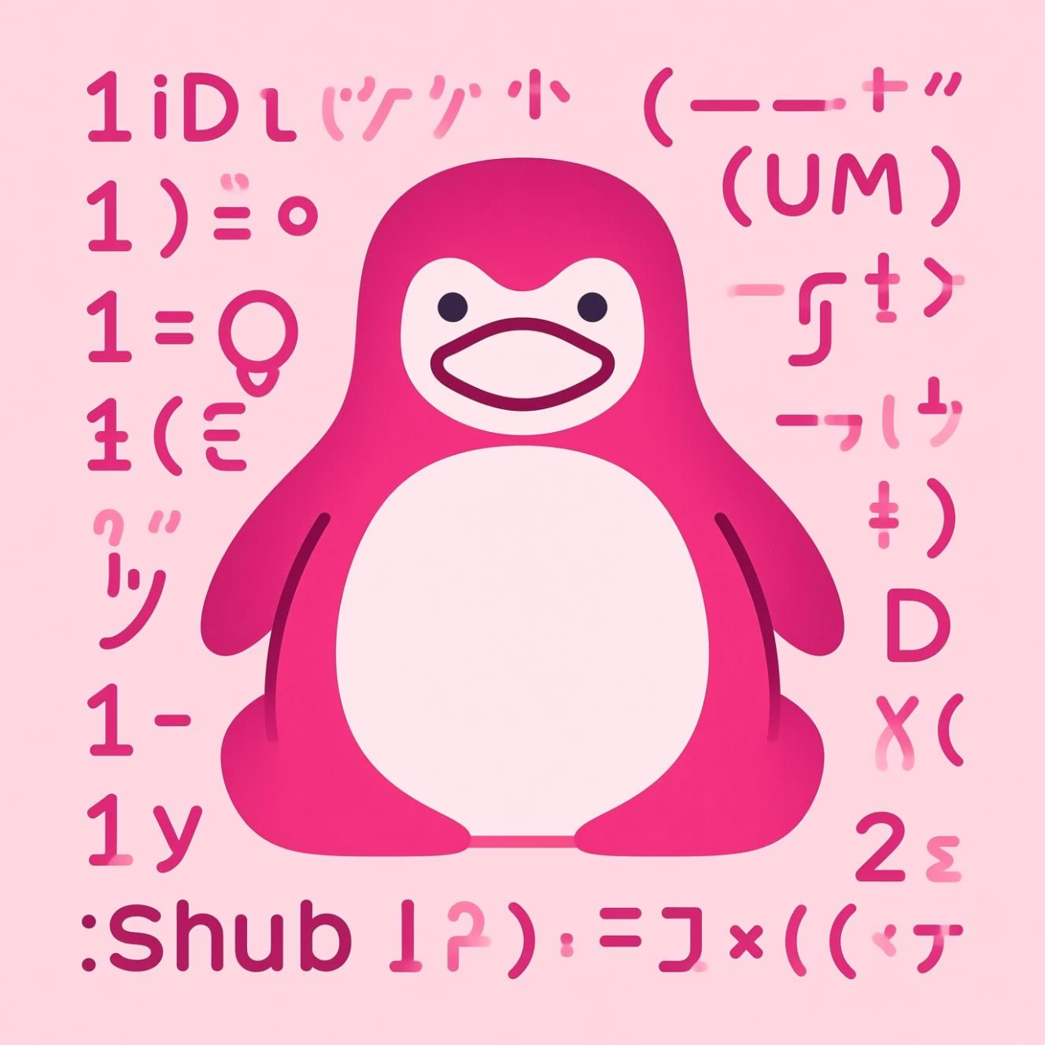
Understanding Linux User IDs (UIDs)
Linux systems support a vast number of users, often up to 60,000, making them highly scalable for diverse environments. Every user account is uniquely identified by a User ID (UID).
UID 0: Reserved for the root (superuser) account, granting full administrative control.
UIDs 1-999: Typically assigned to system accounts and services, often without interactive login shells.
UIDs 1000+: Generally allocated to regular user accounts, though this range can vary based on distribution.
Administrators manage users by creating, modifying, and deleting accounts, setting permissions, and enforcing access policies to maintain system integrity.

Slide 6
Essential User Management Files
These core files are the backbone of user and group management, crucial for maintaining system security and operational integrity.
/etc/passwd
1
Stores basic user account details: username, UID, GID, home directory, default shell.
2
/etc/shadow
Securely stores encrypted user passwords and password-related policies (expiration, inactivity).
/etc/group
3
Defines all system groups, their GIDs, and lists members within each group.
4
/etc/gshadow
The secure counterpart to /etc/group, containing encrypted group passwords and administrators.
/etc/sudoers
5
Controls which users and groups can execute commands with superuser privileges via sudo.
6
/etc/skel/
Contains default configuration files (e.g., .bashrc) copied to new users' home directories.
/var/log/auth.log
7
Logs authentication events, including login attempts, sudo usage, and account lockouts, for auditing.

Slide 7






Types of Users in Linux
Linux supports various user types, each with distinct privileges and roles, ensuring a secure and flexible multi-user environment.
Root (Superuser)
Regular User
Sudo User
Possesses ultimate control over the entire system. Can install software, modify critical configuration files, and access/delete any file. Extremely powerful but carries significant risk if misused.
Has limited access, primarily within their home directory. Can create files, run applications, but cannot modify system-level settings or affect other users' files without explicit permission.
A regular user granted temporary administrative rights via the sudo command. This is a common and safer approach in modern systems than directly logging in as root.
System/Service Account
Guest User
Non-human accounts used by background services (e.g., mysql, nginx). They have minimal, specific privileges necessary for their operations, enhancing security.
Temporary accounts with very minimal privileges. Any changes made by a guest user are typically not saved after logout, ensuring a clean slate for subsequent sessions.

Slide 8





Managing Users in Ubuntu
Creating Users
Modifying & Passwords
Use adduser for interactive user creation with home directory, shell, and group assignment. For automated scripts, useradd offers more granular control without interactive prompts.
Change user attributes with usermod (e.g., home directory, shell, group membership). Set or change a user's password using the passwd command.
Deleting Users
Default User Settings
Remove users with deluser (which can also remove their home directory and mail spool). For a more basic deletion without removing associated files, use userdel.
Customize default user creation parameters by editing /etc/default/useradd. This file allows setting default home directory, shell, and other properties.

Slide 9
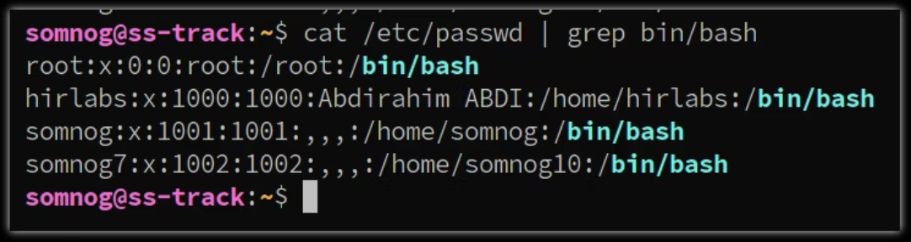
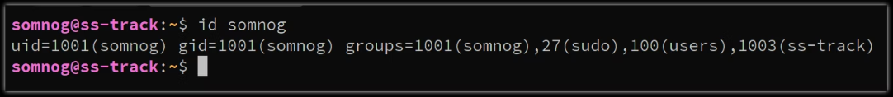
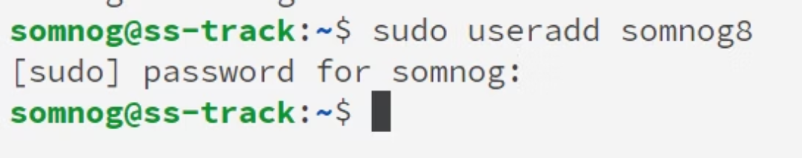
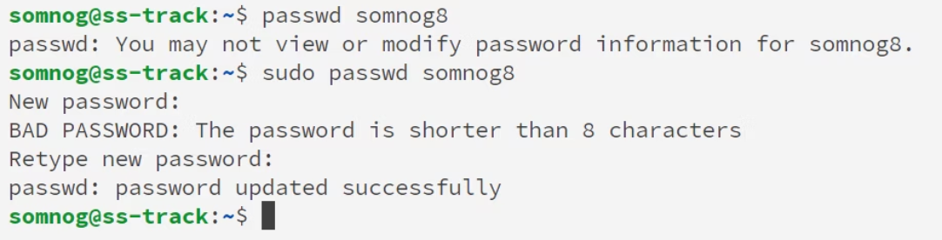
User Account Management Commands
Basic commands for listing, adding, and assigning passwords to users.
List All Users
Get User ID
Displays all usernames by parsing the first field of /etc/passwd.
Retrieves the User ID (UID) and Group ID (GID) for a specific user.
cat /etc/passwd
id username
Example: id somnog
Add a User
Assign a Password
Creates a new user account with an automatically assigned UID.
Sets or changes a password for an existing user, prompting for input.
sudo useradd somnog8
sudo passwd somnog8

Slide 10




Group Management Essentials
Creating Groups
The groupadd command creates a new group. You can specify a Group ID (GID) if needed, but it's often best to let the system assign one automatically.
Modifying Groups
Use groupmod to change a group's name or GID. This helps maintain organization as your system evolves.
Deleting Groups
The groupdel command removes an existing group. Ensure no critical files or services depend solely on the group before deletion.
Managing group memberships is crucial for access control. Users have a primary group (their default group) and can be members of multiple secondary groups. Use gpasswd or usermod -aG to add users to supplementary groups, extending their permissions to shared resources.

Slide 11
User Groups: Simplifying Permissions
User groups are fundamental for managing permissions efficiently in Linux. By assigning permissions to a group, all users within that group inherit those access rights, streamlining administration.
Primary Group
Every Linux user is assigned one primary group upon creation, which is the default group for files they create. This group usually shares the same name as the user.
id somnog
uid=1001(somnog) gid=1001(somnog) groups=1001(somnog),27(sudo),100(users) Here, gid=1000(somnog) indicates "somnog" is the primary group for user "somnog."
Secondary Groups
Users can belong to multiple secondary groups, which grant additional access to specific files, directories, or services (e.g., Docker, video devices).
sudo usermod -aG ss-track somnog
This command adds user "somnog" to the "developers" group. To verify:
groups somnog
Output: somnog : somnog sudo users ss-track

Slide 12
Modifying User Information
The usermod command is versatile for updating various user account settings.
01
02
03
Change User ID (UID)
Change Group ID (GID)
Change Login Name
sudo usermod -u 1010 somnog8
groupmod -g new_group_id username
usermod -l new_login_name old_login_name
Example: sudo usermod -u 1010 somnog8 Changes the UID of 'somnog8' to '1010'.
Example: sudo groupmod -g 1006 somnog8 Moves 'somnog8' to the group with GID '1006'.
Example: sudo usermod -l somnog8 somnog10 Renames user 'somnog8' to 'somnog10'.
04
05
Change Home Directory
Delete a User
usermod -d new_home_directory_path username
userdel -r username
Example: sudo usermod -d /home/somnog10 somnog8Relocates 'somnog8''s home directory.
Example: sudo userdel -r somnog8 Removes 'username' and their home directory. Ensure they are removed from groups first if necessary.

Slide 13

Password Aging & Account Expiration
Enforce stronger security policies by setting expiration dates for passwords and user accounts.
90
7
180
Max Password Days
Min Password Days
Days Inactive
Set with chage -M. Forces users to change passwords regularly.
Set with chage -m. Prevents users from changing passwords too frequently after a reset.
Set with chage -I. Account will be locked after this period of inactivity.
Use chage -l username to view current aging settings. To force a password reset on next login, use chage -d 0 username. Account expiration can be set with chage -E YYYY-MM-DD username, automatically disabling accounts when no longer needed.

Slide 14


Advanced Security & Auditing
Ensuring robust security and proper oversight in user management.
Privilege Escalation Risks
Improperly configured /etc/sudoers can lead to unauthorized privilege escalation.
Solution: Always review and edit /etc/sudoers using visudo to prevent syntax errors and ensure only authorized users have elevated privileges.
Misconfigured User Management Files
Errors in critical files like /etc/passwd or /etc/shadow can severely disrupt user management.
Solution: Use dedicated tools like vipw and vigr to safely edit these files. These commands lock the files during editing, preventing concurrent modifications and potential corruption.
Regular audits of user accounts, groups, and permissions are essential to maintain a secure and compliant Linux environment.

Slide 15


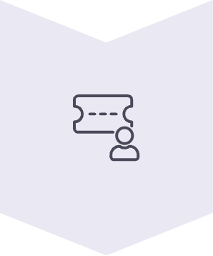
Common User Management Challenges & Solutions
Proactive strategies to address typical issues encountered in Linux user management.
Forgotten Passwords
Solution: Reset using sudo passwd username.
Account Lockouts
Solution: Unlock with sudo usermod -U username.
Misconfigured Group Memberships
Solution: Add users to groups with sudo usermod -aG groupname username.

Slide 16



Summary: Secure Your Linux Environment
Key Commands
useradd, adduser, usermod, deluser, userdel, gruopadd, groupmod, passwd, gpasswd, visudo, chage.
Security Recommendations
Adopt least privilege, audit regularly, enforce strong password and account policies, and monitor access.
Mastering user and group management is crucial for maintaining a secure, stable, and efficient Linux server infrastructure. By following these guidelines, you can ensure controlled access and safeguard your valuable data.

Slide 17

Practical Examples & Best Practices
Practical Applications
Best Practices
Add a new user and assign them to the development and www-data groups for project work.
Principle of Least Privilege: Grant users only the minimum access required for their tasks.
Implement a 90-day password expiry policy for all administrative accounts.
Regular Reviews: Periodically audit user accounts, group memberships, and sudo configurations.
Change permissions for a shared directory so only specific groups can read and write to it.
Strong Policies: Enforce password aging, complexity, and multi-factor authentication where possible.
Configure sudoers to allow a specific user to restart a critical service without full root access.
Logging & Monitoring: Keep detailed logs of all administrative actions and monitor for suspicious activity.

