Slide 1

Linux Security, Monitoring & SIEM Tools
Speaker : Abdirahim M.

Slide 2
Outline
1
2
3
4
Introduction - What is Security?
Linux Security Overview
Security Fundamentals
Security Tools
Why it matters and common threats
Users, permissions, firewalls, SSH
Firewalls, scanners, antivirus, IDS/IPS
Why it matters and common threats
5
6
7
8
Monitoring Tools
SIEM Explained
Wazuh Platform
Hands-On Deployment
Performance, network, and log management
What it is and why you need it
Architecture and key features
Step-by-step Wazuh installation
9
10
Real-World Use Cases
Best Practices
Practical applications and incident response
Security recommendations and next steps

Slide 3

What is Security?
#1
#3
#01
#2
Is security a product?
Is security a process?
Is security a guideline?
#4
Is one time action?
Think about it and share your ideas...

Slide 4
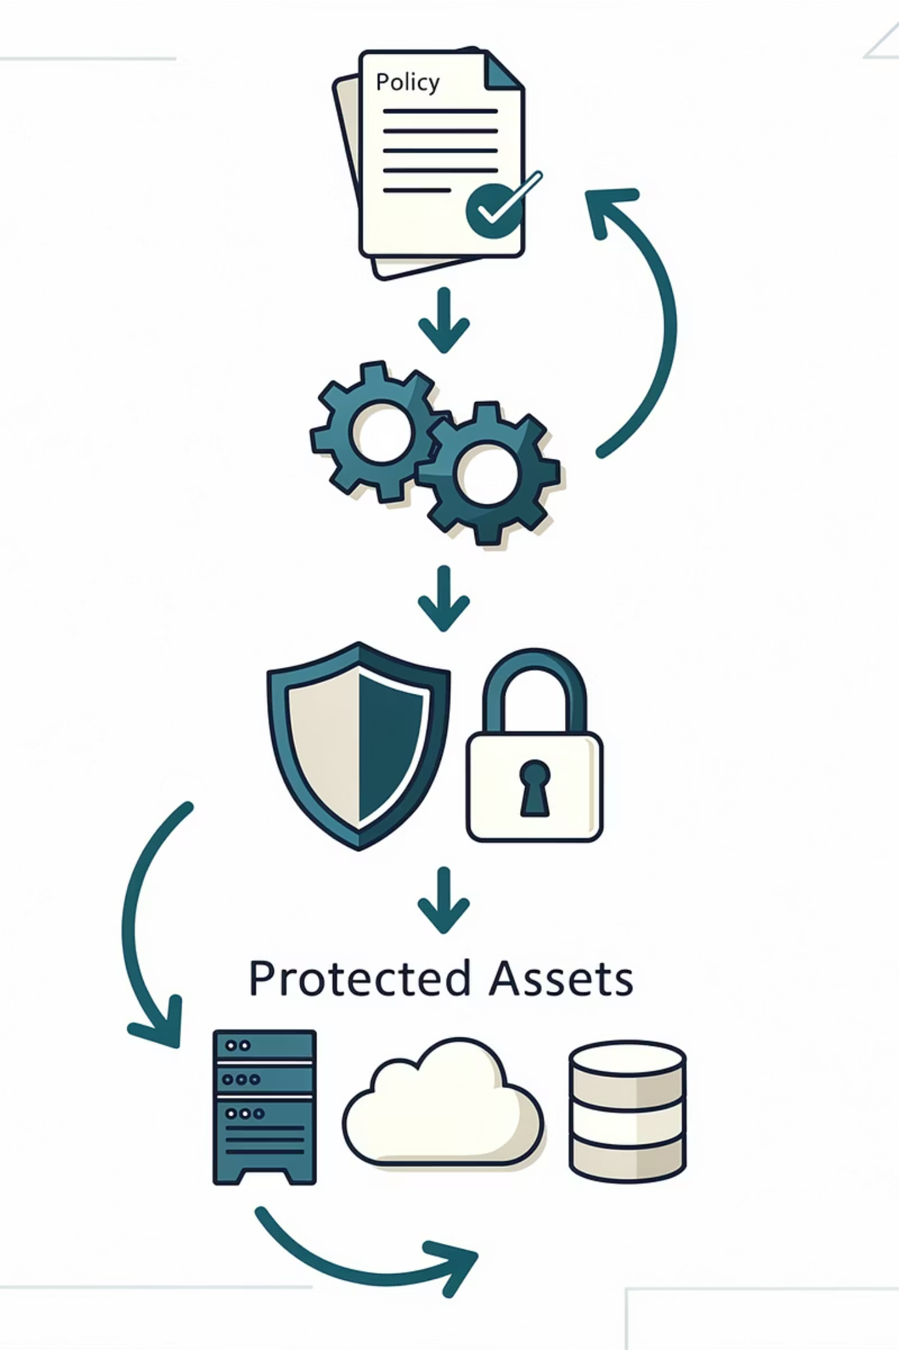

Security is a continuous process, not a one-time action.
Key Components:
Guided by policies, standards, and guidelines that define how protection should be applied
Supported by tools and products (firewalls, antivirus, IDS, encryption, etc.) to enforce controls
Aims to protect information, systems, and physical assets
Ensures Confidentiality, Integrity, and Availability (CIA)
Process
Policies
Tools
Protection of Assets
Continuous operation, monitoring, and improvement.
Rules and guidelines for secure behavior and system configuration.
Technology and software to enforce security controls.
Safeguarding information, systems, and physical resources.
In Summary:
Security = Continuous Process + Policies + Tools → Protection of Assets

Slide 5

Linux Security, Monitoring & SIEM Tools
Learn how to protect Linux systems with security tools, monitoring, and SIEM solutions.

Slide 6
The Critical Importance of Linux Security
Why Linux Security Matters
Common Attack Vectors
Linux systems power over 96% of the world's top one million web servers and dominate cloud infrastructure. As enterprise reliance on Linux grows, so does the attack surface. Modern threat actors specifically target Linux environments for cryptocurrency mining, ransomware deployment, and persistent backdoor access.
Brute-force SSH attacks targeting weak credentials
Privilege escalation through kernel exploits
Web application vulnerabilities (SQL injection, RCE)
Supply chain attacks via compromised packages
Insider threats and misconfigured access controls
DDoS attacks leveraging compromised servers
Unlike Windows, Linux's open-source nature means vulnerabilities are discovered and patched rapidly—but only if administrators stay vigilant. Unpatched systems, misconfigured permissions, and inadequate monitoring create exploitable gaps that sophisticated attackers leverage daily.
Continuous monitoring isn't optional—it's the foundation of modern Linux security posture management.

Slide 7
Linux Security Fundamentals
User & Permission Management
File System Security
Control access with precision using chmod, chown, and sudo policies. Implement least privilege by limiting root access and using sudoers file for granular command permissions.
Protect sensitive data through proper ownership, permissions, and mount options. Use sticky bits, ACLs, and immutable flags to prevent unauthorized modifications.
SSH Hardening
Firewall Configuration
Disable root login, implement key-based authentication, change default ports, and use fail2ban to block brute-force attempts automatically.
Create defense layers with UFW, Firewalld, or IPTables. Default-deny policies ensure only explicitly allowed traffic passes through.

Slide 8
Essential Security Tools in Linux
Firewalls
Vulnerability Scanners
Antivirus & Hardening
IDS/IPS Solutions
UFW: User-friendly interface for IPTables, ideal for quick deployments. Firewalld: Dynamic firewall with zone-based management. IPTables: Low-level packet filtering for advanced configurations.
OpenVAS: Open-source vulnerability assessment with 50,000+ tests. Lynis: System hardening auditor for compliance checks. Nessus: Enterprise-grade scanning with comprehensive coverage.
ClamAV: Open-source malware detection for Linux. SELinux: Mandatory access controls for process isolation. AppArmor: Profile-based application confinement.
Snort: Network-based intrusion detection with signature matching. Suricata: Multi-threaded IDS/IPS with file extraction. OSSEC: Host-based detection with log analysis. Falco: Runtime security for containers.

Slide 9




Comprehensive Monitoring Toolkit
System Performance Monitoring
Network Traffic Analysis
Nmap: Network discovery and security auditing. Wireshark: Packet capture and protocol analysis. Tcpdump: Command-line packet analyzer. Zabbix/Nagios: Enterprise monitoring with alerting and trending capabilities.
Top/Htop: Real-time process and resource monitoring. Glances: Cross-platform monitoring with web interface. Netdata: Distributed real-time performance monitoring with stunning visualizations and anomaly detection.
Log Management & Centralization
Journalctl: Query systemd logs with powerful filtering. Rsyslog: High-performance log processing and forwarding. Logwatch: Automated log analysis and daily reports. ELK Stack: Elasticsearch, Logstash, Kibana for centralized log analytics at scale.

Slide 10
SIEM: The Security Operations Nerve Center
What is SIEM?
Core SIEM Capabilities
Security Information and Event Management (SIEM) combines security information management (SIM) and security event management (SEM) into a unified platform. SIEM solutions aggregate, normalize, and analyze logs from across your infrastructure in real-time, transforming raw data into actionable security intelligence.
Log Aggregation: Centralize data from hundreds of sources
Threat Detection: Correlation rules identify attack patterns
Real-time Alerting: Instant notifications for critical events
Dashboards & Reporting: Visual insights into security posture
Compliance Management: Automated reporting for regulatory standards
By correlating events from disparate sources—firewalls, servers, applications, endpoints—SIEM detects patterns that indicate sophisticated attacks, automates incident response, and provides forensic capabilities for post-breach investigation.
Forensic Analysis: Historical search for incident investigation
Splunk
Graylog
Enterprise leader with powerful analytics and machine learning capabilities
Open-source log management with flexible query language and alerting
QRadar
Wazuh
IBM's AI-powered SIEM with advanced threat intelligence integration
Open-source unified XDR and SIEM platform—our deep-dive focus

Slide 11

Wazuh SIEM: Architecture & Capabilities
Architecture Overview
Key Features
Wazuh employs a server-agent architecture where the Wazuh manager serves as the central processing hub, receiving data from lightweight Wazuh agents deployed across endpoints. The manager analyzes events, triggers alerts, and stores data in an integrated Elasticsearch cluster. The Wazuh dashboard (built on OpenSearch Dashboards) provides visualization and investigation capabilities.
File Integrity Monitoring: Detect unauthorized file changes
Vulnerability Detection: Automated CVE scanning and patching alerts
Configuration Assessment: CIS benchmark compliance checks
Incident Response: Active response with automated remediation
Cloud Security: AWS, Azure, GCP log analysis
This distributed model scales from small deployments to enterprise environments monitoring thousands of endpoints across hybrid cloud infrastructures.
Container Security: Docker and Kubernetes monitoring
Regulatory Compliance: PCI-DSS, GDPR, HIPAA, NIST frameworks
Why Wazuh? As an open-source unified XDR and SIEM platform, Wazuh provides enterprise-grade security capabilities without licensing costs. Its active community, comprehensive documentation, and integration ecosystem make it ideal for organizations building modern security operations centers.

Slide 12
Hands-On: Deploy Wazuh SIEM
Deploy Wazuh Agents
Install Wazuh Manager
Install agents on endpoints to forward security data to the manager. Agents support Linux, Windows, macOS, and container environments.
Deploy the central server on Ubuntu/CentOS using the official installation script. This sets up the manager, indexer, and dashboard components.
wget https://packages.wazuh.com/4.x/apt/pool/main/w/wazuh-agent/wazuh-agent_4.7.0-1_amd64.deb
dpkg -i wazuh-agent*.deb
echo "WAZUH_MANAGER='manager-ip'" >> /var/ossec/etc/ossec.conf
systemctl start wazuh-agent
curl -sO https://packages.wazuh.com/4.7/wazuh-install.sh
bash wazuh-install.sh -a
Access dashboard at https://your-server-ip with generated credentials. Configure network settings and SSL certificates for production.
Build Custom Dashboards
Configure Rules & Decoders
Create visualizations tailored to your environment. Track authentication failures, vulnerability trends, compliance status, and threat indicators across your infrastructure.
Customize detection logic by creating custom rules and decoders. Tune alert severity, add integrations with Slack/PagerDuty, and configure automated responses.
Demo: Simulate SSH brute-force attack using Hydra, watch Wazuh detect and alert in real-time, then trigger automated IP blocking via active response.
<rule id="100001" level="10">
<if_sid>5716</if_sid>
<match>Failed password</match>
<description>SSH brute force</description>
</rule>

Slide 13
Real-World Use Cases & Incident Response
Detect Malicious Activity
Monitor System Resources & Network Traffic
Wazuh correlates failed login attempts across multiple systems, identifying distributed brute-force campaigns. File integrity monitoring alerts on rootkit installation attempts, while behavioral analysis detects unusual process execution patterns indicative of lateral movement.
Integration with system monitoring tools provides visibility into resource consumption anomalies—cryptocurrency miners consuming CPU, data exfiltration causing bandwidth spikes, or memory-resident malware. Network traffic analysis identifies command-and-control communications and suspicious outbound connections.
Incident Response Workflow
Compliance Monitoring
When alerts fire, security teams investigate using Wazuh's forensic tools—reviewing log timelines, examining file changes, and tracing process execution chains. Active response capabilities enable automated containment: isolating compromised hosts, blocking malicious IPs, and disabling compromised accounts while analysts investigate.
Automated compliance scanning ensures adherence to PCI-DSS (payment card security), CIS benchmarks (system hardening), GDPR (data protection), and HIPAA (healthcare privacy). Generate audit reports demonstrating due diligence and regulatory compliance with a few clicks.

Slide 14
Best Practices & Next Steps
Security Best Practices
Your Journey Starts Now
Patch Management
This presentation covered the essential tools and techniques for securing Linux environments—from basic hardening to enterprise SIEM deployment. But knowledge without practice is merely theory.
Automate updates with unattended-upgrades and test patches in staging environments before production deployment.
"Security is not a product, but a process." — Bruce Schneier
Least Privilege
Recommended next steps:
Limit user permissions to minimum required levels. Audit sudo access regularly and implement just-in-time privilege elevation.
Set up a lab environment with virtual machines
Install and configure Wazuh following this guide
Simulate attacks to understand detection capabilities
Strong Authentication
Join the Wazuh community and contribute
Enforce multi-factor authentication, use SSH keys instead of passwords, and implement account lockout policies.
Pursue security certifications (OSCP, GCIH, CEH)
The threat landscape evolves daily. Your commitment to continuous learning and hands-on practice will determine your effectiveness as a security professional. Start building, start breaking, start defending—today.
Continuous Monitoring
Deploy SIEM across all critical systems. Configure real-time alerts for high-severity events and establish 24/7 SOC capabilities.
Backup & Recovery
Implement 3-2-1 backup strategy (3 copies, 2 media types, 1 offsite). Test restoration procedures quarterly.

Slide 15
Wazuh: Lab Session

