Slide 1
Networking Concepts & Configurations
Day 2
Track 2: Systems and Services
Jazeera University Main Campus

Slide 2

Linux Networking Fundamentals
Learn the essential skills you need to set up, manage, and secure networks on Ubuntu Linux systems. This guide covers everything from basic networking concepts to hands-on practice, focusing on real-world tasks that every system administrator should know.

Slide 3
Session Outline
This session will guide you through networking basics to advanced Linux system administration. You'll learn the theory and practical skills needed to set up, fix, and secure Ubuntu systems in real-world situations.
01
02
Networking Basics
Standard Network Models
Understand key networking ideas, including main goals, hardware parts, and different network designs.
Learn about the OSI and TCP/IP models, how data is packaged, and how information moves through networks.
03
04
IP Addressing Basics
Linux Network Setup
Learn about IPv4 addresses, how to divide networks (subnetting), CIDR notation, and good network design.
Accurately set up network connections using Netplan for both fixed (static) and changing (dynamic) IP addresses.
05
06
Network Repair Tools
Network Security
Use command-line tools to find, watch, and fix common network problems quickly.
Make your system safe by setting up UFW and understanding the basics of iptables.

Slide 4
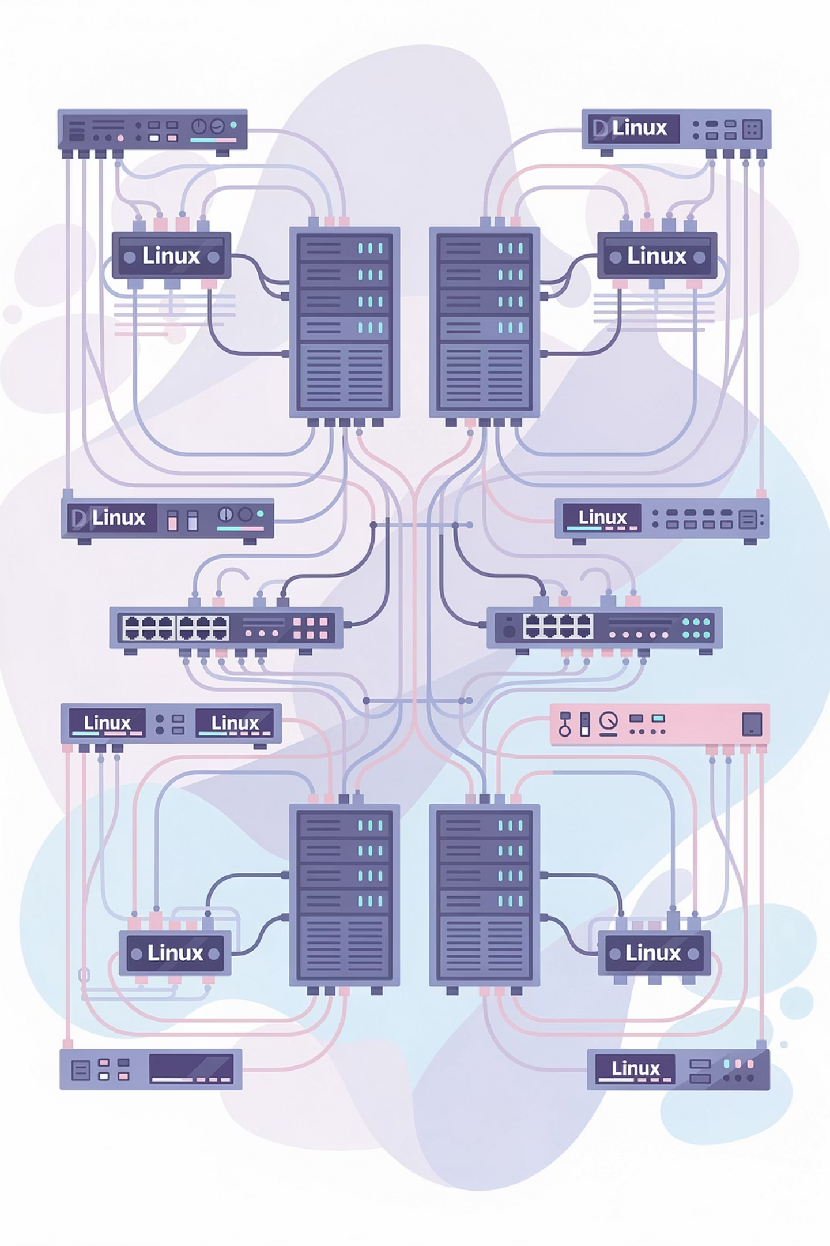
Computer Network Definition
Computer networking refers to interconnected computing devices that can exchange data and share resources with each other. These networked devices use a system of rules, called communications protocols, to transmit information over physical or wireless technologies.
Networks can include computers, servers, printers, smartphones, routers, switches, and other devices.
Devices communicate using protocols like TCP/IP, HTTP, FTP, etc.
Connections can be wired (Ethernet cables, fiber optics) or wireless (Wi-Fi, Bluetooth).
Networks enable sharing of files, internet connections, applications, and hardware resources.
They form the backbone of modern communication, from small home networks to the global internet.

Slide 5



The Foundation of Networking
Resource Sharing
Communication
Collaboration
Networks enable multiple users to access shared resources like printers, storage, and applications efficiently. This reduces hardware costs and centralizes management, making it easier to maintain and update systems across an organization.
Computer networking facilitates instant communication through email, messaging, video conferencing, and collaboration tools. This real-time exchange of information breaks down geographical barriers and enables remote work.
Networks allow teams to work together on shared documents, projects, and databases simultaneously. Version control systems and cloud-based platforms enable seamless teamwork regardless of physical location.

Slide 6
Essential Network Hardware Components
Layer 2: Switches
Network Interface Cards
Switches operate at the Data Link layer, using MAC addresses to forward frames within a local network. They create separate collision domains for each port, significantly improving network performance compared to hubs. Modern switches support VLANs for network segmentation.
NICs provide the physical and logical connection between a computer and the network. Each NIC has a unique MAC address burned into its firmware. Modern Ubuntu systems typically show NICs with names like ens33, enp0s3, or eth0.
Network Media
Layer 3: Routers
Ethernet cables (Cat5e, Cat6, Cat6a) provide wired connectivity up to 10Gbps. Wi-Fi (802.11ac, 802.11ax) offers wireless connectivity with speeds up to several gigabits per second, though subject to interference and distance limitations.
Routers operate at the Network layer, making forwarding decisions based on IP addresses. They connect different networks together, determining the best path for data packets. Routers also provide NAT, DHCP services, and act as the gateway between your LAN and the Internet.

Slide 7
Network Implementation Types
1
2
Local Area Network (LAN)
Wireless LAN (WLAN)
A LAN connects devices within a limited area like an office building or home. Characterized by high speeds (1-10 Gbps), low latency, and private ownership. Typically uses Ethernet switches for connectivity.
WLAN extends LAN functionality using Wi-Fi technology, eliminating the need for physical cables. Access points broadcast signals that devices can connect to. Security protocols like WPA3 protect wireless transmissions from eavesdropping.
3
4
Wide Area Network (WAN)
The Internet
WANs connect networks across large geographical distances, often spanning cities, countries, or continents. Organizations lease WAN connections from ISPs. Lower speeds and higher latency compared to LANs.
The Internet is the largest WAN, connecting billions of devices worldwide. Uses standardized protocols (TCP/IP) to enable universal communication. Your Ubuntu server connects to this global network through your ISP.

Slide 8
The OSI Model: Seven Layers of Communication
The Open Systems Interconnection model provides a conceptual framework for understanding how network protocols interact. Each layer serves a specific function and communicates with the layers directly above and below it.
Layer 1: Physical
Transmits raw bits over physical media (cables, radio waves). Defines voltage levels, cable specifications, and connector types.
Layer 2: Data Link
Provides node-to-node data transfer using MAC addresses. Handles error detection and frame synchronization. Switches operate here.
Layer 3: Network
Routes packets across networks using IP addresses. Determines best path for data delivery. Routers operate at this layer.
Layer 4: Transport
Ensures reliable data transfer with TCP or fast delivery with UDP. Manages port numbers and flow control.
Layer 5-6: Session & Presentation
Session manages dialogues between applications. Presentation handles data formatting, encryption, and compression.
Layer 7: Application
Provides network services directly to applications. HTTP, SSH, DNS, and FTP operate here.

Slide 9





The TCP/IP Model: Real-World Implementation
While the OSI model is conceptual, the TCP/IP model reflects how networking actually works in practice. It consists of four layers that map to the OSI layers, forming the foundation of Internet communication.
Why Two Models?
The OSI model is excellent for teaching and troubleshooting—it breaks networking into logical, digestible pieces. The TCP/IP model reflects what's actually implemented in operating systems like Ubuntu. Understanding both makes you a better network engineer.
Link Layer
Combines OSI Physical and Data Link layers. Handles hardware addressing and media access (Ethernet, Wi-Fi).
Internet Layer
Maps to OSI Network layer. IP protocol routes packets between networks using logical addressing.
Transport Layer
Direct mapping to OSI Transport. TCP provides reliability; UDP provides speed. Port numbers identify services.
Application Layer
Combines OSI Session, Presentation, and Application layers. All user-facing protocols and services.

Slide 10
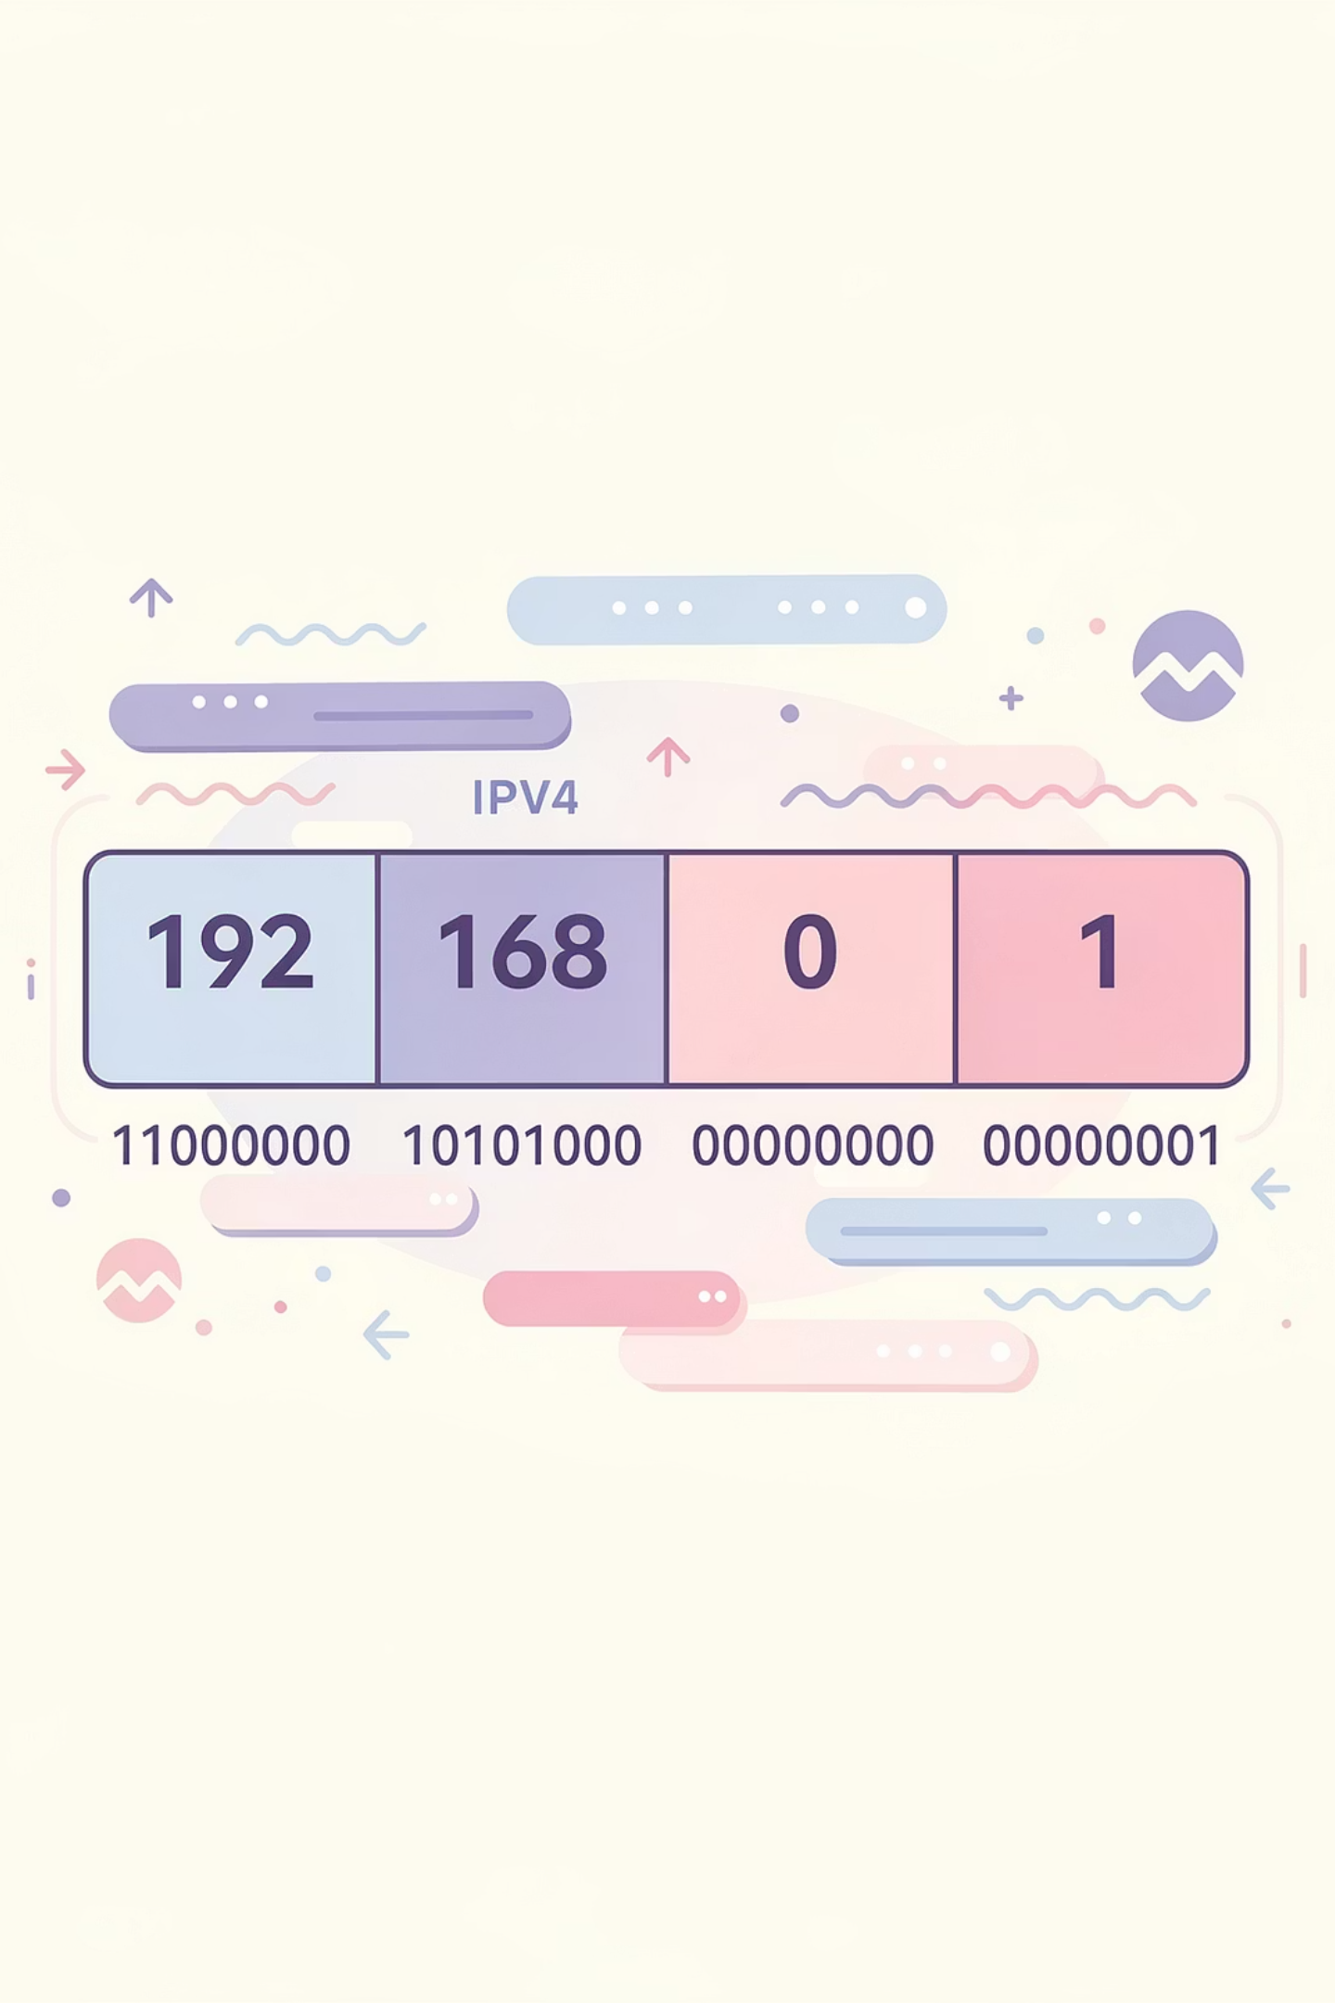
IPv4 Addressing Structure
IPv4 uses 32-bit addresses, typically written in dotted-decimal notation. Understanding this structure is fundamental to network configuration and troubleshooting on Ubuntu systems.
Binary Representation
Network vs Host Portions
Each of the four octets is 8 bits, ranging from 0-255 in decimal. For example, 192.168.1.100 in binary is:
Every IP address is divided into two parts: the network identifier and the host identifier. A subnet mask determines this split.
11000000.10101000.00000001.01100100
With subnet mask 255.255.255.0 (/24), address 192.168.1.100 breaks down as:
This binary representation is how computers actually process IP addresses. Subnetting calculations rely on understanding these binary patterns.
Network: 192.168.1.0
Host: 100
Broadcast: 192.168.1.255

Slide 11
Historical Classes of Networks
Before CIDR, IPv4 addresses were divided into classes. While largely obsolete, understanding classes helps interpret legacy configurations and documentation you'll encounter.
Class A
Class B
Class C
Range: 1.0.0.0 to 126.255.255.255
Range: 128.0.0.0 to 191.255.255.255
Range: 192.0.0.0 to 223.255.255.255
Default Mask: 255.0.0.0 (/8)
Default Mask: 255.255.0.0 (/16)
Default Mask: 255.255.255.0 (/24)
Networks: 126 large networks
Networks: 16,384 medium networks
Networks: ~2 million small networks
Hosts per network: ~16.7 million
Hosts per network: 65,534
Hosts per network: 254
First bit always 0. Designed for very large organizations. Most Class A space is allocated to major corporations and governments.
First two bits always 10. Designed for medium-sized organizations. The 172.16.0.0/12 range is reserved for private use.
First three bits always 110. The 192.168.0.0/16 range is reserved for private networks—most home and small office networks.

Slide 12
Class D and E: Special Purpose Addresses
Class D - Multicast Addresses
Class E - Reserved/Experimental
Range: 224.0.0.0 to 239.255.255.255
Range: 240.0.0.0 to 255.255.255.255
First four bits: Always 1110
First four bits: Always 1111
Purpose: Multicast group communication - one-to-many transmission
Purpose: Reserved for future use and experimental purposes
Not available for general use on the internet
Not assigned to individual hosts
255.255.255.255 is the limited broadcast address
Examples: 224.0.0.1 (all hosts on local network), 224.0.0.2 (all routers), 239.x.x.x (organization-local scope)
Largely unused and considered obsolete
Used for streaming media, video conferencing, routing protocols (OSPF, RIP)
No subnet mask concept applies
While Class D is still actively used for multicast applications, Class E remains reserved and has never been deployed for production use. Modern networks rely on CIDR rather than the class system.

Slide 13
Subnetting: Efficient Network Division
Subnetting divides a large network into smaller, manageable subnetworks. This improves security, reduces broadcast traffic, and enables better network organization. The subnet mask determines how many bits represent the network versus host portions.
Practical Example: Splitting a /24 Network
You have network 192.168.1.0/24 (254 usable hosts) and need to create four subnets for different departments:
Subnet 1
Subnet 2
Network: 192.168.1.0/26
Network: 192.168.1.64/26
Range: .1-.62
Range: .65-.126
Hosts: 62
Hosts: 62
Broadcast: .63
Broadcast: .127
Subnet 3
Subnet 4
Network: 192.168.1.128/26
Network: 192.168.1.192/26
Range: .129-.190
Range: .193-.254
Hosts: 62
Hosts: 62
Broadcast: .191
Broadcast: .255
By borrowing 2 bits from the host portion (moving from /24 to /26), we created four subnets. Each department gets isolated broadcast domains and can implement separate security policies.

Slide 14
CIDR: Modern IP Address Allocation
Classless Inter-Domain Routing (CIDR) replaced the rigid class system in 1993, allowing flexible network sizing. CIDR notation uses a slash followed by the number of network bits: 192.168.1.0/24.
Common CIDR Masks
CIDR
Subnet Mask
Hosts
Benefits of CIDR
/30
255.255.255.252
2
Efficiency: Allocate exactly the address space needed, no waste
/29
255.255.255.248
6
Route Aggregation: Multiple networks summarized in a single route entry
Flexibility: Subnet on any bit boundary, not just class boundaries
/28
255.255.255.240
14
Scalability: Enabled Internet growth by optimizing routing tables
/27
255.255.255.224
30
Modern Ubuntu configurations exclusively use CIDR notation. You'll see addresses like 10.0.0.15/8 (large private network) or 203.0.113.10/29 (8-address subnet).
/26
255.255.255.192
62
/25
255.255.255.128
126
/24
255.255.255.0
254
/16
255.255.0.0
65,534
/8
255.0.0.0
16.7M

Slide 15




Linux Network Interface Types
Ubuntu systems use predictable network interface naming based on hardware topology. Understanding interface types is essential for proper configuration and troubleshooting.
Physical Ethernet Interfaces
Names: ens33, enp0s3, eth0 (legacy)
These represent actual hardware NICs. The naming scheme encodes location: 'en' for ethernet, 's' for hotplug slot, 'p' for PCI bus, followed by numbers indicating bus/slot positions. Physical interfaces connect to switches via Ethernet cables.
Wireless Interfaces
Names: wlan0, wlp3s0
Wireless network adapters connecting to Wi-Fi access points. Use tools like iwconfig or nmcli to manage wireless connections, scan for networks, and configure authentication. Less common on servers, typical on laptops and desktops.
Loopback Interface
Name: lo (always)
Address: 127.0.0.1 (IPv4), ::1 (IPv6)
Virtual interface for local machine communication. Applications use loopback to communicate with services on the same host without network overhead. Traffic never leaves the computer. Essential for testing and local services.
Virtual Interfaces
Examples: docker0, br0, tun0
Software-defined interfaces for virtualization, containers, VPNs, and bridges. Docker creates docker0 for container networking. OpenVPN creates tun interfaces for VPN tunnels. Bridges (br0) connect virtual machines to physical networks.
View All Interfaces
ip link show# Lists all network interfaces with status and MAC addresses

Slide 16

Dynamic vs Static IP Configuration
DHCP (Dynamic)
Static IP Assignment
Dynamic Host Configuration Protocol automatically assigns IP addresses, subnet masks, gateways, and DNS servers to clients. A DHCP server maintains a pool of available addresses and leases them to devices for a set period.
Manually configured IP addresses that don't change. Administrators explicitly set the IP address, subnet mask, gateway, and DNS servers in the system configuration files.
Advantages
Advantages
Predictable addressing for servers and services
Easy setup—no manual configuration needed
Essential for DNS servers, web servers, routers
Reduces IP conflicts and administrative overhead
No dependency on DHCP infrastructure
Automatic updates when network changes
Easier to create firewall rules and port forwards
Perfect for workstations and mobile devices
Disadvantages
Disadvantages
Requires careful documentation to avoid conflicts
Address can change, breaking DNS or firewall rules
Manual updates needed when network changes
Requires functioning DHCP server
More administrative overhead
Not suitable for servers or network infrastructure
Best Practice: Use DHCP for end-user devices and workstations. Use static IPs for servers, network infrastructure (routers, switches), and devices that need consistent addressing for services or security policies. Consider DHCP reservations as a middle ground—centralized management with address consistency.

Slide 17
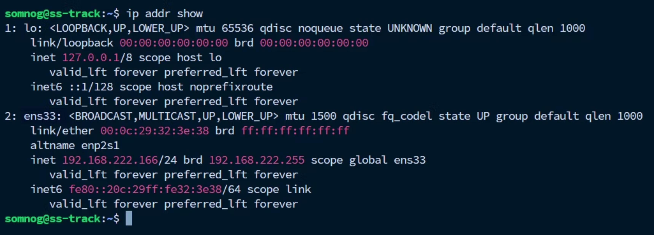
Configuring Static IP with Netplan
Modern Ubuntu releases (17.10+) use Netplan as the network configuration abstraction layer. Netplan reads YAML files in /etc/netplan/ and applies settings using either NetworkManager or systemd-networkd as the renderer.
Step 1: Identify Your Interface

Slide 18
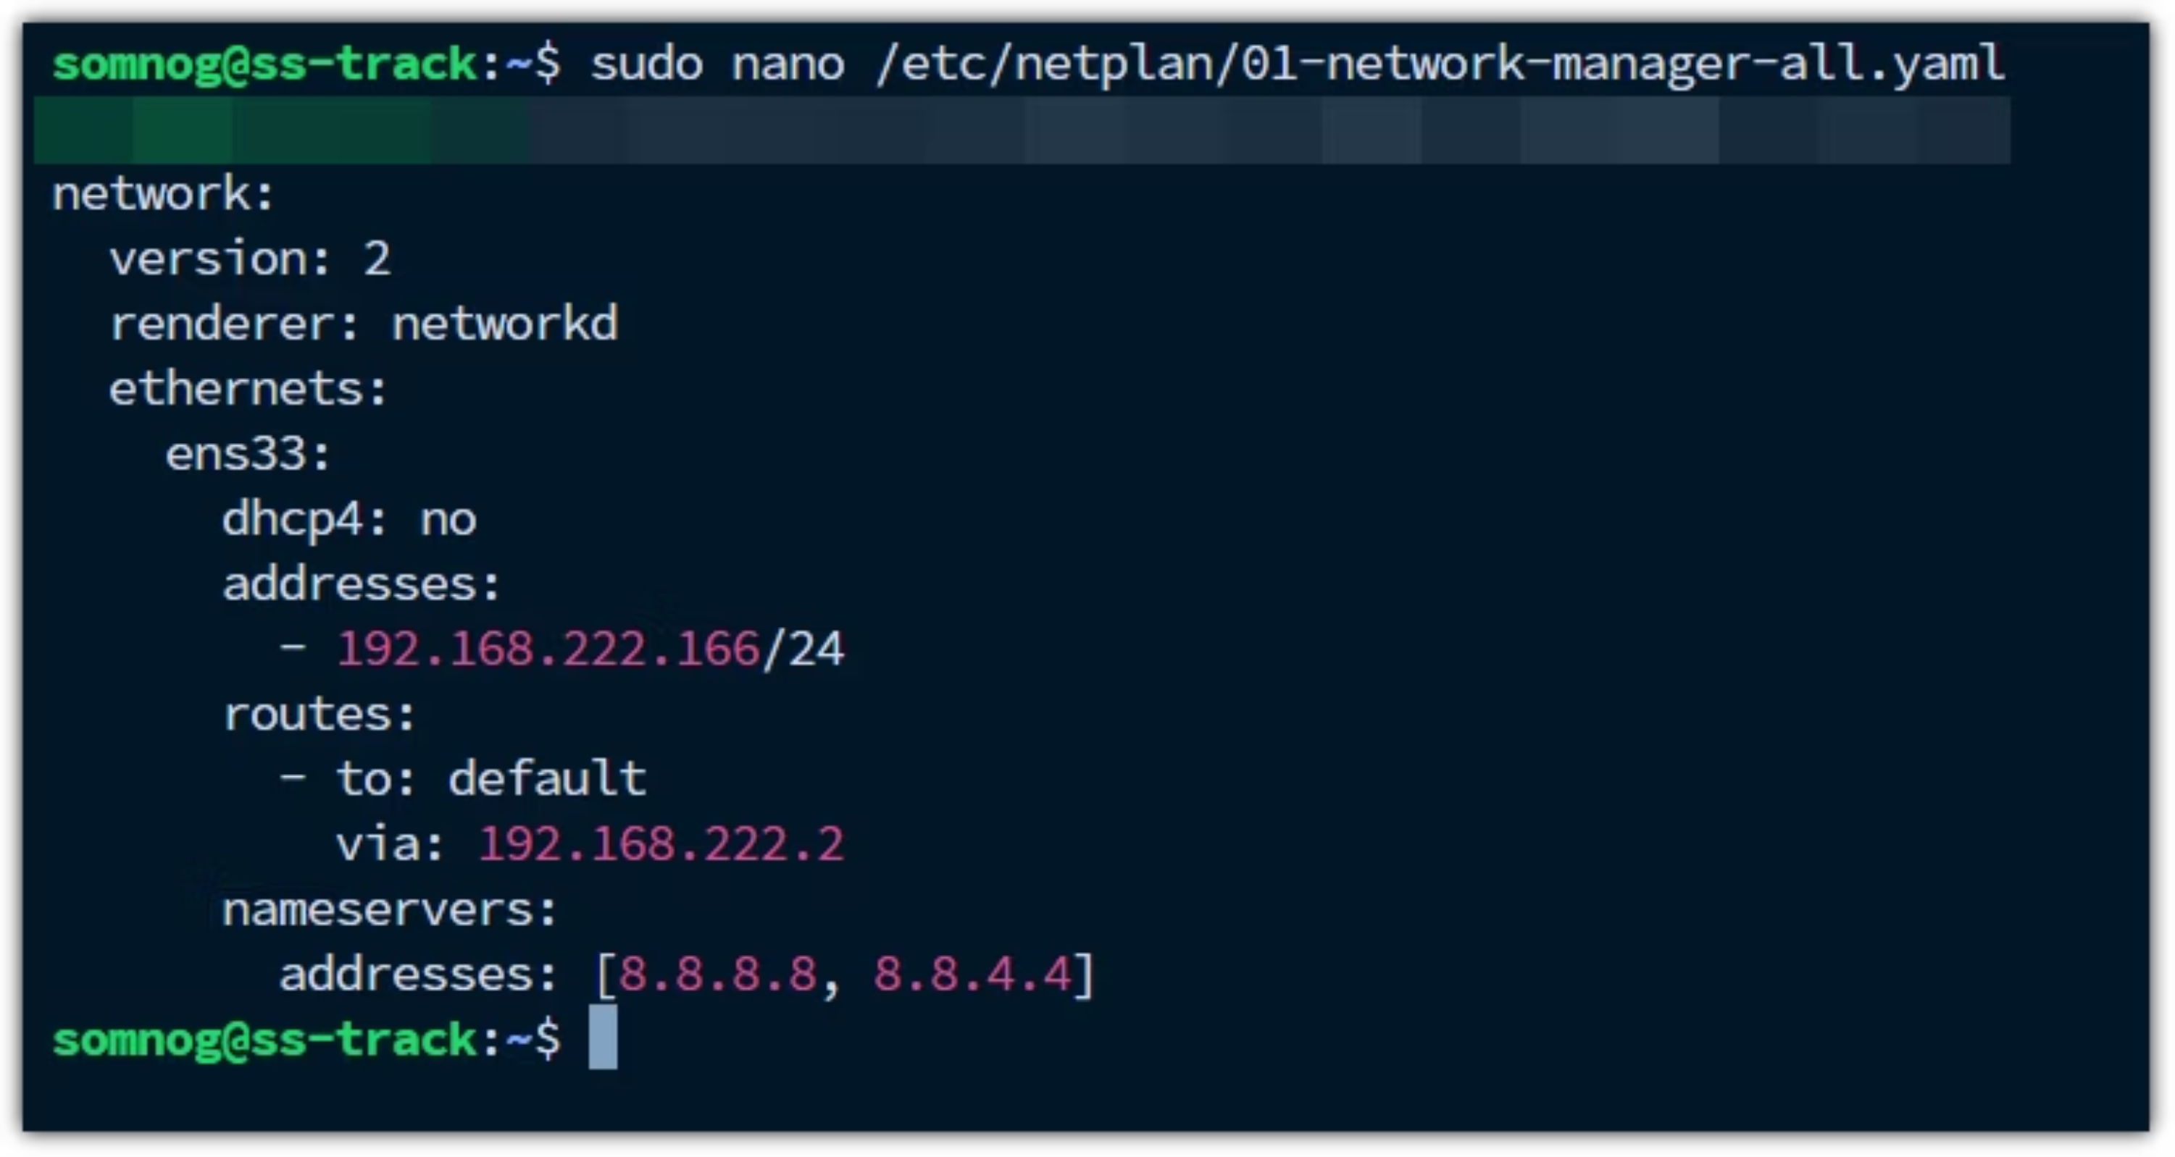
Step 2: Create/Edit Netplan Configuration

Slide 19

Step 4: Test Configuration
Step 5: Apply Configuration
sudo netplan try# Tests config for 120 seconds# Auto-reverts if not confirmed
sudo netplan apply# Applies configuration permanently
Important: YAML is whitespace-sensitive! Use spaces, not tabs. Each indentation level is exactly 2 spaces. The netplan try command is your safety net—it prevents lockout from configuration errors.

Slide 20
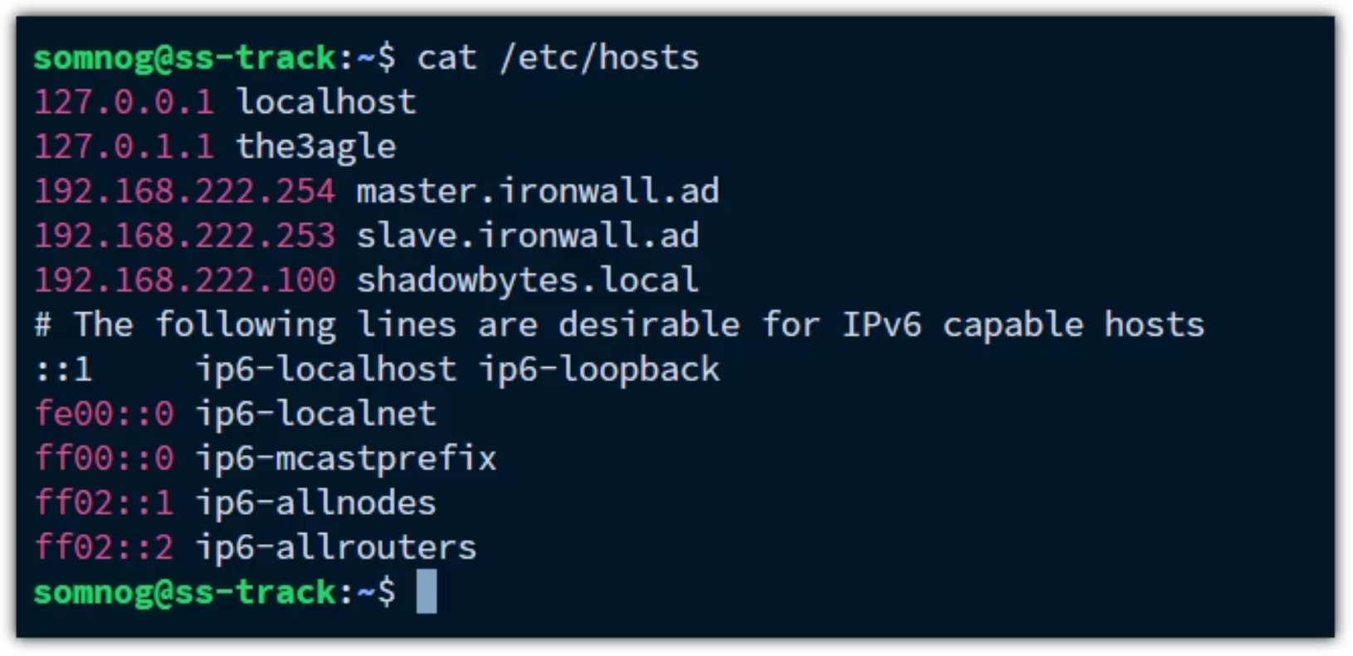
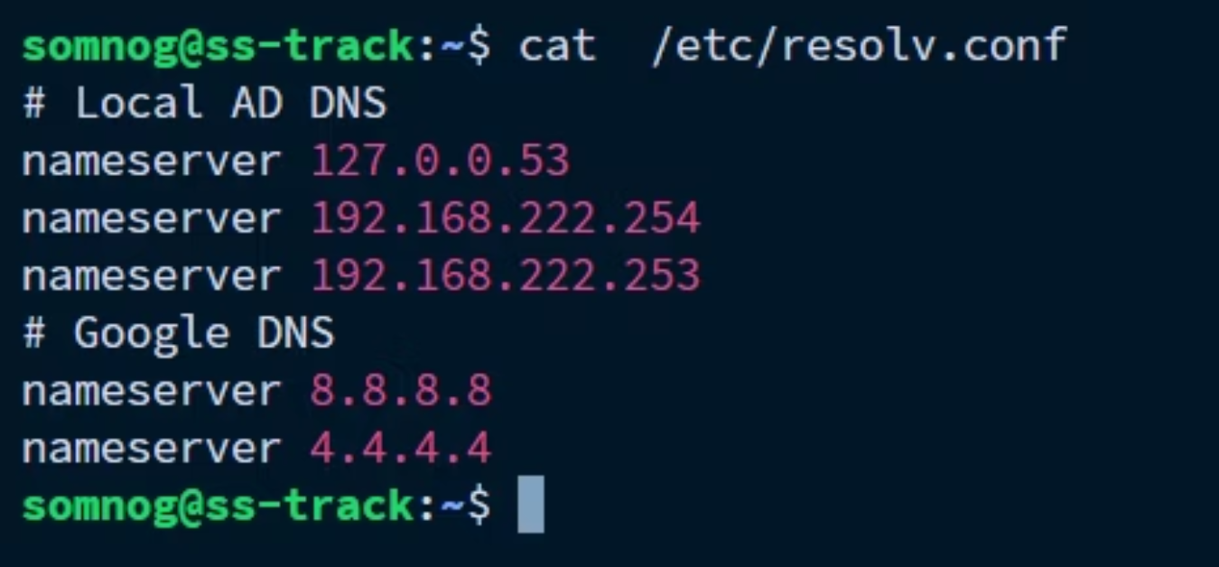
Essential Network Configuration Files
1
2
/etc/hosts
/etc/resolv.conf
Purpose: Local hostname-to-IP address mapping
Purpose: DNS resolver configuration
This file provides static hostname resolution before DNS queries. Each line contains an IP address followed by one or more hostnames. Essential for local network services and testing.
Specifies which DNS servers the system should query for hostname resolution. On modern Ubuntu systems with systemd-resolved, this file is typically a symbolic link to /run/systemd/resolve/stub-resolv.conf.
Important: If using Netplan, configure DNS servers there instead of editing this file directly. Netplan manages resolv.conf through systemd-resolved, and manual edits may be overwritten.
Changes take effect immediately—no service restart required. The hosts file is checked first (by default) before DNS queries are made, based on /etc/nsswitch.conf configuration.

Slide 21
Essential Network Viewing Commands
Master these commands for daily network management and troubleshooting. They replace older tools like ifconfig and netstat with more powerful, modern alternatives.
View IP Addresses and Interface Status
View Routing Table
View Listening Ports and Connections
ip route show# Displays kernel routing table with all routesip route get 8.8.8.8# Shows the route that would be taken to reach a specific IP
ip addr show# Shows all interfaces with IP addresses, subnet masks, and statusip addr show ens33# Shows specific interface details only
ss -tulnp# Shows TCP/UDP listening sockets with port numbers and processes# t=TCP, u=UDP, l=listening, n=numeric, p=process
The default route (usually via your gateway) is critical. Without it, you can't reach the Internet. Look for default via 192.168.1.1 lines.
Use this to verify services are listening on expected ports. The last column shows which process owns each socket. Essential for security auditing and troubleshooting service startup issues.
Look for the UP flag indicating an active interface. The inet line shows IPv4 address and CIDR notation. The link/ether line shows the MAC address.

Slide 22






Linux Networking: Complete Recap
This slide summarizes the core concepts and practical skills covered in our Linux networking discussion, providing a quick reference for key topics.
Network Fundamentals
Addressing & Routing
Essential Commands
OSI Model (7 layers)
MAC addresses (physical)
ip addr, ip route, ss
TCP/IP Model (4 layers)
IPv4 structure, subnetting, CIDR
ping, traceroute
Hardware (switches, routers)
Routing tables
dig/nslookup
Configuration Files
Network Services
Security
/etc/hosts
SSH, Apache/Nginx
UFW firewall
/etc/resolv.conf
DNS, DHCP, FTP
iptables/nftables
/etc/netplan/
NFS, Samba
Basic firewall rules
/etc/network/interfaces

