Slide 1
NETWORK INFRASTRUCTURE WORKSHOP · SOMNOG9
Introduction to BGP
Autonomous Systems, Path Vector Routing and Multi-homing
Track 1 — Network Infrastructure · SNU KM4 Campus, Mogadishu

Slide 2

LEARNING OBJECTIVES
By the End of This Session
Explain why an IGP cannot run the Internet, and what BGP does instead
Say when a network genuinely needs BGP — and when a default route is the right answer
Describe autonomous systems, AS numbers, and where address space and AS numbers come from
Compare the three things an ISP can send you: a default route, a partial table, or the full table
Read an AS path out of a BGP table, and name the four ways a customer can connect to ISPs
Learning Objectives
2

Slide 3

AGENDA
What We'll Cover
Why BGP exists, and why policy matters more than shortest path on the Internet
Autonomous systems, AS numbers, and getting your own address space
What your ISP advertises to you, and what that costs you in memory
Path vector routing, and how BGP chooses
Single-homed to dual multi-homed designs, eBGP configuration, and securing your routes
Agenda
3

Slide 4

CONTEXT
Why This Session Has No Lab
BGP needs at least two autonomous systems, public address space, and a live upstream — none of which a lab pod has
This one is presented rather than practised, so treat it as the map for what comes after the workshop
It matters here because Somali operators run real AS numbers, take transit, and peer at exchange points
Your address space and AS number come from AFRINIC, the regional registry for Africa
The moment your network has two upstreams and its own addresses, everything on these slides becomes your daily work
Nothing in the lab guide depends on this session. It is the bridge between what you built this week and what you will operate next year.
Context
4

Slide 5

MOTIVATION
Forget What You Know About IGPs
RIP, OSPF and EIGRP are interior gateway protocols — they run inside one autonomous system
They all want the same thing: the shortest path to the destination
None of them scales to the size of the Internet, and none was designed to express business policy
On the Internet, being able to steer traffic matters far more than finding the shortest path
There is exactly one protocol carrying routes between networks today, and it is BGP
Motivation
5

Slide 6

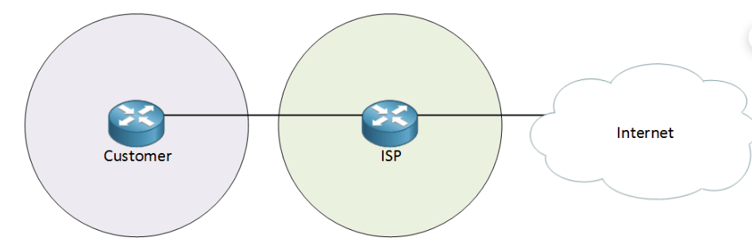
MOTIVATION
When You Do Not Need BGP
One ISP, one public address, NAT for the LAN — a default route pointing at the ISP is all you need
A mail or web server that must be reachable? Port forward it, or ask the ISP for a few more addresses
Want link redundancy to that same ISP? Two default routes with different metrics will do it
Advertise the primary with a low metric and the backup with a high one, and failover happens by itself
In none of these cases does BGP earn its complexity
Motivation
6

Slide 7

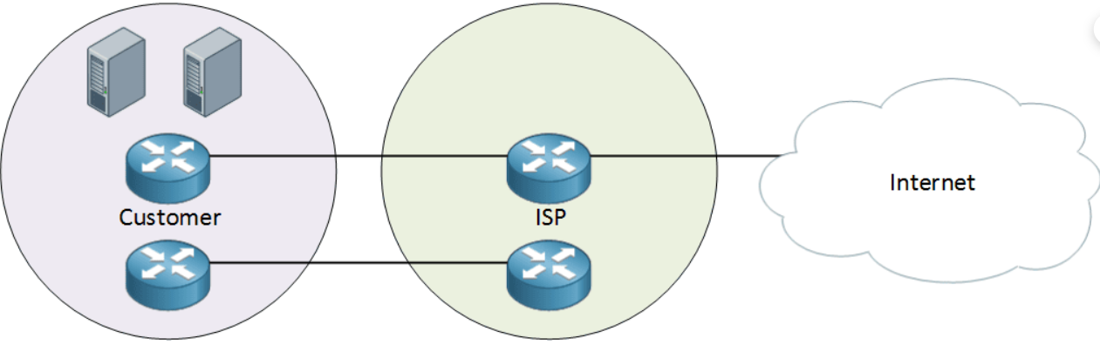
MOTIVATION
Where Default Routing Runs Out
Default routes give you failover, but almost no control over load
Equal metrics get you roughly a 50/50 split, and that is the only ratio on offer
Suppose you want 80% of outgoing traffic on the primary link and 20% on the backup
An IGP cannot express that. BGP can
Control over which traffic leaves by which path is the first real reason to run BGP
Motivation
7

Slide 8

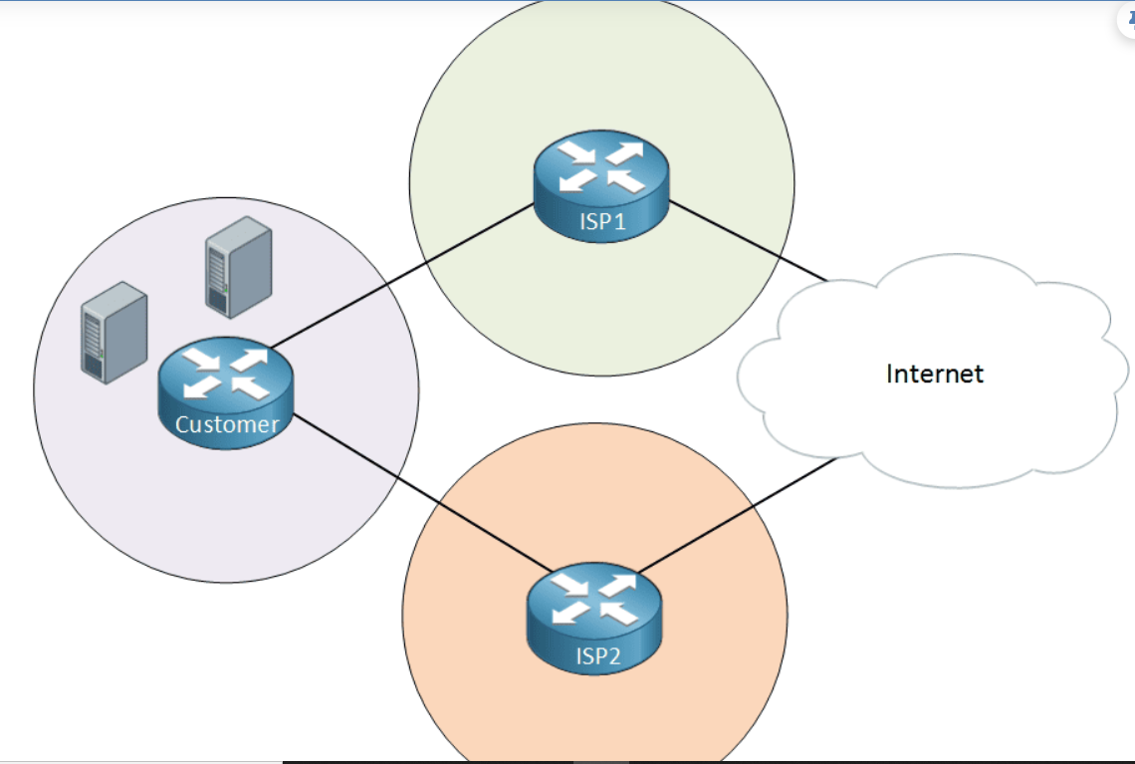
MOTIVATION
When You Do Need BGP
Two different ISPs, so that one provider failing does not take you offline
Addresses from ISP1 become unreachable the moment ISP1 has problems — so you cannot use provider addresses
Instead you get your own public address space, independent of either provider
You then need a way to tell both ISPs that this space is yours and reachable through you
Advertising your own space to more than one provider is exactly what BGP is for
Motivation
8

Slide 9
RESOURCES
Where Addresses and AS Numbers Come From
IANA sits at the top and allocates blocks to the five Regional Internet Registries
AFRINIC covers Africa; the others are RIPE NCC, ARIN, APNIC and LACNIC
The RIR allocates to ISPs and to large organisations, who assign onward to their customers
You register for both an address block and an AS number, and both come with annual fees and policy
IPv4 space is effectively exhausted, so expect a waiting list, a transfer, or an IPv6-first plan
Resources
9

Slide 10
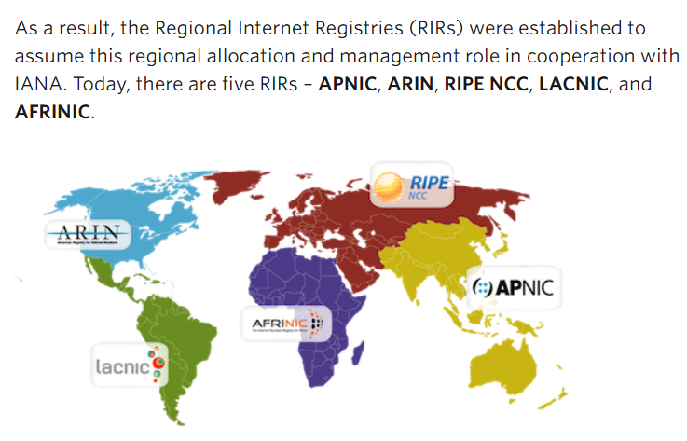
RESOURCES
The Regional Internet Registries
IANA allocates to the five RIRs, who allocate onward to ISPs and large organisations. Somalia is served by AFRINIC.
Resources
0

Slide 11

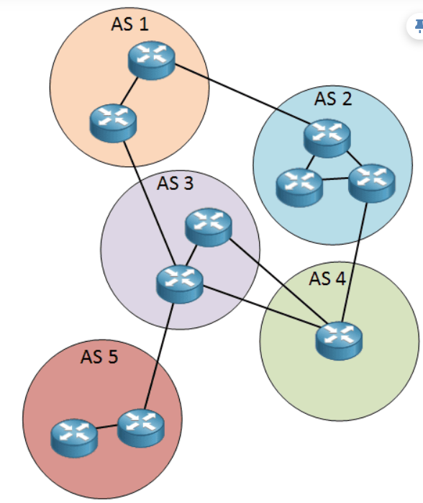
SCOPE
Autonomous Systems
An autonomous system is a collection of networks under one administrative control
The Internet is nothing more than a large number of autonomous systems connected to each other
Inside your AS you run an IGP such as OSPF — that is what Lab 12 was about
Between autonomous systems you run an exterior gateway protocol, and today that means BGP
The boundary of your AS is where your routing policy stops being your own decision
Scope
10

Slide 12
SCOPE
AS Numbers
AS numbers were originally 16-bit, giving 0 to 65535 — and the Internet ran out of them
Since RFC 6793 they are 32-bit, giving over four billion, and 4-byte ASNs are now routine
Public 16-bit range: 1 to 64495. Private 16-bit range: 64512 to 65534
Private 32-bit range: 4200000000 to 4294967294. AS 0 and AS 65535 are reserved
Private AS numbers are used where a customer runs BGP but has no need to be seen globally
If a slide anywhere tells you AS numbers are 16-bit, it was written before 2007. Four-byte ASNs have been the norm for well over a decade.
Scope
11

Slide 13
SCOPE
Two Flavours of BGP
External BGP (eBGP)
Internal BGP (iBGP)
Runs between two different autonomous systems
This is the session you build with your ISP
Administrative distance 20 on Cisco — trusted over any IGP
Peers are normally directly connected
Runs between routers inside the same autonomous system
Carries externally learned routes across your own network
Administrative distance 200 — deliberately worse than your IGP
Needed as soon as you have more than one border router
Scope
12

Slide 14
CHECK YOUR UNDERSTANDING
Checkpoint 1 — Why BGP Exists
QUESTION 1
QUESTION 2
QUESTION 3
Why is OSPF not used between ISPs?
How many bits does an AS number have today?
You have one ISP, one link, and a default route. Do you need BGP?
A. It converges too quickly
B. IGPs seek the shortest path, and do not scale or express policy
C. It has no IPv6 support
D. It cannot be authenticated
A. 8
B. 16
C. 32
D. 64
A. Yes, always
B. No — one exit path means a static default is enough
C. Only if you use NAT
D. Only if you host servers
Checkpoint
13

Slide 15

SCALE
The Size of the Internet Routing Table
A full IPv4 table held about 300,000 prefixes in 2011
By the start of 2026 it had grown to roughly 1.2 million prefixes
Prefixes of /24, /23 and /22 make up around 84% of that table
Every one of those entries costs memory and CPU on every router that carries a full table
You can watch the number yourself at the CIDR Report, cidr-report.org
Source: APNIC, BGP in 2025, January 2026. Table growth is the reason router memory sizing is a real budget item.
Scale
14

Slide 16
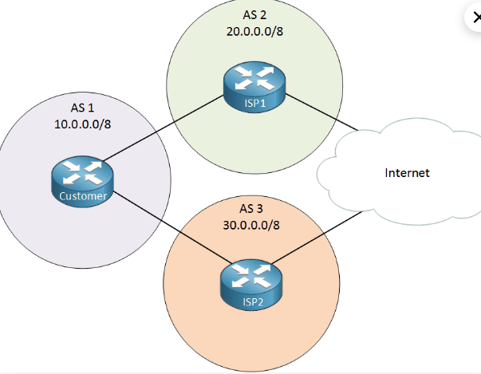
DESIGN
The Picture We Will Use
AS 1 is the customer with 10.0.0.0/8, connected to two providers — AS 2 with 20.0.0.0/8 and AS 3 with 30.0.0.0/8.
Design
0

Slide 17
DESIGN
What Your ISP Can Send You
Default Route Only
Default Plus Partial
Full Internet Table
One entry reaches everything
Cheapest possible option for router memory
You have no idea what lies behind each ISP
Leads to sub-optimal routing when you have two of them
A default route, plus the address space each ISP serves directly
Better decisions without carrying the whole Internet
The sensible middle ground for most multi-homed customers
Every prefix on the Internet, from both providers
Lets you make the best possible routing decisions
Needs serious memory and CPU — and you pay for it in hardware
Design
15

Slide 18
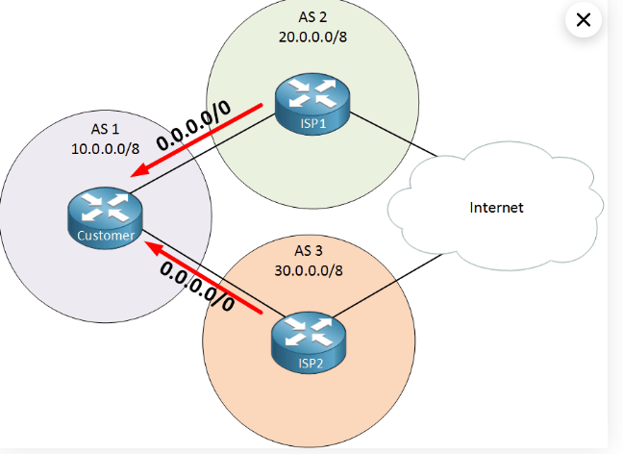
DESIGN
Receiving Only a Default Route
One entry reaches everything. Cheapest on memory, but the customer has no idea what lies behind either provider.
Design
0

Slide 19
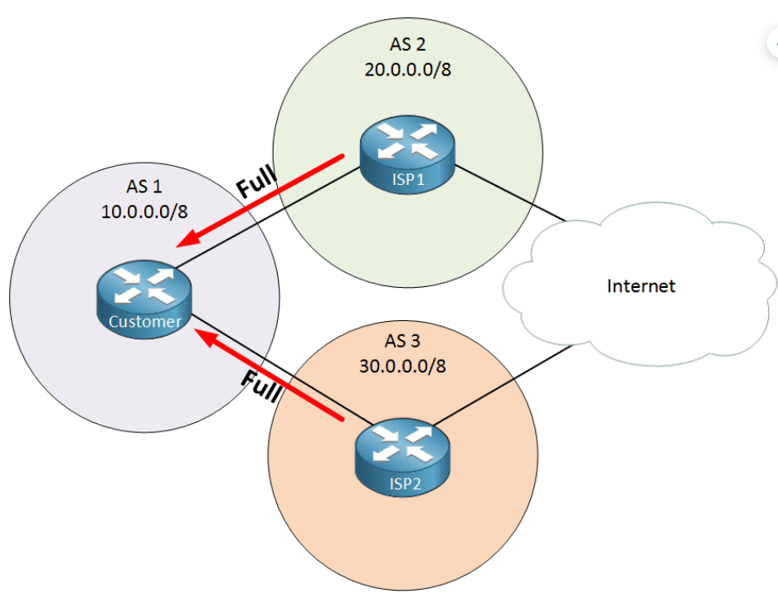
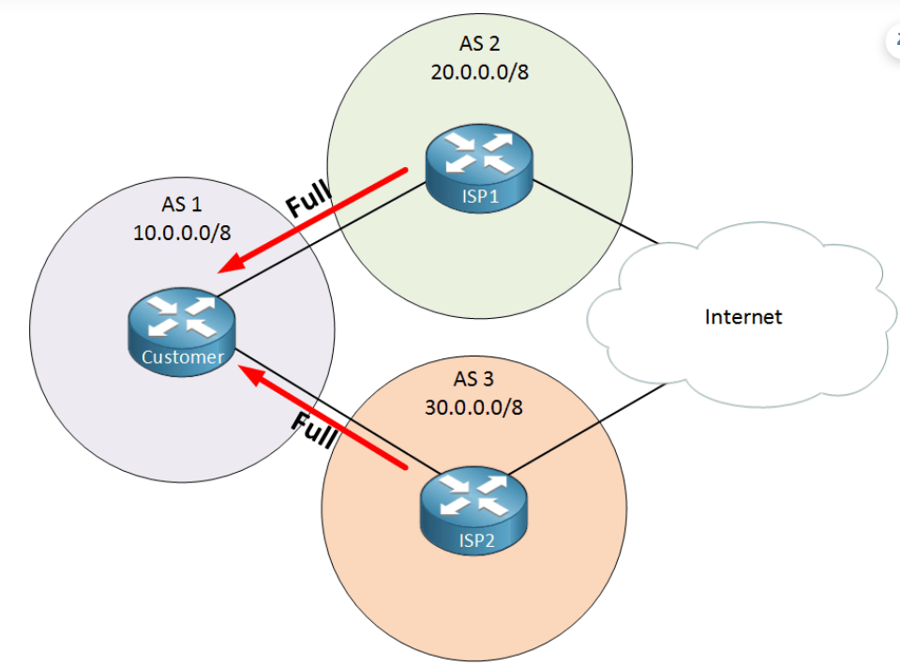
DESIGN
Partial and Full Routing Tables
Left: a default route plus each provider’s own customer space. Right: the full Internet table from both providers.
Design
0

Slide 20
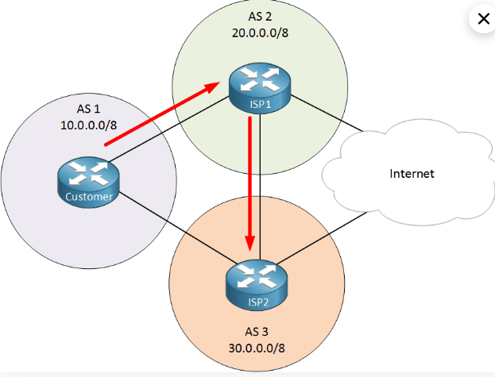
DESIGN
The Cost of Knowing Nothing
With only default routes from two ISPs, your router picks one of them for everything
Traffic for an address that lives behind ISP2 still leaves through ISP1
ISP1 then hands it to ISP2, and it arrives — just by a longer path than it needed
Not broken, but wasteful, and invisible until someone measures it
The more routing information you hold, the fewer of these detours you take
Design
16

Slide 21
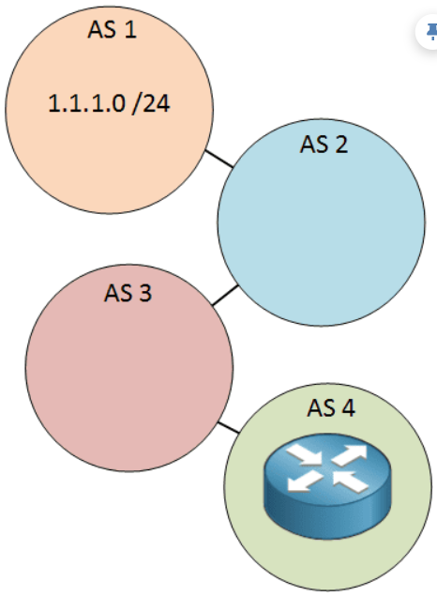
MECHANISM
Path Vector Routing
BGP is a path vector protocol — it advertises a prefix together with the list of autonomous systems it crossed
That list is the AS path, and it is what makes loop detection possible
If a router sees its own AS number in the path, it discards the route
The AS path is also the main input to route selection when nothing else has been configured
This is why BGP thinks in autonomous systems rather than in links or hop counts
Mechanism
17

Slide 22
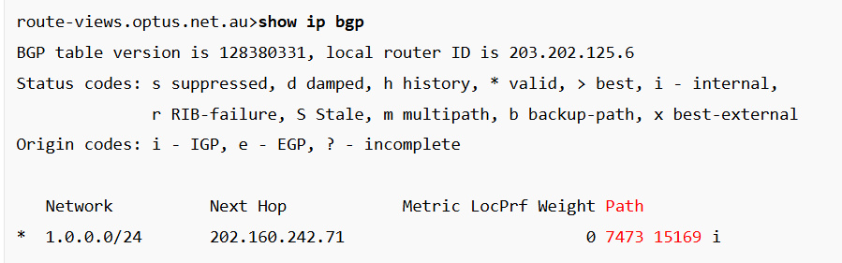
MECHANISM
Reading a BGP Table
Network is the prefix; next hop is the router that advertised it to you
The path is read left to right — the rightmost AS originated the prefix
Here the route reaches AS 15169 by way of AS 7473
This output came from a public looking glass server, reading a real Internet routing table
Mechanism
18

Slide 23
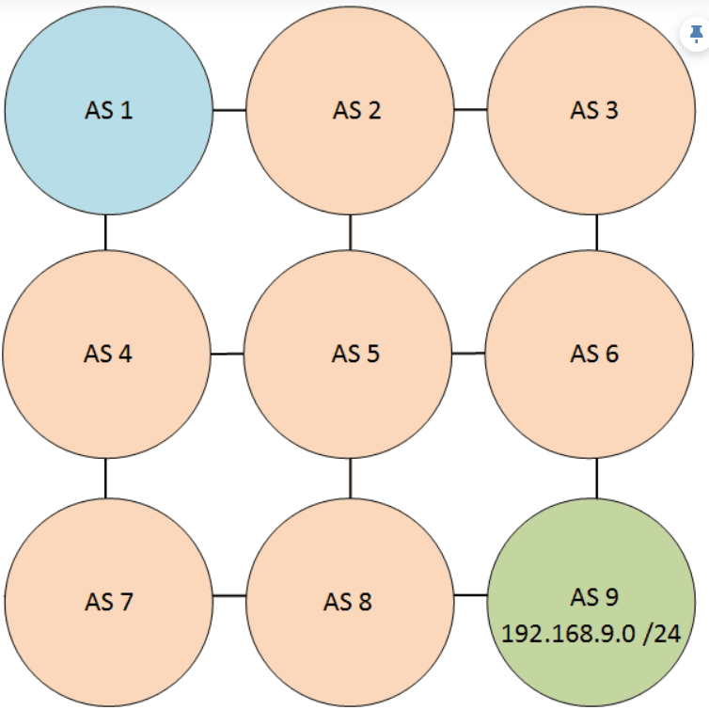
POLICY
How Much Control Do You Actually Have?
BGP lets you apply policy at the level of the autonomous system, not the individual link
You control which exit path your own traffic takes — that decision is genuinely yours
You do not make routing decisions for anybody else’s autonomous system
Each AS advertises only its own best path onward, so you never see the alternatives it rejected
You learn a second-best path only when the best one fails
Influencing inbound traffic is much harder than influencing outbound, because the decision is made in someone else’s network.
Policy
19

Slide 24
CHECK YOUR UNDERSTANDING
Checkpoint 2 — Paths and Policy
QUESTION 4
QUESTION 5
QUESTION 6
What does the AS path in a BGP table tell you?
What administrative distance does Cisco assign to an external BGP route?
Your network command does not advertise the prefix. What is the usual cause?
A. The latency to the destination
B. The autonomous systems the route has crossed
C. The bandwidth of the path
D. The number of routers in the path
A. 1
B. 20
C. 110
D. 200
A. The exact prefix and mask are not in the routing table
B. BGP is not enabled
C. TCP port 179 is blocked
D. You have no AS number
Checkpoint
20

Slide 25
TOPOLOGY
Four Ways to Connect to an ISP
Single-Homed
Dual-Homed
Single Multi-Homed
Dual Multi-Homed
One link to one ISP
Simple and cheap
No redundancy at all — both the link and the provider are single points of failure
Does not need BGP
Two or more links to the same ISP
Link redundancy, and router redundancy if you add a second router
Still depends entirely on one provider
One link each to two different ISPs
Provider redundancy, which is the important kind
One customer router is still a single point of failure
Two or more links to two or more ISPs
Both customer routers connected to both providers
The highest redundancy, and the highest cost and complexity
Topology
21

Slide 26
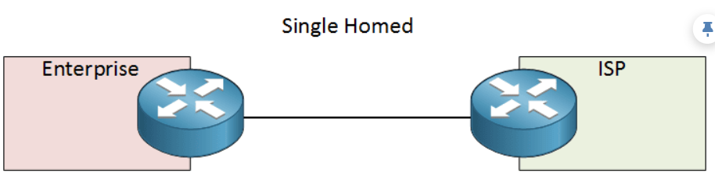
TOPOLOGY
Single-Homed
One link to one ISP. No redundancy, and no need for BGP — a static default route does the job.
Topology
0

Slide 27
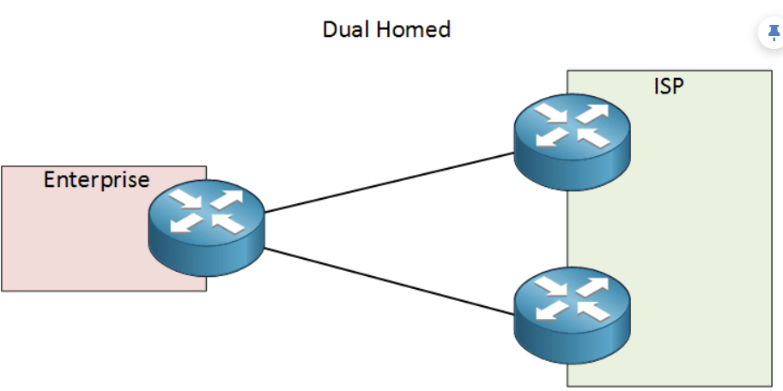
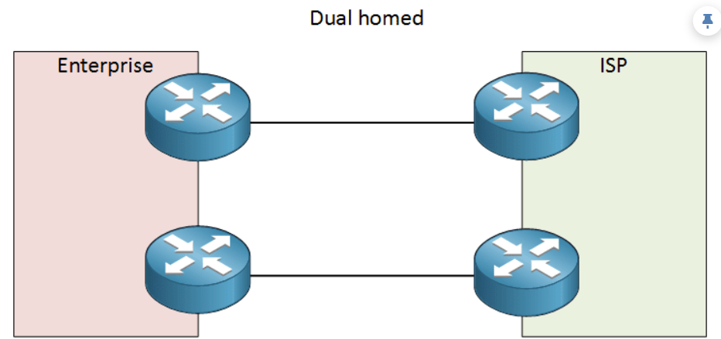
TOPOLOGY
Dual-Homed
Two links to the same ISP. Left: one router each end. Right: two routers each end, which is as far as redundancy goes with a single provider.
Topology
0

Slide 28
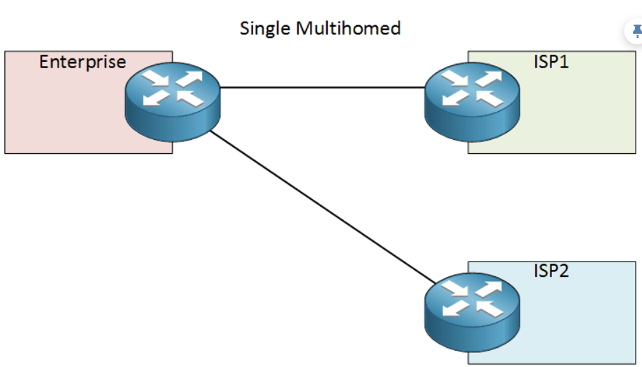
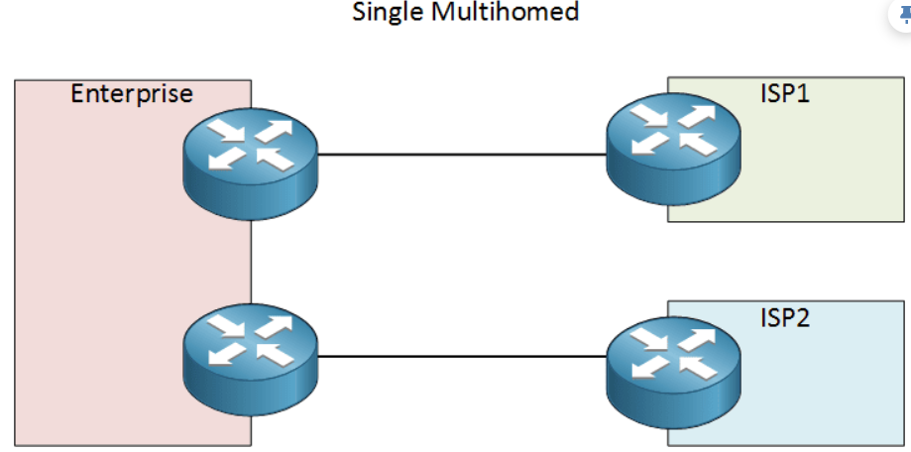
TOPOLOGY
Single Multi-Homed
Two different ISPs. Left: one customer router, still a single point of failure. Right: two routers, one to each provider.
Topology
0

Slide 29
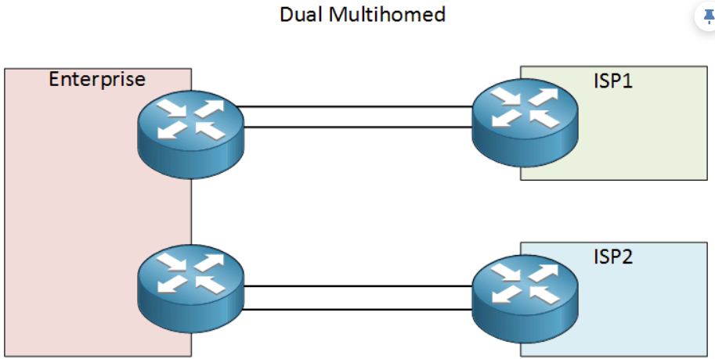
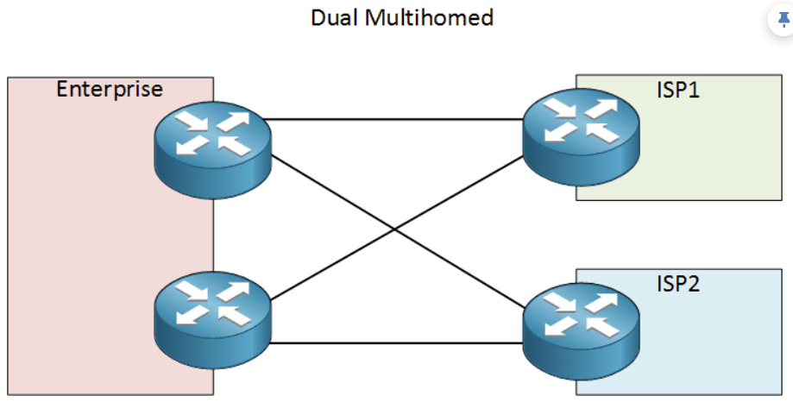
TOPOLOGY
Dual Multi-Homed
Redundant links to redundant providers. On the right, both customer routers reach both ISPs — the most resilient and the most expensive.
Topology
0

Slide 30
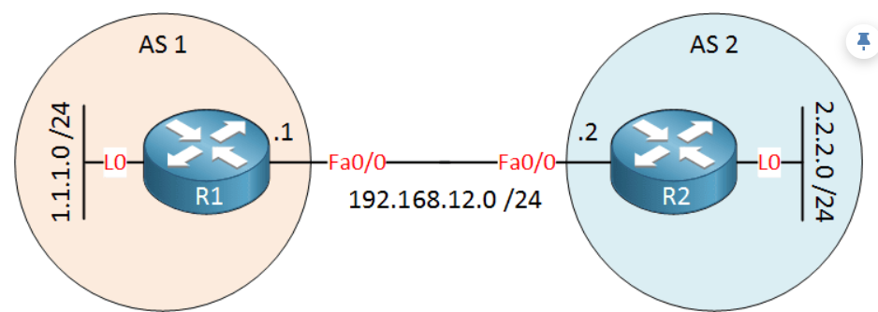
CONFIGURATION
The Topology We Will Configure
Two routers, two autonomous systems, and a loopback on each that we will advertise into BGP.
Configuration
0

Slide 31
CONFIGURATION
Configuring eBGP
R1(config)# router bgp 1
R1(config-router)# neighbor 192.168.12.2 remote-as 2
R2(config)# router bgp 2
R2(config-router)# neighbor 192.168.12.1 remote-as 1
R1(config-router)# neighbor 192.168.12.2 password <secret>
router bgp takes your own AS number — there is only one BGP process per router
Neighbours are never discovered automatically. You configure each one by hand, with its AS number
A different remote-as from your own makes it an eBGP session; the same number makes it iBGP
BGP runs over TCP port 179, and the optional password adds an MD5 digest to every segment
Configuration
22

Slide 32
CONFIGURATION
Advertising a Network
R1(config-router)# network 1.1.1.0 mask 255.255.255.0
R1(config-router)# network 1.0.0.0 mask 255.0.0.0
this will not work if 1.0.0.0/8 is not in
the routing table exactly as written
The network command tells BGP to advertise a prefix you already have
The prefix and mask must match an entry in the routing table exactly — not a subnet of it, not a supernet
If the route is not in the table, BGP silently advertises nothing
This is the single most common reason a new BGP session carries no prefixes
Configuration
23

Slide 33
VERIFICATION
Checking BGP
Router# show ip bgp summary
Neighbor V AS MsgRcvd MsgSent Up/Down State/PfxRcd
192.168.12.2 4 2 15 17 00:10:32 1
Router# show ip bgp the full BGP table
Router# show ip route bgp what actually got installed
show ip bgp summary is where you start — it tells you whether the session is up
A number under State/PfxRcd means the session is established and that many prefixes arrived
Anything else in that column — Idle, Active, Connect — means it is not working
A route can be in the BGP table but not the routing table if something better won
Verification
24

Slide 34
SECURITY
Protecting the Routing System
BGP trusts what it is told, which is how route hijacks and leaks happen
Filter what you accept and what you announce — never let a customer or peer send you the whole Internet by accident
Register your prefixes in an IRR so others can build filters from published data
Create ROAs through AFRINIC so your prefixes can be validated — this is RPKI route origin validation
Drop RPKI-invalid routes at your edge. This is now normal practice among serious operators
MANRS — Mutually Agreed Norms for Routing Security — collects these practices into a checklist worth working through as a network operator.
Security
25

Slide 35
DISCUSSION
How This Session Works
This session is presented, not practised — there is no lab step attached to it
The checkpoint questions are for discussion, and nothing here is graded
Bring your own network: if you already have an AS number or take transit, say so and we will use it as the example
The useful outcome is knowing what to ask your upstream for, and what you would need before you could run BGP
If you want to practise afterwards, the public BGP looking glass servers let you read real routing tables from anywhere in the world without owning any of it.
Discussion
26

Slide 36
SUMMARY
Key Takeaways
IGPs find the shortest path. BGP expresses policy, and that is why the Internet runs on it
You need BGP when you have your own address space and more than one provider — not before
AS numbers are 32-bit, and both addresses and AS numbers come from your regional registry, AFRINIC
A default route is cheap and blunt; a full table is expensive and precise. Most people want something in between
BGP trusts what it hears, so filtering and RPKI are part of running it, not optional extras
Summary
27

Slide 37
INSTRUCTOR NOTES
Answer Key
Question 1 B
Question 2 C
Question 3 B
IGPs optimise for shortest path and cannot carry policy or a million prefixes.
AS numbers have been 32-bit since RFC 6793 in 2007. The old 16-bit space ran out.
With one exit path there is nothing to decide. A static default route is the right answer.
Question 4 B
Question 5 B
Question 6 A
The AS path lists the autonomous systems crossed, and is how BGP detects loops.
eBGP is 20, ahead of every IGP. iBGP is 200, deliberately behind them.
The network command only advertises a prefix that is already in the routing table, exactly as written.
Answer Key — remove for student handout
28

Slide 38

Questions?
Introduction to BGP — Network Infrastructure Workshop, SomNOG9
Based on original materials by the Network Startup Resource Center (NSRC, nsrc.org)
Licensed under Creative Commons Attribution-NonCommercial 4.0 International

