Slide 1

You can’t manage
what you can’t see.
NETWORK MANAGEMENT & MONITORING
Building visibility, control, and reliability across the network

Slide 2

LEARNING OBJECTIVES
By the End of This Session
State the difference between network management and network monitoring, and give an example of each
Name the five FCAPS areas and say which one a given task belongs to
Choose the right data source for a question — SNMP, NetFlow, syslog or ICMP
List the metrics worth alerting on, and explain why each one matters
Describe how alert fatigue happens, and what a sensible threshold looks like instead
Learning Objectives
2

Slide 3





AGENDA
What we'll cover
Network Management
Network Monitoring
Definition, scope, and goals
Continuous visibility into health & activity
Core Components
Protocols & Data Sources
The FCAPS management model
SNMP, NetFlow, Syslog, and more
Key Metrics
Tools & Best Practices
What to track and why it matters
Choosing tools and avoiding pitfalls
Agenda
3

Slide 4

AFTER THE LABS
Watching the Network You Just Built
This session is not a lab step — it comes after your pod is built and working
Once every group has finished, we will point a monitoring server at your own switches and router
You will enable SNMP on your 3560v2 switches and your 2800 router, and see your pod appear as hosts
You will send syslog from your devices to a collector and watch messages arrive as you make changes
Then we break something on purpose — pull a link, shut an interface — and watch the alert fire
This part is instructor-guided. Follow along on the screen first, then repeat it on your own pod with an instructor beside you.
After the Labs
4

Slide 5


DEFINITION
What is Network Management?
The set of processes, tools, and policies used to configure, operate, maintain, and secure a network so it runs efficiently and reliably.
Configuring devices, routing, and access policies
Provisioning and maintaining network infrastructure
Management is
the control layer.
Enforcing security and compliance standards
Planning capacity for future growth
Definitions
5

Slide 6


DEFINITION
What is Network Monitoring?
The continuous, real-time collection and analysis of network data — devices, traffic, and performance — to detect issues before they become outages.
Monitoring answers:
“Is everything working
right now?”
Continuously observes devices, links, and traffic
Raises alerts the moment thresholds are crossed
Feeds dashboards and historical trend reports
Management vs. Monitoring:
Management acts on the network.
Monitoring watches it.
Definitions
6

Slide 7



WHY IT MATTERS
Visibility is the foundation of control
Faster response
Stronger security
Informed planning
Better experience
Spot problems early and shorten time to resolution
Unusual traffic and anomalies surface quickly
Historical trends guide capacity decisions
Reliable networks keep users and services productive
Why It Matters
7

Slide 8


CORE COMPONENTS
The FCAPS Management Model
The ISO framework used to organize network management functions
F
C
A
P
S
Fault
Configuration
Accounting
Performance
Security
Detect, log, and resolve problems
Track device settings and changes
Monitor usage and resource allocation
Measure throughput, latency, and load
Control access and protect data
Core Components
8

Slide 9


HOW IT WORKS
A typical monitoring pipeline
Devices
Collection
Processing
Dashboards
Alerts
Routers, switches, servers, endpoints
SNMP, NetFlow, Syslog, APIs
Normalize, store, and correlate data
Visualize trends and current state
Notify teams when thresholds are crossed
Data flows from devices through collection and processing to the dashboards and alerts your team acts on.
How It Works
9

Slide 10


DATA SOURCES
Protocols behind the visibility
SNMP
NetFlow / sFlow
Polls device metrics like CPU, memory, and interface status
Captures traffic flow data for bandwidth and usage analysis
Syslog
ICMP
Collects event and error logs from devices and systems
Simple reachability and latency checks (ping, traceroute)
APIs / WMI
Packet Capture
Pulls structured data from modern platforms and OSes
Deep inspection of traffic for troubleshooting
Data Sources
10

Slide 11
CHECK YOUR UNDERSTANDING
Checkpoint 1 — Concepts and Data Sources
QUESTION 1
QUESTION 2
QUESTION 3
Which statement separates management from monitoring correctly?
Which protocol polls a device for CPU, memory and interface status?
You need to know who is talking to whom and how much bandwidth they used. Which source?
A. Monitoring acts on the network; management watches it
B. Management acts on the network; monitoring watches it
C. They are two names for the same task
D. Monitoring applies only to servers, not network devices
A. NetFlow
B. SNMP
C. Syslog
D. ICMP
A. Syslog
B. ICMP
C. NetFlow or sFlow
D. SNMP interface counters alone
Checkpoint
11

Slide 12


WHAT TO TRACK
Key metrics to monitor
Uptime / Availability
Bandwidth Utilization
Latency
Is the device or service reachable?
How much capacity is being used?
How long does traffic take to travel?
Packet Loss
CPU & Memory
Error Rates
Are packets being dropped in transit?
Is hardware under strain?
How often do interfaces report faults?
Key Metrics
12

Slide 13
TOOLING
The tools landscape
Open-Source
Commercial
Zabbix
SolarWinds NPM
Nagios Core
PRTG Network Monitor
Cacti
ManageEngine OpManager
LibreNMS
Datadog Network Monitoring
Choose based on team size, budget, and how deeply you need to customize.
Tooling
13

Slide 14
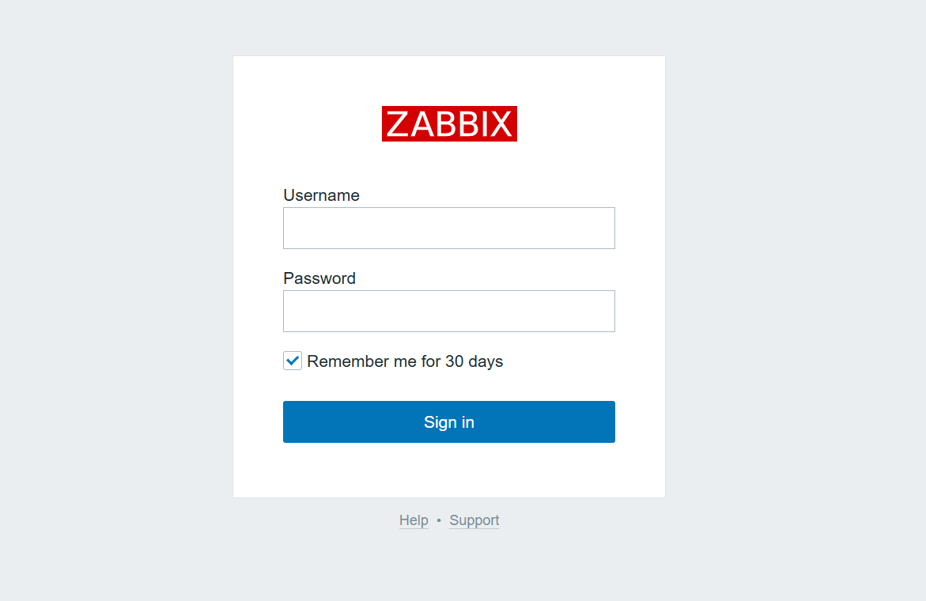
Getting into a monitoring tool
Every monitoring platform starts the same way — a secure sign-in gate, like this Zabbix login screen, before an admin can view or configure the network.
Tooling
14

Slide 15
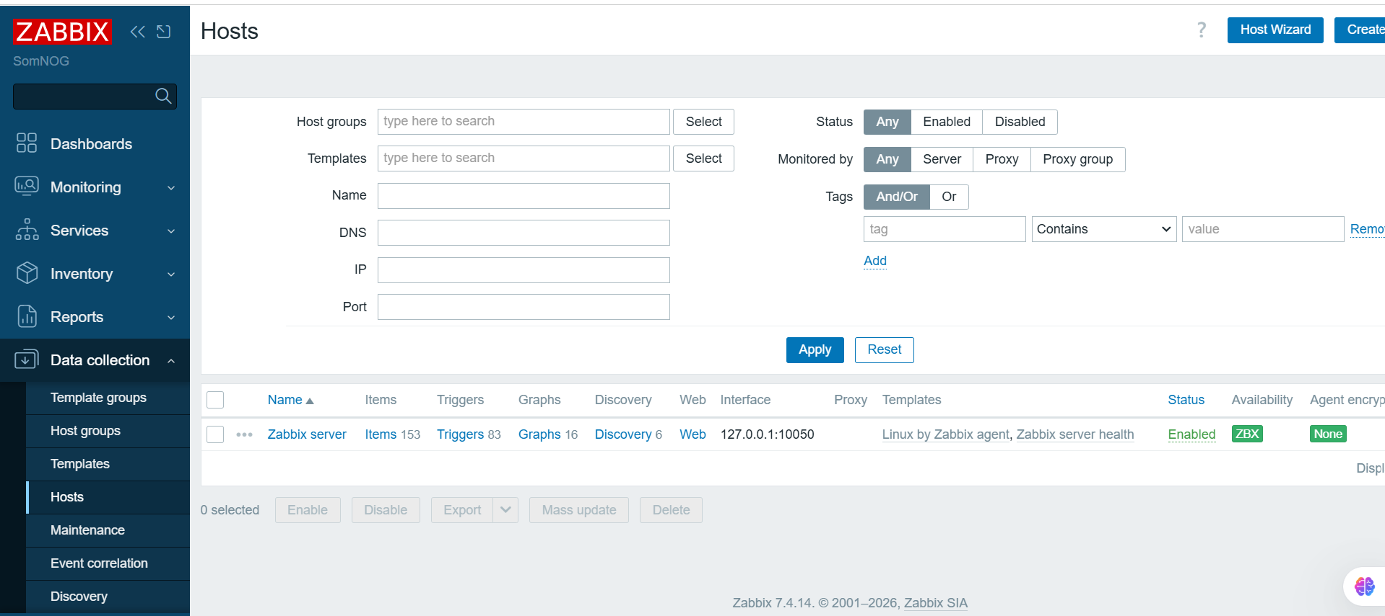
Inside the dashboard: hosts at a glance
Tooling
15

Slide 16


CHALLENGES
Common challenges
Alert fatigue
Too many low-value alerts bury the ones that matter
Scale & complexity
Hybrid and multi-vendor networks are harder to unify
Security blind spots
Unmonitored segments can hide threats
Legacy devices
Older hardware may lack modern monitoring support
Cost & licensing
Enterprise tools can be expensive to scale
Challenges
16

Slide 17
BEST PRACTICES
Getting it right
Centralize dashboards into a single pane of glass
Set meaningful, tiered alert thresholds
Automate routine responses where possible
Run regular audits of devices and configurations
Plan capacity ahead of projected growth
Document topology, baselines, and escalation paths
Best Practices
17

Slide 18
CHECK YOUR UNDERSTANDING
Checkpoint 2 — Metrics and Practice
QUESTION 4
QUESTION 5
QUESTION 6
In the FCAPS model, what does the F stand for?
Your team stops reading alerts because hundreds arrive daily. What is this called?
Which metric answers the question “are packets being dropped in transit?”
A. Firewall
B. Fault
C. Flow
D. Failover
A. Alert fatigue
B. Packet loss
C. A security blind spot
D. Oversubscription
A. Latency
B. Bandwidth utilisation
C. Packet loss
D. CPU utilisation
Checkpoint
18

Slide 19
IMPACT
Why it pays off
Reduced downtime
Issues are caught and fixed before users notice
Faster troubleshooting
Root causes are found with data, not guesswork
Smarter capacity planning
Trends guide upgrades before bottlenecks hit
Stronger security posture
Anomalies are visible across the network
Easier compliance
Logs and reports support audits and policy
Impact
19

Slide 20
ASSESSMENT
How You'll Be Assessed
This session is instructor-guided rather than graded — you follow along and then repeat it on your own pod
An instructor checks that your devices appear in the monitoring tool and that their status is green
You will be asked to interpret one graph and one alert, and say what you would do about each
Checkpoint questions are formative — they tell us where to slow down, nothing more
Success criteria — by the close of this session each group can see its own switches and router in the dashboard, read the interface graph for its trunk, and explain what the alert meant when a link was pulled.
Assessment
20

Slide 21
INSTRUCTOR NOTES
Answer Key
Question 1 B
Question 2 B
Question 3 C
Management configures and changes the network. Monitoring observes it and reports.
SNMP polls device metrics. NetFlow describes traffic; syslog carries events.
Flow data records conversations and byte counts. SNMP counters give totals, not who talked to whom.
Question 4 B
Question 5 A
Question 6 C
Fault, Configuration, Accounting, Performance, Security — the ISO management model.
Alert fatigue. Too many low-value alerts bury the ones that actually matter.
Packet loss counts packets that never arrived. Latency measures how long the ones that did took.
Answer Key — remove for student handout
21

Slide 22
You can’t manage
what you can’t see.
Strong network management and monitoring turn that visibility into control — fewer surprises, faster fixes, and a more resilient network.
Thank you — Questions?
16

