Slide 1

NETWORKING FUNDAMENTALS
Spanning Tree Protocol
STP (IEEE 802.1D) — How switched networks stay loop-free
Layer 2 Switching Series

Slide 2

LEARNING OBJECTIVES
By the End of This Session
Explain why a redundant Layer 2 link without a control protocol takes a network down in seconds
Describe how the root bridge is elected, and why lower always wins in spanning tree
Identify a port’s role and state from show output, and say what it will do next
Compare classic 802.1D, RSTP, PVST+ and MSTP on convergence and on VLAN flexibility
Configure a root bridge deliberately, and protect the edge with BPDU Guard and PortFast
Learning Objectives
2

Slide 3

OVERVIEW
Agenda
01
The Loop Problem
02
STP Fundamentals
Why redundant Layer 2 links break networks
BPDUs, Bridge IDs, and root election
03
Ports & States
04
Timers & Convergence
Roles, states, and path cost
How long STP takes to react
05
STP Evolution
06
Security & Best Practices
RSTP, PVST+, and MSTP
Hardening STP in production
Spanning Tree Protocol
3

Slide 4

IN TODAY’S LAB
From Concept to Console
Lab 8: your two switches are already cross-connected on Fa0/22 and Fa0/23, so you have a physical loop
You will find the root bridge with show spanning-tree, and see which of those two ports has been blocked
You will then set the root deliberately by lowering the priority, and watch the topology move
Pull the forwarding link and time the recovery — that number is the whole argument for RSTP
Lab 9 then bundles the same two ports into an EtherChannel, and spanning tree sees one logical link
Your 3560v2 switches run PVST+ by default. Set spanning-tree mode rapid-pvst before you time anything — otherwise you are measuring 1990s behaviour.
In Today's Lab
4

Slide 5

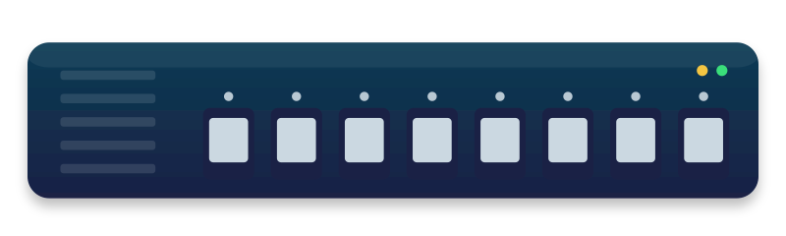

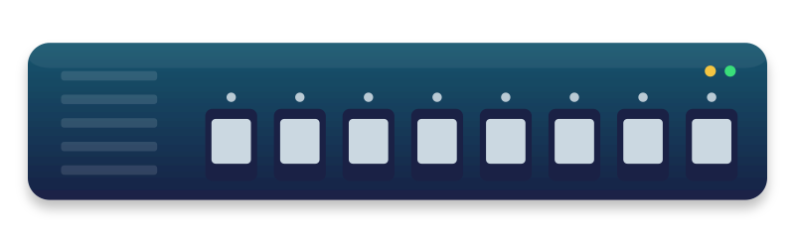
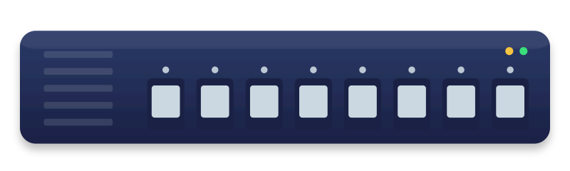
01 · MOTIVATION
The Problem: Layer 2 Loops
Switches provide redundancy by linking to each other multiple ways — but Ethernet frames have no TTL (time-to-live). A frame entering a loop is forwarded endlessly, flooding every device on it — including end users.
SW-A
Frame loops endlessly: A → B → C → A
SW-B
SW-C
End-user PC
The loop itself lives entirely between the switches — SW-A, SW-B, and SW-C keep circulating the same frame forever. Every device attached to any of them, including this PC, is flooded with copies on every pass.
Spanning Tree Protocol
5

Slide 6



01 · MOTIVATION
Broadcast Storms & MAC Instability
Broadcast Storms
CPU Exhaustion
MAC Table Instability
Looped broadcast frames multiply exponentially, consuming all available bandwidth within seconds.
Switch CPUs spike toward 100% processing the flood, and management access is often lost.
The same source MAC appears on multiple ports in rapid succession, so switches constantly relearn it.
Without a loop-prevention mechanism, a single redundant cable can take down an entire switched network in under a minute.
Spanning Tree Protocol
6

Slide 7


02 · STP FUNDAMENTALS
What Is Spanning Tree Protocol?
STP (IEEE 802.1D) is a Layer 2 protocol that logically blocks redundant paths to build a single, loop-free tree across a switched (bridged) network — while keeping the physical links available as backups.
Elects a Root Bridge
Calculates best paths
Blocks redundant links
One switch becomes the logical center of the tree.
Every other switch finds its shortest path to the root.
Extra links are placed in a blocking state, not removed.
Spanning Tree Protocol
7

Slide 8

02 · STP FUNDAMENTALS
A Brief History
1985
1990
1998
2001
2002
Radia Perlman designs the original Spanning Tree Algorithm at DEC.
IEEE standardizes it as 802.1D.
Cisco PVST+ brings per-VLAN spanning trees.
802.1w (RSTP) delivers sub-second convergence.
802.1s (MSTP) maps multiple VLANs to shared instances.
Spanning Tree Protocol
8

Slide 9


02 · STP FUNDAMENTALS
Bridge Protocol Data Units (BPDUs)
Switches exchange BPDUs every 2 seconds (Hello time) to learn the topology, elect a root, and detect changes.
BPDU Field
Purpose
Root Bridge ID
Priority + MAC of the bridge believed to be root
Root Path Cost
Cumulative cost from the sender to the root bridge
Sender Bridge ID
Priority + MAC of the switch sending the BPDU
Sender Port ID
Identifies which port sent the BPDU
Timers
Hello Time, Max Age, Forward Delay
Spanning Tree Protocol
9

Slide 10

02 · STP FUNDAMENTALS
The Bridge ID
Every switch is identified on the network by a single 8-byte Bridge ID, used to elect the root and break ties.
Bridge Priority
MAC Address
Bridge ID
2 bytes · 0–65535
Default: 32768
Configurable in steps of 4096
+
6 bytes
Burned-in address of the switch
Guarantees uniqueness
=
Lower Bridge ID wins the root election
Lower is better everywhere in STP: lower priority, lower path cost, and lower MAC (as a tiebreaker) all win.
Spanning Tree Protocol
10

Slide 11

02 · STP FUNDAMENTALS
Root Bridge Election
1. Advertise
2. Compare
3. Converge
Every switch initially advertises itself as the root, sending BPDUs with its own Bridge ID.
Each switch compares received Bridge IDs against its own and keeps the lowest it has seen.
All switches agree: the switch with the lowest Bridge ID becomes the Root Bridge.
Tip: The root bridge should be chosen deliberately
Lower the priority on your core/distribution switch so it always wins — don't let election happen by MAC address chance.
Spanning Tree Protocol
11

Slide 12
CHECK YOUR UNDERSTANDING
Checkpoint 1 — Loops and Root Election
QUESTION 1
QUESTION 2
QUESTION 3
Why does a Layer 2 loop flood the network, when a Layer 3 routing loop eventually stops?
Two switches have the default priority. Which one becomes the root bridge?
What is carried in a BPDU that lets a switch work out its distance from the root?
A. Switches forward faster than routers
B. An Ethernet frame has no TTL field to expire
C. Broadcasts are always sent twice
D. MAC addresses are shorter than IP addresses
A. The one powered on first
B. The one with the lowest MAC address
C. The one with the highest MAC address
D. Neither — the election fails
A. The sender’s IP address
B. The root path cost
C. The VLAN database
D. The MAC address table
Checkpoint
12

Slide 13



03 · PORTS & STATES
STP Port Roles
Root Port (RP)
Designated Port (DP)
One per non-root switch — the port with the best (lowest cost) path to the Root Bridge.
One per network segment — forwards traffic for that segment toward the root.
Blocking / Alternate
Disabled
Receives BPDUs but does not forward frames — kept as a loop-free standby path.
Administratively shut down — takes no part in STP at all.
Spanning Tree Protocol
13

Slide 14
03 · PORTS & STATES
STP Port States
Blocking
Listening
Learning
Forwarding
20s
15s
15s
—
Discards frames, listens to BPDUs only
Prepares to forward; no MAC learning yet
Builds the MAC address table
Fully operational: sends and receives data
A Disabled port takes no part in this process at any time.
Total worst-case convergence: 20 + 15 + 15 = 50 seconds before a blocked port can carry data.
Spanning Tree Protocol
14

Slide 15
03 · PORTS & STATES
Path Cost
STP prefers the highest-bandwidth path by assigning each link a cost — lower cost, more preferred. A switch's total path cost to the root is the sum of costs along the way.
Link Speed
Media Type
IEEE 802.1D Cost
10 Mbps
Ethernet
100
100 Mbps
Fast Ethernet
19
1 Gbps
Gigabit Ethernet
4
10 Gbps
10-Gigabit Ethernet
2
Spanning Tree Protocol
15

Slide 16
03 · PORTS & STATES
Putting It Together: An Election Walkthrough
ROOT BRIDGE
SW-1
Priority 4096
RP
RP
SW-2
Blocked
SW-3
Priority 32768
Priority 32768
SW-1 has the lowest priority (4096) and becomes root. SW-2 and SW-3 each pick their Root Port toward SW-1, and the link between them is blocked on the higher-cost side to remove the loop.
Spanning Tree Protocol
16

Slide 17
04 · TIMERS & CONVERGENCE
The Cost of Convergence
30–50s
2s
<1s
Typical STP (802.1D) convergence time
Default Hello interval between BPDUs
Convergence achievable with RSTP
During convergence, an affected segment has no forwarding path — end users experience a full network outage until a blocked port transitions to forwarding.
Spanning Tree Protocol
17

Slide 18
04 · TIMERS & CONVERGENCE
STP Timers
Timer
Default
What It Controls
Hello Time
2 seconds
How often the Root Bridge sends configuration BPDUs
Forward Delay
15 seconds
Duration of both the Listening and Learning states
Max Age
20 seconds
How long a switch keeps BPDU info before it expires
These are advertised in every BPDU from the Root Bridge, so all switches in the tree stay synchronized to the same values.
Spanning Tree Protocol
18

Slide 19

04 · TIMERS & CONVERGENCE
Topology Change Notification
When a link fails or a new one comes up, a switch sends a TCN BPDU toward the root to trigger faster relearning of the topology.
1. A non-root switch detects a topology change and sends a TCN BPDU upstream
2. Each switch relays the TCN toward the Root Bridge, acknowledging it hop by hop
3. The Root Bridge sets the Topology Change flag in normal BPDUs
4. All switches temporarily shorten their MAC address table aging time to flush stale entries
Spanning Tree Protocol
19

Slide 20
02
The Evolution of STP
From a 50-second failover to sub-second recovery

Slide 21

05 · STP EVOLUTION
RSTP — Rapid Spanning Tree (802.1w)
RSTP re-defines port roles and states to converge in under a second, and is backward-compatible with classic 802.1D.
Aspect
STP (802.1D)
RSTP (802.1w)
Convergence
30–50 seconds
< 1 second
Port states
5 (incl. Listening)
3 (Discarding, Learning, Forwarding)
New roles
—
Alternate & Backup ports
Change propagation
Passive, timer-based
Active handshake (proposal/agreement)
Spanning Tree Protocol
21

Slide 22

05 · STP EVOLUTION
PVST+ — Per-VLAN Spanning Tree
A Cisco enhancement that runs a separate spanning-tree instance for every VLAN, instead of one shared tree for the whole network.
Per-VLAN load balancing
Independent root per VLAN
More BPDU overhead
Different VLANs can use different links as their forwarding path, spreading traffic across redundant uplinks.
Each VLAN can have a different root bridge, tuned to where that VLAN's traffic actually needs to go.
One BPDU set per VLAN means more control-plane traffic than a single shared spanning tree.
Spanning Tree Protocol
22

Slide 23

05 · STP EVOLUTION
MSTP — Multiple Spanning Tree (802.1s)
MSTP maps groups of VLANs to a small number of spanning-tree instances, combining PVST+'s flexibility with far less overhead.
MST Instance 1
MST Instance 2
MST Instance 3
VLANs 1–100
VLANs 101–200
VLANs 201–300
One RSTP-based tree
One RSTP-based tree
One RSTP-based tree
Runs on top of RSTP for fast convergence, while grouping VLANs so the number of trees stays manageable even in large networks.
Spanning Tree Protocol
23

Slide 24
CHECK YOUR UNDERSTANDING
Checkpoint 2 — Ports, States and Convergence
QUESTION 4
QUESTION 5
QUESTION 6
A blocked 802.1D port must start forwarding. How long does that take?
Which port role does a non-root switch use to reach the root bridge?
An access port with PortFast receives a BPDU. What should happen?
A. Under a second
B. About 30 seconds
C. About 50 seconds
D. It never does
A. Designated port
B. Root port
C. Alternate port
D. Backup port
A. Nothing — PortFast ports ignore BPDUs
B. BPDU Guard shuts the port down
C. The port becomes the new root port
D. The switch reboots
Checkpoint
24

Slide 25

06 · SECURITY & BEST PRACTICES
Hardening STP: Security Features
BPDU Guard
Root Guard
PortFast
Disables an access port the instant it receives a BPDU — stops rogue switches on user-facing ports.
Prevents a port from ever becoming a Root Port, protecting the intended root from a hostile takeover.
Skips Listening/Learning on access ports so end devices get network access immediately.
Spanning Tree Protocol
25

Slide 26


06 · SECURITY & BEST PRACTICES
Advantages & Limitations
Advantages
Limitations
Automatic loop prevention with no manual link tracking
Slow convergence in classic 802.1D (up to 50s)
Keeps redundant links as live standby, not wasted cable
Blocked links sit idle, wasting available bandwidth
Works transparently — no end-host configuration needed
Misconfiguration can trigger accidental loops
Well-supported across virtually every vendor
Per-VLAN variants add real management overhead
Spanning Tree Protocol
26

Slide 27
06 · SECURITY & BEST PRACTICES
Best Practices
Pin the root bridge deliberately — lower its priority rather than leaving election to chance
Enable BPDU Guard on every access/edge port
Enable Root Guard on ports facing untrusted switches
Use PortFast only on true end-device ports, never between switches
Prefer RSTP or MSTP over classic 802.1D wherever supported
Document your intended topology so blocked ports are expected, not alarming
Spanning Tree Protocol
27

Slide 28
ASSESSMENT
How You'll Be Assessed
Each lab step is verified before the group moves on — the instructor checks your show spanning-tree output
You are assessed on the topology you can explain, not just the one the switch produced
When a port blocks where you did not expect it, a correct diagnosis counts as much as a correct command
Checkpoint questions between sections are formative, not graded
Success criteria — by the close of this session each group can name its root bridge and say why it won, point at the blocked port, force the root onto the other switch, and state the recovery time they measured.
Assessment
28

Slide 29
Key Takeaways
Loops are the enemy
STP builds one tree
Redundant Layer 2 links without a control protocol cause broadcast storms.
A Root Bridge is elected, and every other switch finds its best path to it.
Ports have roles & states
Newer variants are faster
Root, Designated, and Blocking ports move through Blocking → Listening → Learning → Forwarding.
RSTP, PVST+, and MSTP improve convergence speed and VLAN flexibility over classic 802.1D.
Spanning Tree Protocol
29

Slide 30
INSTRUCTOR NOTES
Answer Key
Question 1 B
Question 2 B
Question 3 B
Ethernet has no TTL, so a looped frame is forwarded forever. IP headers expire; Ethernet headers do not.
With equal priority the Bridge ID is decided by MAC address, and lower always wins.
Root path cost accumulates hop by hop, so each switch knows how far it is from the root.
Question 4 C
Question 5 B
Question 6 B
Blocking 20s, then Listening 15s, then Learning 15s — 50 seconds worst case in 802.1D.
Each non-root switch has exactly one root port: its lowest-cost path toward the root.
A BPDU on an edge port means a switch was plugged in. BPDU Guard err-disables the port.
Answer Key — remove for student handout
30

Slide 31
Thank You
Questions about Spanning Tree Protocol?

