Slide 2
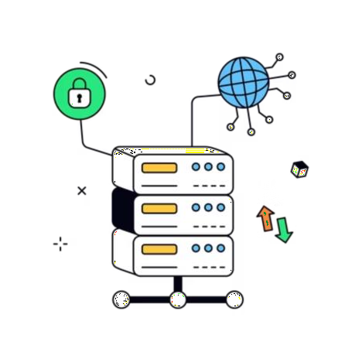
Data Sovereignty in Everyday Life: Who Controls Our Data, Platforms and Digital Identity.
KEYNOTE ADDRESS ·
Abdikarim Abdullahi Osman
Sernior Network Engineer
Dalkom Somalia

Slide 3
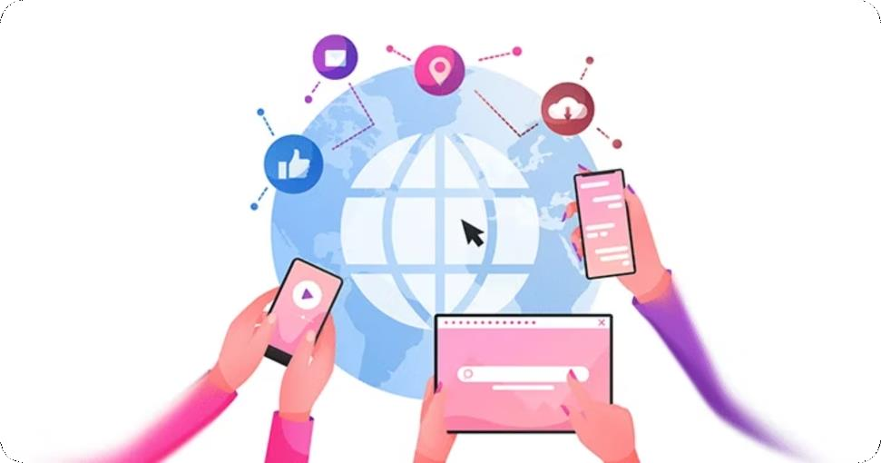
What Is Data Sovereignty — and Why Does Somalia Need It?
Data sovereignty means Somalia's citizens, businesses, and institutions retain legal and practical power to control, govern, and own their digital identity, data flows, and platform interactions - over data generated within its borders.
Without it, sensitive information flows to foreign jurisdictions — beyond Somali law, beyond Somali protection.
National Security
Protects critical infrastructure and citizen data from foreign exploitation
Economic Independence
Enables Somalia to negotiate digital trade on its own terms
Citizen Trust
Builds confidence in Somalia's growing digital economy

Slide 4
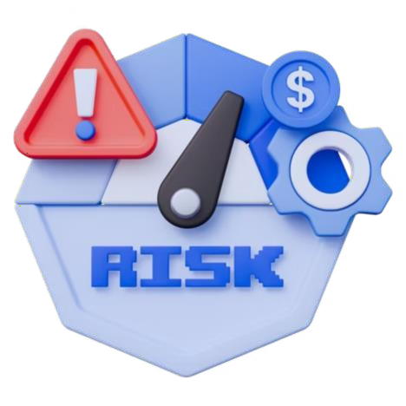
3 Major Risks of Unsovereign Data
THE STAKES
Foreign Surveillance & Exploitation
Somali citizen data stored abroad is subject to foreign intelligence laws — no Somali legal recourse exists.
Regulatory & Financial Penalties
Non-compliance with international data standards blocks global partnerships and triggers costly sanctions.
Loss of Digital Governance Control
Without sovereign data frameworks, Somalia cannot enforce its own digital policies or protect public registries.

Slide 5
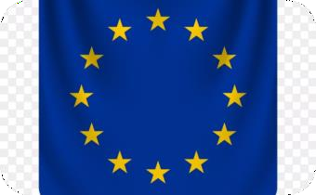
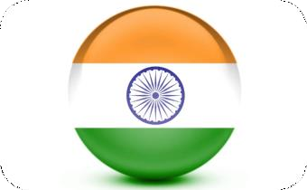
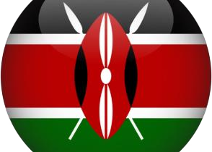
Data Sovereignty in Action: 3 Global Case Studies
GLOBAL CONTEXT
EU — GDPR Enforcement (2024)
Meta fined €1.2B for transferring EU user data to the US
— proving sovereignty has real financial consequences.
India — Data Localization Law (2023)
India mandated in-country storage of all financial and personal data, forcing global tech giants to build local infrastructure.
Kenya — Data Protection Act (2023)
Kenya's ODPC enforced cross-border transfer restrictions, setting the regional benchmark for East African data governance.

Slide 6
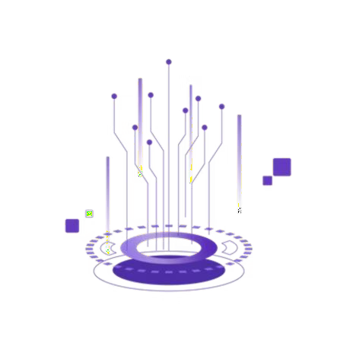



Telecommunications: Lead With Trust
SECTOR VALUE · TELECOM
Risk Minimization
Registered operators gain legal clarity on data handling, reducing liability exposure and
regulatory uncertainty.
Seamless National
Routing
DPA compliance enables standardized transit routing across Somalia's telecom ecosystem — cleaner, faster, more reliable.
International Roaming Trust
Registered carriers earn recognition from global roaming partners, unlocking better interconnect agreements and revenue.

Slide 7

Private Business: Unlock Global Confidence
SECTOR VALUE · BUSINESS
For FinTech, banking, and logistics
— DPA registration is your passport to global markets. It signals to international investors and partners that your data practices meet world-class standards.
Consumer Confidence
Customers choose businesses they trust with their data
GDPR Alignment
Registration mirrors international data protection frameworks
Investment Readiness
Global VCs and partners require compliance proof before
engagement

Slide 8
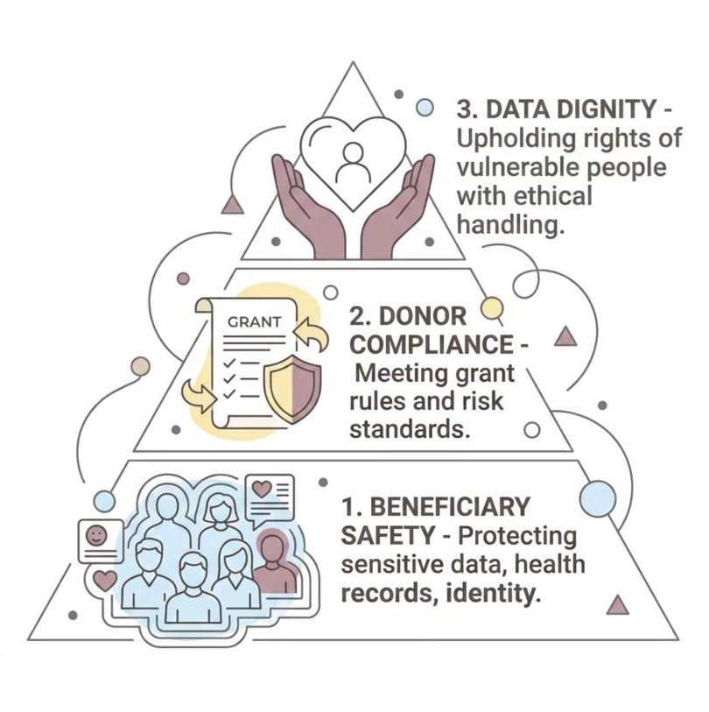
NGOs: Protect Those You Serve
SECTOR VALUE · NGOS
Beneficiary Safety First
Humanitarian data — health records, displacement status, identity — demands the highest protection. DPA
registration formalizes that commitment.
Donor Compliance Made Simple
International donors increasingly require data governance frameworks. Registration satisfies due-diligence requirements and strengthens grant applications.
DPA registration demonstrates advanced risk management — a competitive advantage in donor reporting.

Slide 9
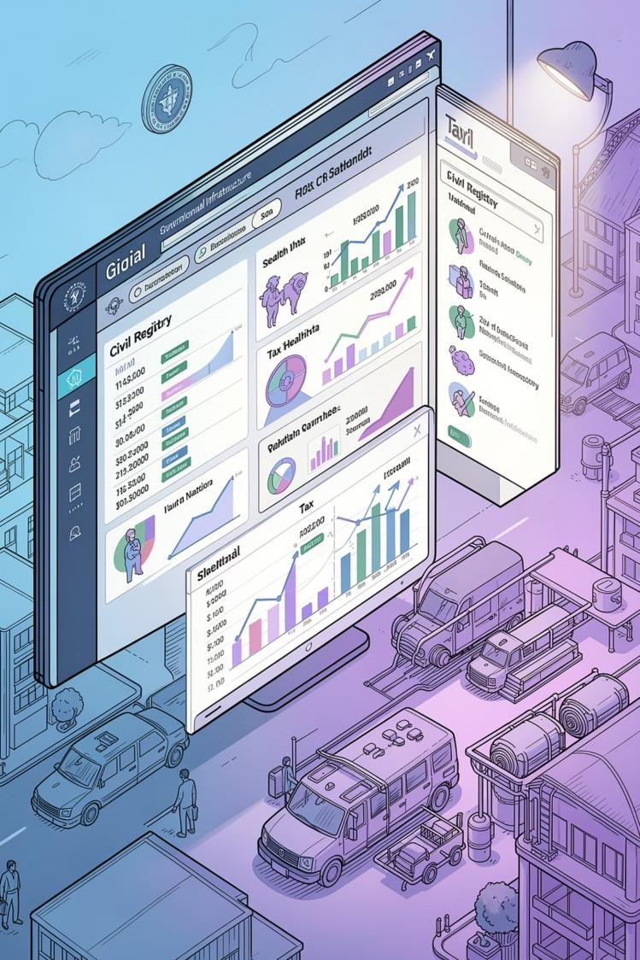

Government: Sovereign Digital Governance
SECTOR VALUE · GOVERNMENT
Civil Registry Security
Protect national identity, tax, and health databases under Somali jurisdiction — not foreign servers.
Territorial System Control
Sovereign data frameworks ensure all government digital systems remain under Somali law and oversight.
International Recognition
A registered data governance framework positions Somalia as a credible digital partner on the world stage.

Slide 10
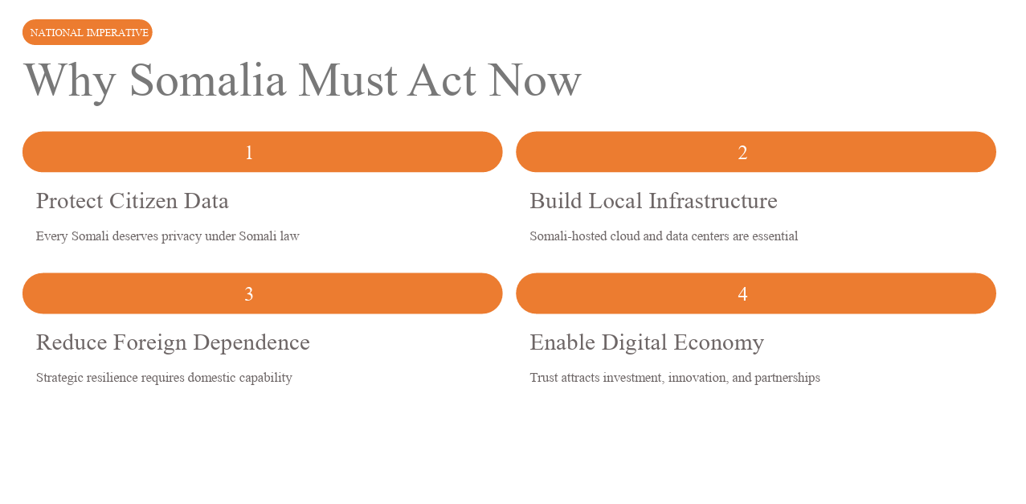

Slide 11
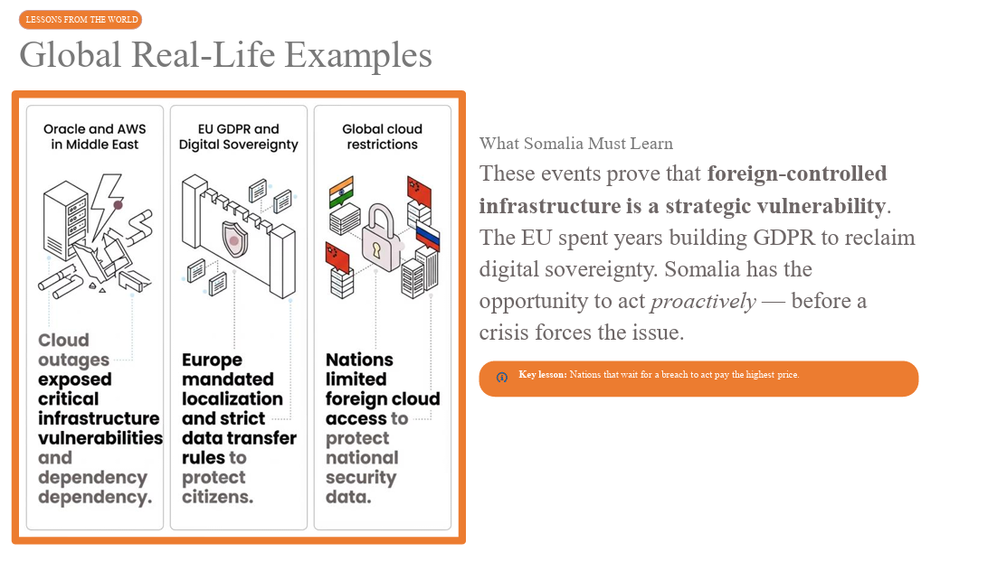

Slide 12
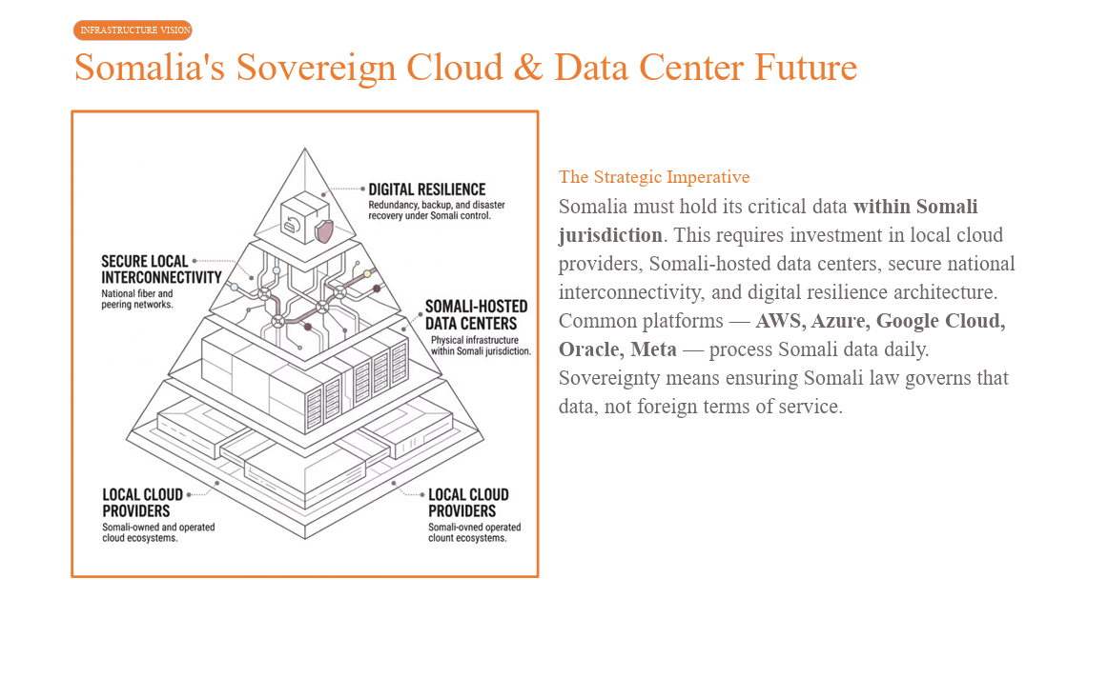

Slide 13
"Somalia's data belongs to Somalia”

