Slide 1
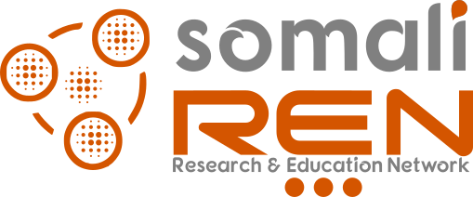

Identity Federation and eduGAIN
SomaliREN Identity Federation (SIF)

Slide 2

Introduction
In today's interconnected world, where collaboration and access to resources across institutions and borders are crucial, Identity Federations and eduGAIN play a vital role in enabling seamless and secure authentication and authorization for users in the research and education communities.
Identity Federations provide a framework for federated identity management, allowing users to access various services and resources using a single set of credentials. By establishing trust networks among institutions, Identity Federations simplify the process of collaboration and resource sharing.

Slide 3

eduGAIN
eduGAIN, on the other hand, takes this concept a step further by connecting national and regional identity federations globally. It creates a global interfederation service, enabling users to access resources beyond their home federation. This global reach enhances the collaboration potential and provides users with a broader range of services and resources.
Identity Federations are trusted networks that enable secure authentication and authorization for users across multiple institutions.

Slide 4
SAML-based Federations
In the context of SAML-based federations, there are the following technical components:
  Identity Provider (IdP): The system component that authenticates a user (e.g. with username and passwords) and issues identity assertions on behalf of the user who wants to access a service protected by a Service Provider.
  Service Provider (SP): The system component that evaluates identity assertions from an Identity Provider and uses the information from the assertion for controlling access to protected services.
  Discovery Service(DS): The Discovery Service service, also known as "Where Are You From (WAYF)" service, lets the user choose his/her home institution from a list and then redirects the user to the login page of the selected institution for authentication.

Slide 5
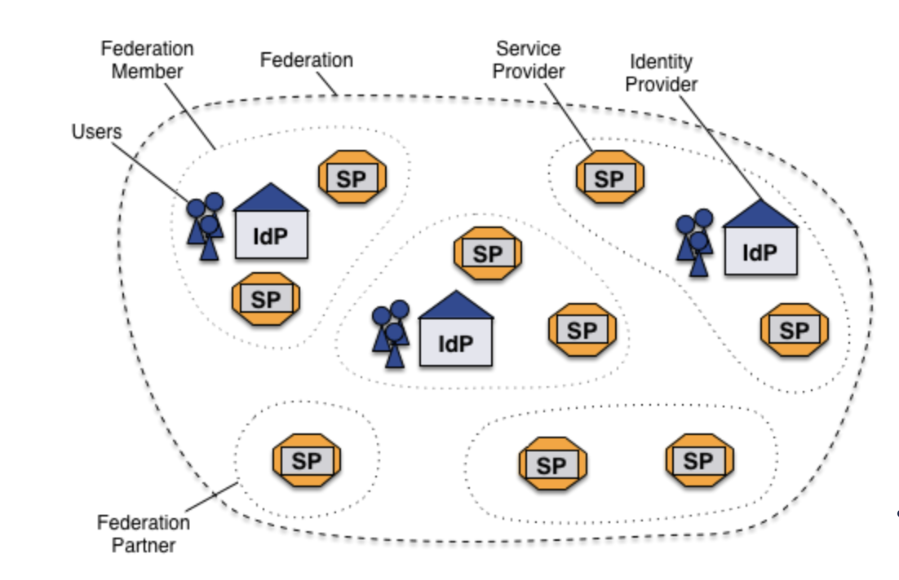
eduGAIN

Slide 6

Benefits of Identity Federations
Enhanced Collaboration: Identity Federations simplify the process of accessing resources and collaborating with colleagues from different institutions, fostering seamless collaboration and knowledge exchange.
Single Sign-On (SSO): Users can access multiple services with a single set of login credentials, eliminating the need to remember multiple usernames and passwords.
Privacy and Security: Identity Federations employ strong authentication mechanisms, ensuring secure access to resources while safeguarding user privacy.

Slide 7
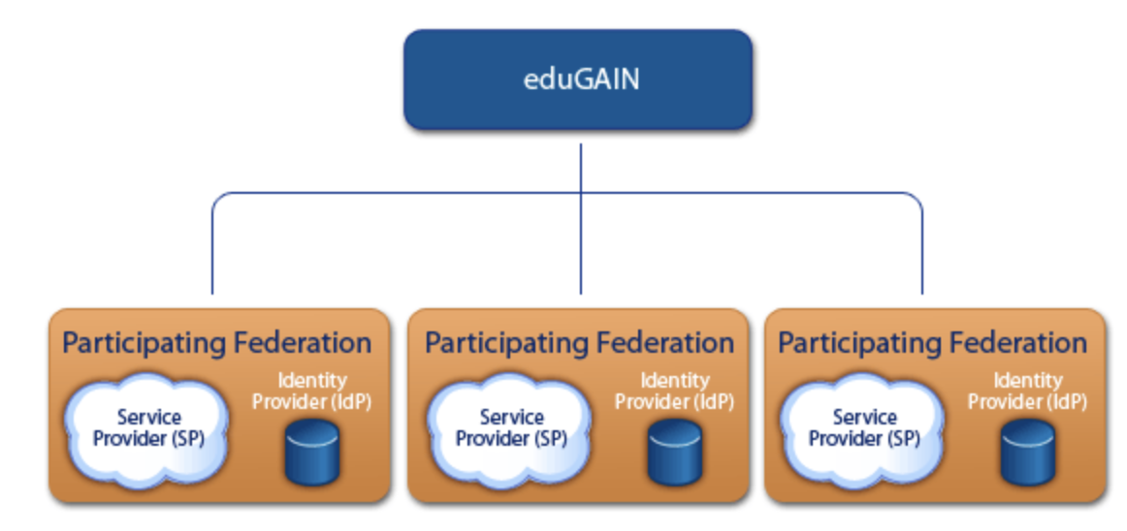
SomaliREN Identity Federation (SIF)
SIF is a participant in eduGAIN, which allows SomaliREN users to access resources and services offered by other federations worldwide

Slide 8
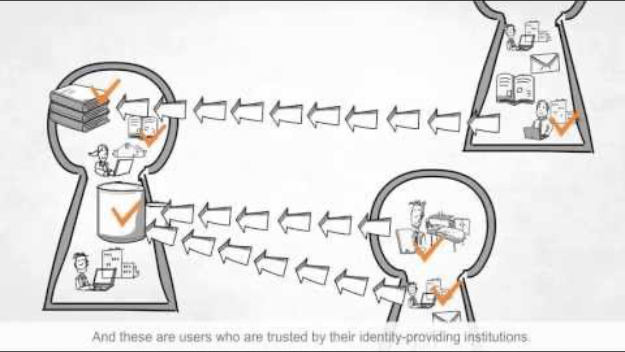
How eduGAIN works?

Slide 9
eduroam
Mastering SomaliREN Services

Slide 10
eduroam
eduroam (education roaming) is a global Wi-Fi service that provides secure and seamless network access for members of the research and education communities.
It allows users from participating institutions to securely connect to Wi-Fi networks when visiting other participating institutions.

Slide 11
How Does eduroam Work?
Authentication: Users authenticate using their home institution's credentials, providing a secure and familiar login experience.
Roaming: Once authenticated, users can automatically connect to eduroam Wi-Fi networks at other participating institutions without additional login steps.
Federated Trust: eduroam uses federated identity management, ensuring secure and seamless access while protecting user privacy.

Slide 12

Benefits of eduroam
Global Connectivity: eduroam provides users with Wi-Fi access at thousands of participating institutions worldwide, enabling seamless collaboration, research, and education wherever they go.
Convenience: With eduroam, users only need to configure their devices once at their home institution, and they can connect to Wi-Fi networks at other eduroam-enabled institutions without further configuration.
Security: eduroam utilizes strong encryption and authentication protocols, ensuring a secure connection and protecting sensitive information.

Slide 13
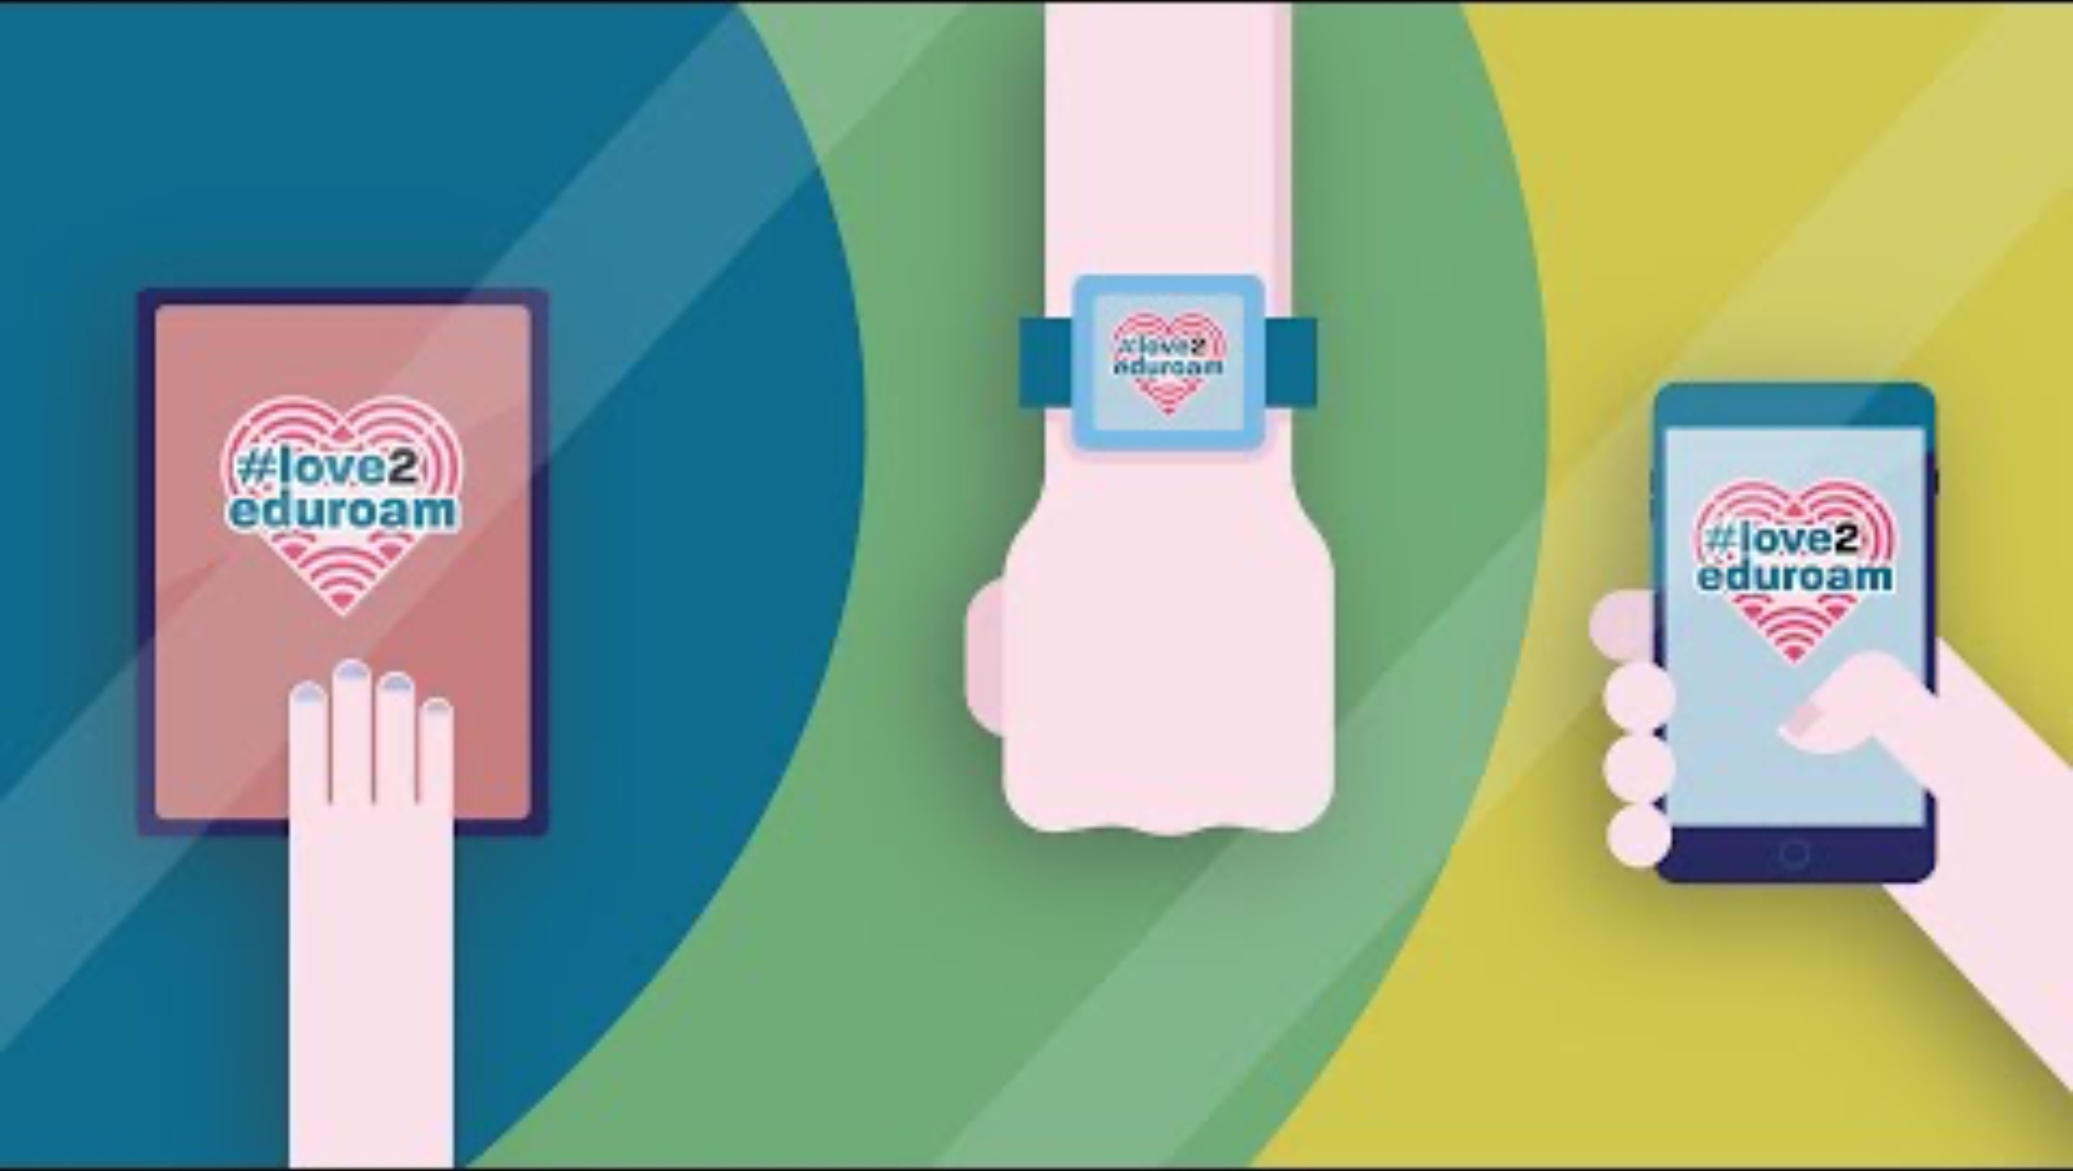
How eduroam works?

Slide 14

Q&A

