Slide 1
Library Resources and Services
Mohamud Mohamed Siad

Slide 2
Table
Of Content
01
.
What is a library?
05
.
How to locate books and other valuable materials in the library?
02
.
How important is a library?
03
How librarians help information seekers find resources in the library ( thru ILP & Info desk)
.
Types of libraries
06
.
04
.
What Information resources and services found in university libraries?
07
Practical exercise in locating resources in a university library
.

Slide 3
Objectives
To provide students with sufficient knowledge on finding information resources in preparation for their research assignments, exams, projects and presentations.

Slide 4
Definitions
A library is a building or room containing an organized collections of books, periodicals, and sometimes films and recorded music made accessible to a defined community to read, borrow, or refer to.
In other words, Libraries are technologies developed to handle information storage and retrieval and have long played an essential role in containing, preserving, and sharing for information
Libraries are service organizations.

Slide 5
Importance
During the course of studies, it is insufficient to rely solely on handouts or notes your lecturers provide.
So, you will probably need to find more information on notes from other sources to complement your lecture notes.
One good place to start with is the LIBRARY which houses a wealthy of information. The library will be invaluable resources during anybody’s studies
A good library is however immensely important:
To built a nation.
To help in research work.
To help in personality development.
To conservation of knowledge & ideas.
To help in self studies.
To increase the knowledge.

Slide 6
Library
Quotes
It often requires more courage to read some books than it does to fight a battle.
A house without books is like a room without windows. No man has a right to bring up children without surrounding them with books.... Children learn to read being in the presence of books.
- Sutton Elbert GRIGGS (1872-1930)
-Horace MANN
(1796-1859)

Slide 7
Types of
Libraries
1.
3.
Public library
School library
2.
4.
Special library
Academic library

Slide 8
Public
libraries
serve communities of all sizes and types.
Wherever you live, there's bound to be a local public library nearby!
As the name implies, public libraries serve the general public, "from cradle to grave" as more than one public librarian has been heard to say.
Public libraries often have departments that focus on areas of service, such as youth, teens and adults.

Slide 9
Special
libraries
Offer unique opportunities to work in a specialized environment of interest, such as corporations, hospitals, the military, museums, private businesses, and the government.
Special libraries can serve particular populations, such as the blind and physically handicapped, while others are dedicated to special collections, such as the Library of Congress or a presidential library.

Slide 10
School
libraries
Are usually part of a school system, and serve students between Kindergarten and grade 12.
Many are called media centers, and librarians are often required to have a second degree in education or a certificate in school media.

Slide 11
Academic
libraries
Serve colleges and universities, their students, staff and faculty.
Larger institutions may have several libraries on their campuses dedicated to serving particular schools such as law and science libraries.
Many academic librarians become specialists in an area of knowledge and can have faculty status.

Slide 12
Library Information Resources
The SU library has over 20 thousand titles which cover disciplines in accordance with the academic programs of the university.
The resources in SU library are available in both print and online formats with print formats dominating the bigger percentage.

Slide 13
THE LIBRARY
COLLECTIONS
Library collections may consist of several groups depending on patrons’ needs such as General Collection, Reference Collection, Controlled Access Collection, Serials Collection, Special Collection, Law Collection, Multimedia Collection, Electronic Collection, and Light Reading Collection

Slide 14
General
COLLECTION
SU Library materials from the General Collection make up the major portion of the library’s collection.
This collection comprises of monographic texts and additional reading covering all the disciplines of the University’s academic and research programs.

Slide 15
Reference
COLLECTION
As the name refers, users can only refer to this reference collection within the library.It is not a borrowable collection.
They comprise of: Dictionaries, Encyclopedias, Directories, Biographies, Numerical data compilations, Handbooks, Manuals, Bibliographies, Yearbooks, Gazetteers, Atlases, Indexes, and Abstracts.

Slide 16
Serials
COLLECTION
This collection may contain titles in various subjects. Items in the Serials Collection are usually available in variety of formats: loose-journals, bounded journals, online databases and electronic journals.
However, SU library has very few titles of printed journals, reports, yearbooks, directories and etc. all printed materials are for Reference only (non-circulated). Both current and back volumes of journals are placed together on the open shelves.

Slide 17
Law
COLLECTION
This collection comprises: Statute, Report, Journals, Law Books, and Seminar papers and etc.
Services include literature and case searching. The collection is managed by capable library staffs who also offer services like literature and case searching.

Slide 18
Multmedia
COLLECTION
This section holds a range of non-print materials in the form of: Audio and Video cassettes, Microfilms, Microfiche, CDs, Slides, Transparencies, and Kits.
Note: There is no multimedia service as such currently in provision

Slide 19
Electronic
COLLECTION
Electronic resources refer to any source of information that can only be accessed or used via a stand-alone personal computer, the network or the internet.
Materials in this category include: CD-ROMs, e-journals, Website, In-house Databases., Online Databases, and Digital Library Services.
Users can have full access to standalone CD-ROMs, In-House databases and digital library services via specified workstations in the library.
On the other hand, those accessible through the internet can be accessed remotely from within and outside the University's campus.

Slide 20
Light Reading
COLLECTION
Materials in this section comprise of light reading materials covering: Fiction, Bestsellers Motivation, Hobbies, Crafts and the like. The loan privilege for these materials is the same as the general collection.

Slide 21
Library Information Services
There are sets of services related activities provided by academic library which include:

Slide 22
Loans/Borrowing
Return, Overdue/Late Return fines/Penalty
All registered members are allowed to borrow library materials according to their eligibility. Loan eligibility and borrowing period differ according to the borrower types.
Library users are expected to return library books before or on the due date, after which an overdue fine will be imposed.
The user will not be allowed to borrow any library materials until the fine is paid.
This is done to encourage users to return books on time and to give others fair opportunity to borrow the books. Payment is to be made at the Circulation counter.
Renewal
Loans renewal can only be done or negotiated If the loan period is not yet due

Slide 23
Reservation/Hold
Book Security System
A user may reserve a book which is out on loan to ensure that he/ she gets the item when it is returned.
A notice will be sent to the requestor informing him/her to claim the reserved book when it is available.
The book will be kept (on hold) at the Circulation Counter for 7 days only after which it will be returned to the shelves.
The system of one-entry one-exit together with electronic sensing of books at the exit point, ensures that only materials that have been systematically borrowed can be brought out of the Library Building.
A warning bell is triggered if a material that has not been officially borrowed is brought through the exit.

Slide 24
INTER-LIBRARY LOAN (ILL) AND DOCUMENT DELIVERY SERVICES (DDS)
The library can obtain materials which are not in its collection from other libraries, inside and outside the country.
The library offers ILL and Document Delivery services to facilitate library users as well as member libraries.
Some materials especially articles which are not available locally may be obtained from overseas. The service may be charged for where necessary.

Slide 25
INFORMATION
SERVICES
Academic libraries provide information services such as:
Reference Enquiry
Literature Search
Searching Assistance
Information Desks are available at the different levels ( 1& 2) of the library which are manned by trained staff to assist library customers. Liaison librarians also entertain walk-in enquiries at their offices.
The library subscribes to a number of online databases which carry indexes, abstracts or full text articles on various subjects to facilitate literature searching activities.
These databases are accessible from the public workstations.
Customers can make a request for searching assistance at the Circulation counter if the books needed are not available on the shelves by completing the Request for Searching Assistance Form.
Library staff will then search for the books and results of searches are displayed on the notice board.

Slide 26
Digital Library
Services
Customer can access a variety of digital resources through the Digital Library services - examination papers, thesis, Islamic Economics, Islamic Law, contents pages, videos, online databases and e-books.
These resources which are accessible remotely significantly complements information available in print format.

Slide 27
Exhibitions
Library Orientation
To update library users on specific information, an academic Library organizes regular exhibitions which focuses on specific themes and other current topics of interest.
The library orientation programmes help to familiarize new students with the services and facilities available in the library.
These are usually conducted at the beginning of each new semester.
USER EDUCATION
Information Literacy Workshop
The library also provides a variety of user education programmes to enable users to utilize the library to its maximum potential.
The programmes educate the users on the techniques of searching for information from abstracts, indexes, databases and other information sources.
User education and Information Literacy Courses are courses offered to the library customers as an attempt to provide quality services and provide the latest information on the library to assist customers in information seeking and researches.

Slide 28
Objectives of the
IL course
01.
To introduce the services, collection and facilities to the Library customers
To enable the customers to identify and access various information resources, printed and electronic, for their information search.
To enable the customers to understand how to use strategic searching skills in information searching
To develop lifelong culture among the library customers.
02.
03.
04.

Slide 29
Internet powered
PC reservation
To assist the information and research needs of the library users, the library provides every registered customer a PC reservation of two hrs. daily in the library.

Slide 30
LIBRARY
FACILITIES
Reader Advisory/Information Desk
STUDY ROOMS
Research Room
Discussion Room
These rooms are available for students in thesis writing. There are 2 types of carrel room: Monthly and Three Hourly.
Loans can only be extended if the room is not reserved by others.
In order to maintain fair distributions of carrel room services, any late returns of keys will be fined per day.
These rooms can only be used by a group of not less than three (3) users and not more than six(6), eight(8) or sixteen(16) depending on the size of the room.
Prior booking is necessary as the number of rooms is limited and can be borrowed for three hours only and will be extended if it is not reserved by others.
Reader advisory/Information Desks is usually available at level 1 & 2 of the library.
Manned by trained staff to assist library customer, Liaison librarians also entertain walk-in enquiries at their offices.
These rooms are available for academic staff only. Booking is limited to the research period and can be extended if it is not reserved by others.

Slide 31
LIBRARY
FACILITIES...
Other facilities
Reading Areas
Computer Facilities/ Computer Labs
Internet Workstations
OPAC Thin Client
Wireless Facility
Viewing And Listening Stations
Auditorium And Multipurpose Room

Slide 32
Library Classification
Structure and Systems
Two types of Library classification
Library of Congress Classification sys
Used by Public libraries
Dewey decimal classification Sys.
Used by Academic / University libraries

Slide 33
Library Classification (Cont.)
LCC
21 classes using letters
A General works
B Philosophy. Religion
C History: Aux. sciences
D World history and history of Europe, Asia, Africa, etc.
E-F History of the Americas
G Geography. Anthropology. Recreation
H Social sciences
J Political science
K Law
L Education
M Music
N Fine Arts
P Language and literature
Q Science
R Medicine
S Agriculture
T Technology
U Military science
V Naval science
Z Bibliography.
Library science. Info resources

Slide 34
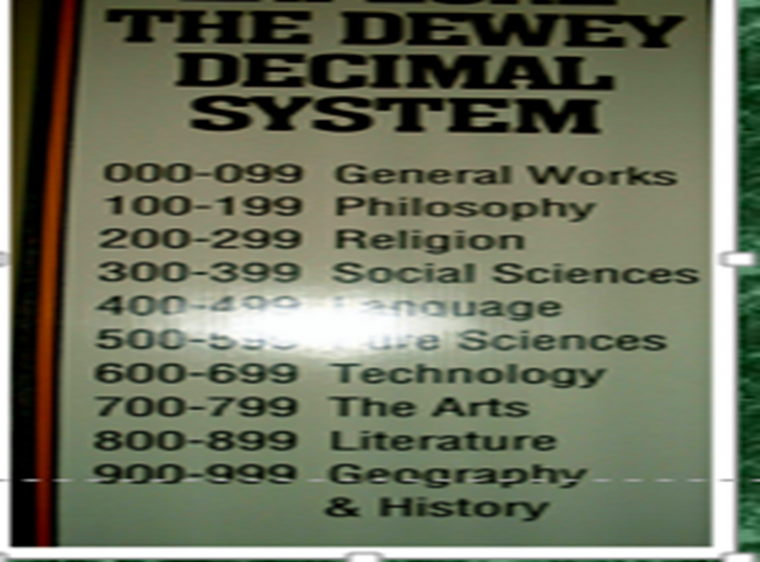
Library Classification (Cont.)
DDC

Slide 35
Library Classification Structure and Systems
Terminologies
Classification - a system of coding and organizing library materials according to their subject and assigning a call number to that information resource.
Classification schedule - A printed volume or machine-readable database that contains classification numbers and captions, arranged by subject in a logical, hierarchical manner; also called classification scheme.

Slide 36
Library Classification Structure and Systems
Terminologies
Call number – an alphanumeric designation that uniquely identifies a bibliographic item.
The call number is printed on a label affixed to a bibliographic item so that the item can be shelved and found.

Slide 37
Library Classification Structure and Systems
Terminologies
More on Call Numbers
Consists of class number (also called classification number) and a book number (also called a Cutter number)
Class number à subject of the work
Book number organizes works within a class
May also include other information (notably a date)

Slide 38
Librarian`s
Help
Librarians help their students through the following 4 programs:
Library briefing & orientations
Basic library skills
Library research skills
Internet navigation skills for specific purpose
Librarians also help their students through face to face by the reference librarian on duty

Slide 39
Thank You
for Listening

