Slide 1
Qatar National Library https://www.youtube.com/watch?v=-EK4bjKxK2Q https://www.qnl.qa/en/about/qnl-brochures 3 in 1

Slide 2
National Library
Objective
Function
Collections
Departments/Divisions/service lines
Services
Staff qualification

Slide 3
Objectives & Functions
National Library is a library specifically established by a government of a country to serve as the preeminent repository of information for that country
A national library is that library which has the duty of collecting and preserving the heritage and the literature of the nation within and outside the country.
Unlike public libraries, these rarely allow citizens to borrow books.

Slide 4
Collections (National Library)
General collections or Monographs
Special collection
Serials and annual reports
Newspapers
Stamps
Manuscripts and private archives
Posters and photographs
Maps
Audiovisual materials ( video and audiotapes, CDs, VCDs, DVDs and CD ROMs)

Slide 5
Cont...
Anglo-American Cataloguing Rules (AACR2) or (RDA in this modern time)
Dewey Decimal Classification (DDC) and Library of Congress Subject Headings (LCSH).
Users can search bibliographical information of these materials on the National Library Online Pubic Access Catalogue (OPAC).

Slide 6
Collections (Academic library)
General collections or Monographs
Reference Collection,
Controlled Access Collection,
Serials Collection,
Special Collection
Multimedia Collection,
Electronic Collection,
and Light Reading Collection

Slide 7
Collections (National Library) “people’s University”
Country Books and documents or e-resources
National heritage collection
Periodicals /Serials Collection (including news papers)
Multimedia /Audiovisual Material Collection,
Regional collections
Digital collection
Rare materials
Legal deposits ( books, periodicals, and e-resources)
https://www.youtube.com/watch?time_continue=216&v=JZtJMbRtG4s&feature=emb_logo

Slide 8
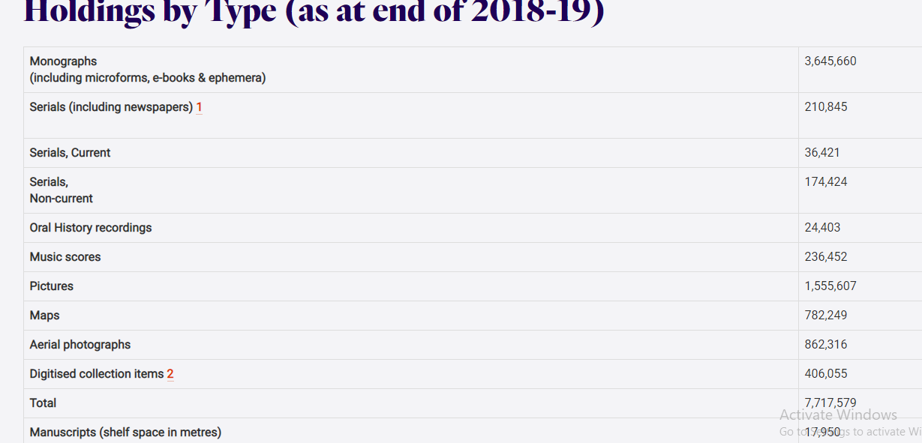
Cont. Page Collections
https://web.nli.org.il/sites/nli/English/collections/Pages/default.aspx
https://www.nla.gov.au/collections

Slide 9
Departments
Planning, Research & Statistics Department (PRSD)
Collection Development and Technical Services Department (CDTSD)
Legal Deposit Department (LDD)
Virtual Library Service Department (VLSD)
Public Services Department (PSD)
International Standards and Programmes Department
https://www.nln.gov.ng/open-dept?pgid=CDTSD

Slide 10
Services
Legal Deposits
Bibliographic Control Services
Court Subpoena and Summons
Issuance of ISBN, ISSN, ISMN
Production of National Bibliography of Somalia (NBS)
To Establish and maintain a Branch of the National Library of Somalia in each state
Readership Promotion Campaign (RPC)
Book Gifts and Exchanges
Virtual Library Services – ICT, Content Development, Internet Services

Slide 11
Services…
Provision of Reference and Document Delivery Services
Publication of Catalogues, Classification tools, indexes and Seminar Research Aids
Maintenance of Cataloguing Standards
E-Resources – i.e EBSCO
Promotion of Research in the field of Library and Information Science
Library Development, Consultancy and Technical Services
Exhibitions and Displays
To Develop, Maintain and sustain the ONLINE NATIONAL UNION CATALOGUE (ONUC) and ONLINE PUBLIC ACCESS CATALOGUE (OPAC)

Slide 12
Staff qualification
https://www.thebalancecareers.com/library-careers-525868#librarians

Slide 13
National library as a National Pride and integrity
https://www.youtube.com/watch?v=mLCVQ2XIW_s
https://www.youtube.com/watch?v=eDn1CWn3RRA
https://www.youtube.com/watch?v=xHJpynvNYkU
https://www.youtube.com/watch?v=fP1idRZs_w4

Slide 14
Thank You
for Listening

