Slide 1
Introduction to Open Science
A high-level view on global Open Science movements and key terms
Library Management and Open Science Workshop,
14-16 February 2023, Mogadishu, Somalia

Slide 2
Outline
Introduction
Open Science Concept
Global Trends in Open Science
Open Science Movements and Principles
Some of the Open Science Initiatives and Projects
Future of Open Science
FAIR and Plan S Requirements
Open Access Rights and Principles

Slide 3
Introduction
General Definition:
Open Science is a movement aimed at making scientific research and data more transparent, accessible, and collaborative.
Open Science has significant implications for higher education institutions, including the potential to increase the impact and visibility of research, promote collaboration and innovation, and improve the reproducibility and reliability of scientific findings.

Slide 4
UNESCO Open Science Definition
UNESCO – “A new paradigm of transparent and collaborative research practices based on sharing and collaboration between researchers, institutions, and society.”

Slide 5
Open Science Movements – Key principles
Open Access Publishing: To make research publications freely and openly accessible to anyone, regardless of their financial or institutional resources.
Open Data: Sharing of research data in a way that is transparent and accessible to others.
Open Research Methods: The importance of transparent and replicable research methods.
Open Peer Review: Allowing for more collaboration and input from the scientific community.
Open Collaborative Research: Encourages the development of open scientific communities. Promotes collaboration and knowledge sharing among scientists,

Slide 6
Global Trends in Open Science
Increased adoption of open-access publishing: As of February 2022, there are over 16,000 journals indexed (DOAJ).
The number of articles available in open-access repositories is over 200 million.
Growing emphasis on research data management: 70% of researchers agreed the importance of data sharing for the future of research, and 60% made their data openly available (Source: SPRINGER Nature 2020 report).

Slide 7
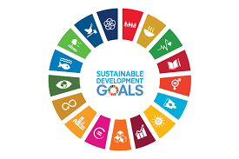
Some of the initiatives/projects that promote the use of Open Science movements.

Slide 8
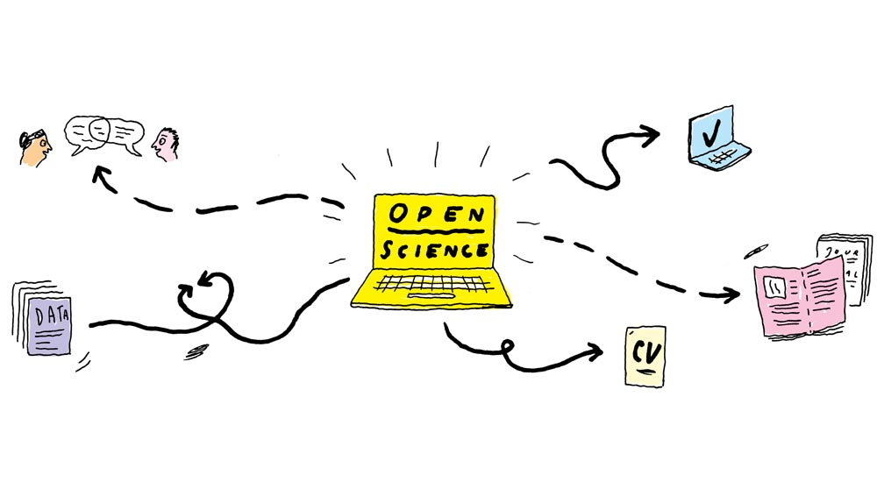
Future of Open Science
Increasing adoption: By 2026, the global open access market is expected to reach $6.78 billion, up from $3.5 billion in 2017
New technologies and tools: The use of artificial intelligence and machine learning is expected to play an increasingly important role in Open Science research.
Increased collaboration and partnerships: increased collaboration and partnerships between institutions, researchers, and other stakeholders.

Slide 9
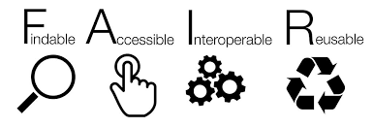
FAIR Principles and Plan S requirements
FAIR Principles: FAIR (Findable, Accessible, Interoperable, Reusable) principles are a set of guidelines that aim to improve the findability, accessibility, and reuse of research data.
Plan S: Plan S is a global initiative that aims to make all research publications from publicly funded research freely available and accessible by 2025.

Slide 10
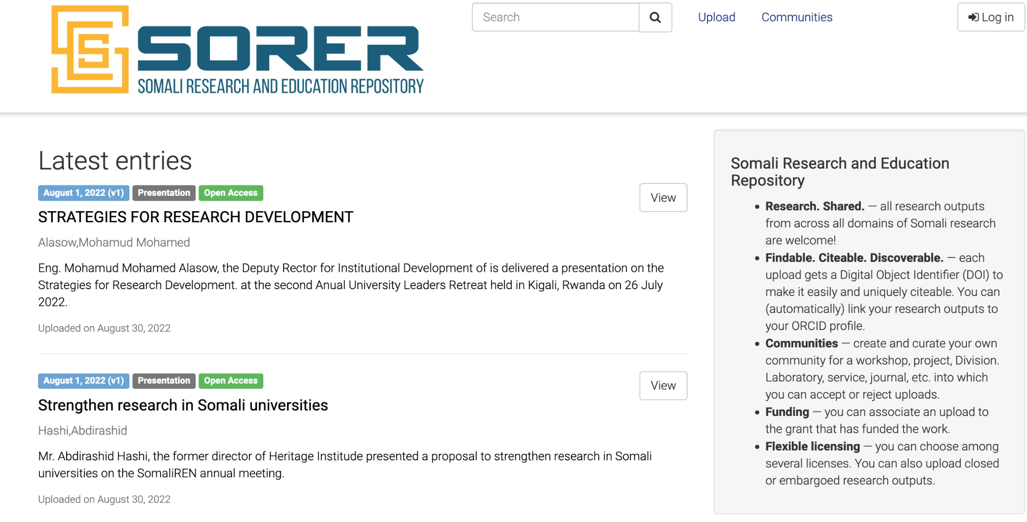
Example of FAIR and Plan S requirements Research Database

Slide 11
Open Access Rights and Licenses.
Open Access Rights and Licenses - promote the free and unrestricted access to research publications, enabling wider dissemination of research findings, and leading to increased impact and citation rates.
Creative Commons Attribution (CC BY) - It allows others to share and adapt the work, as long as they give appropriate credit, making research publications widely available and promoting the open sharing of knowledge.

Slide 12
Thank you

