Slide 1
Cyber Security Career Opportunities
Cyber Security Training Workshop

Slide 2
introduction
Cybersecurity professionals are in demand. According to a study by the cybersecurity professional organization (ISC), there are some 3.1 million unfilled positions worldwide.
Working in the cybersecurity field also gives you the chance to work in a fast-paced environment where you continually learn and grow.
Cybersecurity might be worth considering if you’re already in the world of Information Technology (IT) or looking to make a career switch.
We will look at some of the many roles available to cybersecurity professionals. We’ll also discuss how to get started in cybersecurity and what your career path might look like.

Slide 3
entry-level cybersecurity jobs
For some roles, the National Security Agency (NSA) defines entry-level as requiring a bachelor’s degree plus up to three years of relevant experience—less with higher-level degrees.
Most cybersecurity professionals enter the field after gaining experience in an entry-level IT role. Here are a few of the most common entry-level jobs within the bigger world of cybersecurity.

Slide 4
entry-level cybersecurity jobs
Information Security Analyst (Average salary: $89,795)
Feeder role: Network or systems administrator
As an information security analyst, you help protect an organization’s computer networks and systems by:
Monitoring networks for security breaches
Investigating, documenting, and reporting security breaches
Researching IT security trends
Helping computer users with security products and procedures
Developing strategies to help their organization remain secure.

Slide 5
entry-level cybersecurity jobs
Information Security Analyst
Common Certifications:
CompTIA Security+,
GIAC Certified Intrusion Analyst (GCIA),
GIAC Certified Incident Handler (GCIH)
Related job titles: Cybersecurity analyst, IT security analyst
Notes:
Global Information Assurance Certification (GIAC) is an information security certification entity that specializes in technical and practical certification as well as new research in the form of its GIAC Gold program.

Slide 6
entry-level cybersecurity jobs
Information Security Specialist (Average salary: $93,885)
Feeder role: Networking, IT support, systems engineering
In this role, you’re the company’s point person for security, ensuring that data remains secure against unauthorized access and cyberattacks. Responsibilities for security specialists vary from organization to organization but may include:
Testing and maintaining firewalls and antivirus software
Implementing security training
Researching new security risks
Suggesting improvements for security weaknesses

Slide 7
entry-level cybersecurity jobs
Information Security Specialist
Common certifications:
CompTIA Security+,
Systems Security Certified Practitioner (SSCP),
GIAC Security Essentials (GSEC)
Related job titles:
Cybersecurity Specialist,
Information Security Specialist

Slide 8
entry-level cybersecurity jobs
Digital Forensic Examiner (Average salary: $92,565)
Feeder role: IT Support, Risk Analyst
If you enjoy seeking clues to solve a puzzle, this role might be for you. Digital forensic investigators retrieve information from computers and other digital devices to discover how an unauthorized person accessed a system or to gather evidence for legal purposes. Day-to-day tasks might include:
Collecting, preserving, and analyzing digital evidence
Recovering data from erased or damaged hard drives
Documenting the data retrieval process and maintaining chain of custody
Assisting law enforcement in criminal investigations
Providing expert testimony in court proceedings

Slide 9
entry-level cybersecurity jobs
Digital forensic examiner
Common certifications:
GIAC Certified Forensic Analyst,
EnCase Certified Examiner (EnCE),
Access Data Certified Examiner (ACE)
Related job titles: Computer forensic specialist, cyber forensic specialist, digital forensics analyst

Slide 10
Moving up: mid-level and advanced cybersecurity jobs
Security Systems Administrator
Feeder role: Systems administrator, information security analyst
In this role, you’re typically put in charge of the day-to-day operations of an organization’s cybersecurity systems. Your responsibilities might include:
Monitoring systems and running regular backups
Managing individual user accounts
Developing and documenting security procedures for the organization
Collaborating with security teams to respond to unwanted intrusions
Participating in company-wide security audits

Slide 11
Moving up: mid-level and advanced cybersecurity jobs
Security Systems Administrator
Common certifications:
Certified Information Systems Security Professional (CISSP),
Certified Information Security Manager (CISM)
Related job titles: Security administrator, cybersecurity administrator, information security officer

Slide 12
Moving up: mid-level and advanced cybersecurity jobs
Penetration tester (Average salary: $97,383)
Feeder role: Information security analyst, incident responder
As a penetration tester (pen tester for short), you’ll help businesses identify their security weaknesses before malicious hackers can do the same. You do this by attempting to breach computer networks with the company’s permission. Tasks might include:
Planning, designing, and carrying out penetration tests
Creating reports on test results and offering recommendations to security decision-makers
Developing scripts to automate parts of the testing process
Conducting social engineering exercises (attempting to get company employees to disclose confidential information)
Providing technical support during incident handling

Slide 13
Moving up: mid-level and advanced cybersecurity jobs
Penetration Tester
Common certifications:
Certified Ethical Hacker (CEH),
CompTIA PenTest+,
GIAC Certified Penetration Tester (GPEN)
Related job titles: White Hat hacker, Ethical hacker, Vulnerability Assessor

Slide 14
Moving up: mid-level and advanced cybersecurity jobs
Other Cybersecurity jobs include:
Security Engineer (Average salary: $128,893)
Common certifications:
Certified Information Systems Security Professional (CISSP),
Certified Cloud Security Professional (CCSP)
Security Architect (Average salary: $195,333)
Common certifications:
Certified Information Systems Security Professional (CISSP),
Certified Information Security Manager (CISM),
CSA Certificate of Cloud Security Knowledge (CCSK)

Slide 15
How to get a job in cybersecurity?
While requirements for cybersecurity jobs vary widely from company to company, you might notice some common trends.
Let’s take a closer look at some of the requirements and how you can go about meeting them to get your first cybersecurity job.

Slide 16
Educational requirements
Many jobs in security list a bachelor’s degree in computer science, information technology, or a related field as a requirement. While degrees are common among professionals in the cybersecurity industry, they’re not always required.
Having a bachelor’s or master’s degree can often create more job opportunities, make you a more competitive candidate in the cybersecurity job market, or help you advance in your career.

Slide 17
Cybersecurity certifications
Typically, cybersecurity job postings may request at least one certification. You’ll find more than 300 different certifications, and the quality isn’t always the same.
If you’re new to cybersecurity, consider starting with a more foundational certification, like the CompTIA Security+. From there, you can begin gaining the necessary work experience to earn more advanced certifications.

Slide 18
In-demand cybersecurity skills
To prepare for a cybersecurity role, start building your technical and workplace skills through online courses, boot camps, or self-study. These skills are a good place to start:
Cloud Security
Programming (especially scripting) languages
Encryption
Risk assessment
Intrusion detection
Problem-solving
Analytical thinking

Slide 19
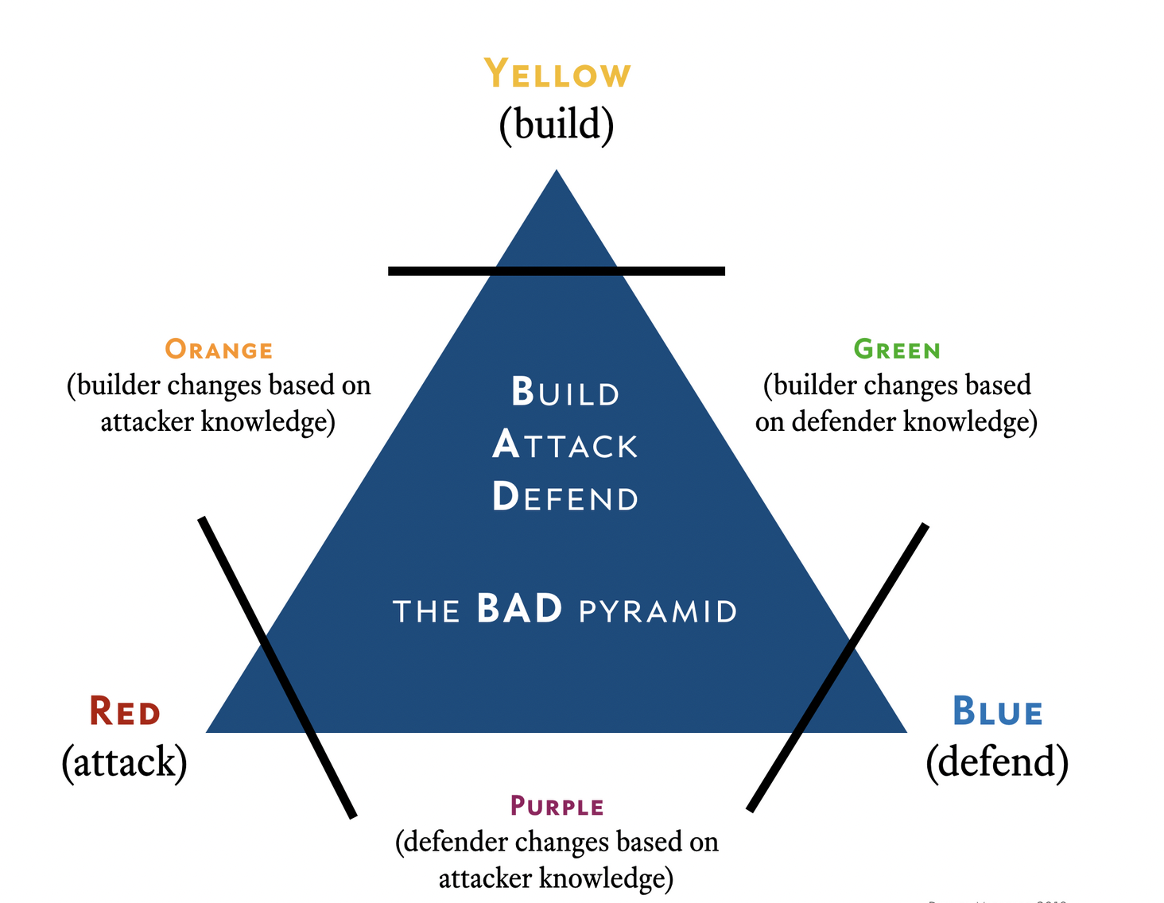
Red, Blue, and purple teams
Conducting Red team vs. Blue team exercises can be an eye-opening experience. Whether they're testing an organization's cybersecurity defenses against threats or assessing the talent of security team members, such simulated attacks can be beneficial for companies of all shapes and sizes.

Slide 20
Red, Blue, and purple teams
Red Teams are internal or external entities dedicated to testing the effectiveness of a security program by emulating the tools and techniques of likely attackers in the most realistic way possible. The practice is similar, but not identical to, Penetration Testing and involves the pursuit of one or more objectives—usually executed as a campaign.
Common red team techniques include:
penetration testing;
phishing, social engineering, and other forms of credential theft mechanisms;
port scanning; and
vulnerability scanning.

Slide 21
Red, Blue, and purple teams
Blue Teams refer to the internal security team that defends against both real attackers and Red Teams. Blue Teams should be distinguished from standard security teams in most organizations, as most security operations teams do not have a mentality of constant vigilance against attack, which is the mission and perspective of a true Blue Team.

Slide 22
Red, Blue, and purple teams
Purple Teams exist to ensure and maximize the effectiveness of the Red and Blue teams. They do this by integrating the defensive tactics and controls from the Blue Team with the threats and vulnerabilities found by the Red Team into a single narrative that maximizes both. Calling the purple team a "team" is a bit misleading. The purple team is, in fact, not a standalone team but a mix of blue and red team members.

Slide 23
Networking tips
When starting a new career path, it's helpful to network with industry professionals to learn more about the field and to create mutually beneficial relationships.

Slide 24
The end
Thank you for listening

