Slide 1
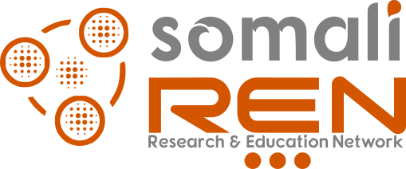
Understanding Cybersecurity
Cybersecurity Training Workshop

Slide 2
Training Content
What is Cybersecurity
CIA Triad
Five elements of AAA
Threat and Vulnerability
Risk Assessment
Cybersecurity Threats
Cryptography
Cybersecurity Career Opportunities

Slide 3
Objective of Training
To educate government’s MDA and private sector on the basics of cybersecurity
To identify cybersecurity needs of government institutions and private sector

Slide 4
What is Cybersecurity?
Cybersecurity is the practice of protecting systems, networks, and programs from digital attacks.
These cyberattacks are usually aimed at accessing, changing, or destroying sensitive information; extorting money from users via ransomware; or interrupting normal business processes.
In an organization, the people, processes, and technology must all complement one another to create an effective defense from cyber attacks.

Slide 5
What is Cybersecurity?
Cybersecurity is the protection of internet-connected systems such as hardware, software and data from cyberthreats.
The goal of a cybersecurity program is to understand, manage, and reduce the risk to information under the control of the organization.

Slide 6
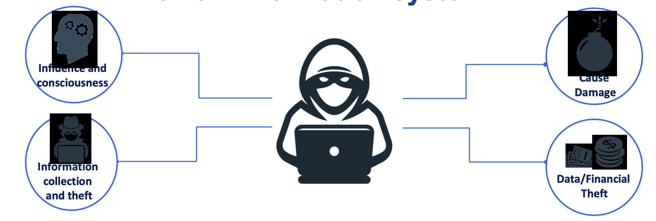
What is Cyber Attack?
To gain control without permission on an information system

Slide 8
What is your password?

Slide 9
NIST Framework
The NIST Cybersecurity Framework helps businesses of all sizes better understand, manage, and reduce their cybersecurity risk and protect their networks and data.

Slide 10
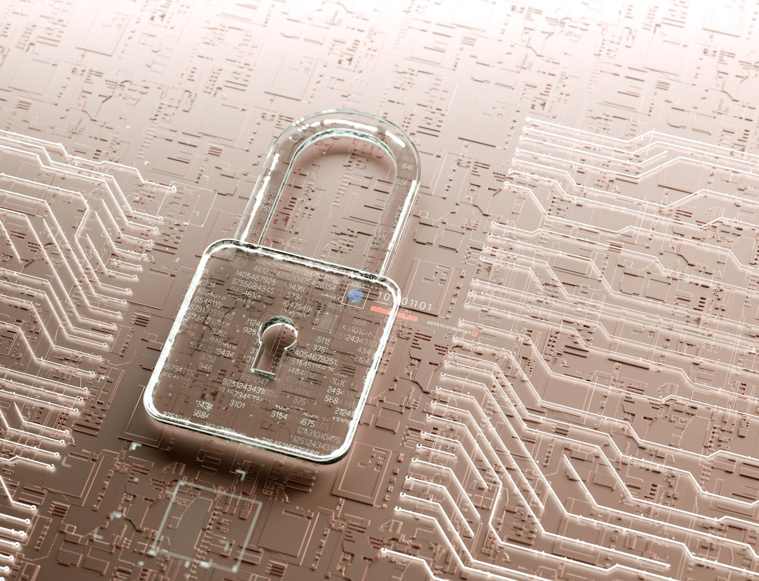
Why Cybersecurity is important
Security is important because it helps to ensure that an organization is able to continue to exist and operate in spite of any attempts to steal its data or compromise its physical or logical elements.

Slide 11
Elements of Cybersecurity
Application security
Information or data security
Network security
Disaster recovery/business continuity planning
Operational security
Cloud security
Critical infrastructure security
Physical security
End-user education

Slide 12
Understand and Apply Security Concepts

Slide 13
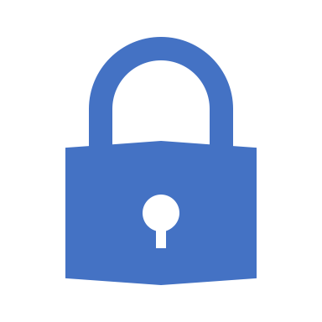
Confidentiality
Confidentiality is the concept of the measures used to ensure the protection of the secrecy of data, objects, or resources.
The goal of confidentiality protection is to prevent or minimize unauthorized access to data.
Confidentiality violations can result from the actions of an end user or a system administrator. They can also occur because of an oversight in a security policy or a misconfigured security control.

Slide 14
Confidentiality
Numerous countermeasures can help ensure confidentiality against possible threats. These include encryption, network traffic padding, strict access control, rigorous authentication procedures, data classification, and extensive personnel training
Violations of confidentiality are not limited to directed intentional attacks. Many instances of unauthorized disclosure of sensitive or confidential information are the result of human error, oversight, or ineptitude.

Slide 15
Integrity
Integrity is the concept of protecting the reliability and correctness of data
Integrity protection prevents unauthorized alterations of data
Preventing unauthorized subjects from making modifications
Preventing authorized subjects from making unauthorized modifications, such as mistakes
Maintaining the internal and external consistency of objects so that their data is a correct and true reflection of the real world and any relationship with any other object is valid, consistent, and verifiable

Slide 16
Integrity
For integrity to be maintained on a system, controls must be in place to restrict access to data, objects, and resources. Maintaining and validating object integrity across storage, transport, and processing requires numerous variations of controls and oversight.
Human error, oversight, or ineptitude accounts for many instances of unauthorized alteration of sensitive information. They can also occur because of an oversight in a security policy or a misconfigured security control.

Slide 17
Availability
Availability means authorized subjects are granted timely and uninterrupted access to objects.
Often, availability protection controls support sufficient bandwidth and timeliness of processing as deemed necessary by the organization or situation. Availability includes efficient uninterrupted access to objects and prevention of denial-of-service (DoS) attacks.
For availability to be maintained on a system, controls must be in place to ensure authorized access and an acceptable level of performance, to quickly handle interruptions, provide for redundancy, maintain reliable backups, and prevent data loss or destruction.
Notes:
Quiz note- If

Slide 18
Availability
There are numerous threats to availability. These include device failure, software errors, and environmental issues (heat, static electricity, flooding, power loss, and so on).
Numerous countermeasures can ensure availability against possible threats. These include designing intermediary delivery systems properly, using access controls effectively, monitoring performance and network traffic, using firewalls and routers to prevent DoS attacks, implementing redundancy for critical systems, and maintaining and testing backup systems.
Notes:
Quiz note- If

Slide 19
The five elements of AAA services
Identification is claiming to be an identity when attempting to access a secured area or system.
Authentication Authentication is proving that you are that claimed identity.
Authorization is defining the permissions (i.e., allow/grant and/or deny) of a resource and object access for a specific identity or subject.
Auditing is recording a log of the events and activities related to the system and subjects.
Accounting (aka accountability) is reviewing log files to check for compliance and violations to hold subjects accountable for their actions, especially violations of organizational security policy.

Slide 20
Threat
A threat is any circumstance or event with the potential to adversely impact organizational operations and assets, individuals, other organizations, or the Nation through an information system via unauthorized access, destruction, disclosure, or modification of information, and/or denial of service

Slide 21
Threat sources
Hostile cyber or physical attacks;
Human errors of omission or commission;
Structural failures of organization-controlled resources (e.g., hardware, software, environmental controls); and
Natural and man-made disasters, accidents, and failures beyond the control of the organization.

Slide 22
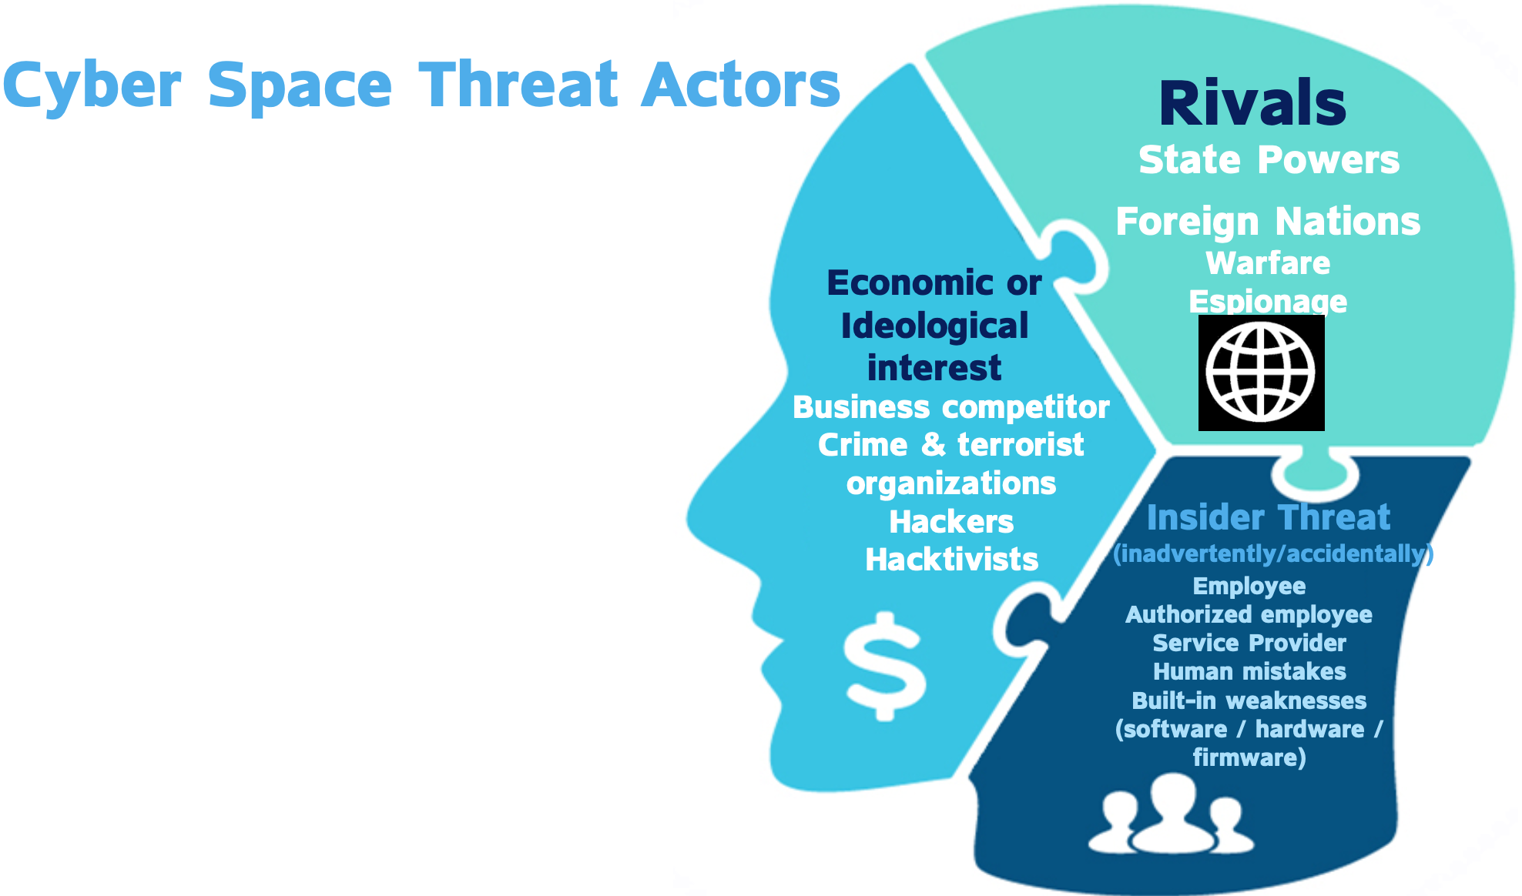
Threat Actors

Slide 23
Three approaches Identifying Threats
Focused on Assets This method uses asset valuation results and attempts to identify threats to the valuable assets.
Focused on Attackers Some organizations are able to identify potential attackers and can identify the threats they represent based on the attacker’s motivations, goals, or tac- tics, techniques, and procedures (TTPs).
Focused on Software If an organization develops software, it can consider potential threats against the software.

Slide 24
Vulnerabilities
A vulnerability is a weakness in an information system, system security procedures, internal controls, or implementation that could be exploited by a threat source.
Most information system vulnerabilities can be associated with security controls that either have not been applied (either intentionally or unintentionally), or have been applied, but retain some weakness.

Slide 25
Vulnerability
Vulnerability scans automatically probe systems, applications, and networks, looking for weaknesses that may be exploited by an attacker. The scanning tools used in these tests pro- vide quick, point-and-click tests that perform otherwise tedious tasks without requiring manual intervention.

Slide 26
Reasons for Cyber Attack: Attacker motivations
Hacktivism
Cyber vandalism
Extortion
Business competition
Cyber warfare
Personal rivalry

Slide 27
Employee Responsibility
Any employee in the organization can be, usually without his knowledge, a target or a "gateway" to a cyber attack.

Slide 28
Group Exercise
What are the assets you want to protect?
What are the threats to the assets?
How can you protect those assets?

