Slide 1
Introduction to Cryptography
Cyber Security Training Workshop

Slide 2
Cryptography
is the science of using mathematics to encrypt and decrypt data. Cryptography enables you to store sensitive information or transmit it across insecure networks (like the Internet) so that it cannot be read by anyone except the intended recipient.

Slide 3
Cryptography
Cryptography is a process in which the letters of each word are “scrambled”, so that certain pieces of information are hidden. In fact, this word gives us this definition if we simply break down the word… Crypt-o-graphy The prefix “crypt-” means hidden and the suffix “-graphy” means writing. So, all together it says hidden writing
Fun Facts About Cryptography
In the days of the Roman Empire, encryption was used by Julius Caesar and the Roman Army to cipher text. Encryption is known to be the easiest and most practical way to protect electronically stored data.
The most popular Cryptographic Techniques include:
○ The Caesar Cipher ○ Scytale ○ Steganography ○ The Pigpen Cipher

Slide 4
Terminology
Cipher :A secret or disguised way of writing code
Plaintext :to convert a message into cipher Encipher A text that is not specially formatted or written in code
Encode: to convert a message from one system of communication to another
Decode :To convert a coded message back to its plaintext
Key is a string of numbers or characters
Symmetric: if same key is used for encryption & decryption the algorithm .
asymmetric : if different keys are used for encryption & decryption the algorithm.

Slide 5
Cryptography
Encryption is the process by which a readable message is converted to an unreadable form to prevent unauthorized parties from reading it.
Decryption is the process of converting an encrypted message back to its original (readable) format.

Slide 6
Types of cryptography
Asymmetric vs. Symmetric Cryptography
Symmetric encryption is when you only have to figure out one “key” to encrypt and decrypt the ciphered text.
Asymmetric encryption is the newer method of the two. Unlike symmetrical encryption, there are two different “keys” or ways to encrypt and decrypt. Then through the internet, “secret” keys are exchanged that only a select few get in order to decrypt the text. Then there is a public key that encrypts the plain text back to the ciphered text

Slide 7
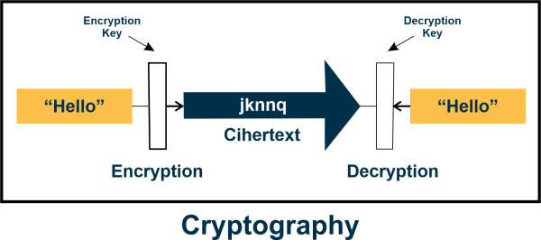
Cryptography

Slide 8
Caesar Cipher
Caesar Cipher: is standard example of ancient cryptography that is said to have been used by Julius Caesar himself. Surprisingly enough, Caesar Cipher is known by many names including the shift cipher, Caesar’s code, and even Caesar shift

Slide 9
Caesar Cipher
Caesar Cipher is a method in which each letter in the alphabet is rotated by three letters as shown
Example
plaintext: Cyber
Key 3
Cipher: FBEHU
A B C D E F G H I J K L M N O P Q R S T U V W X Y Z
D E F G H I J K L M N O P Q R S T U V W X Y Z A B C

Slide 10
Caesar Cipher
Exercise 1
plaintext: Somalia
Key 2
Cipher: UQOCNKC
Exercise 2
plaintext: DAL
Key 3
Cipher: GDO

Slide 11
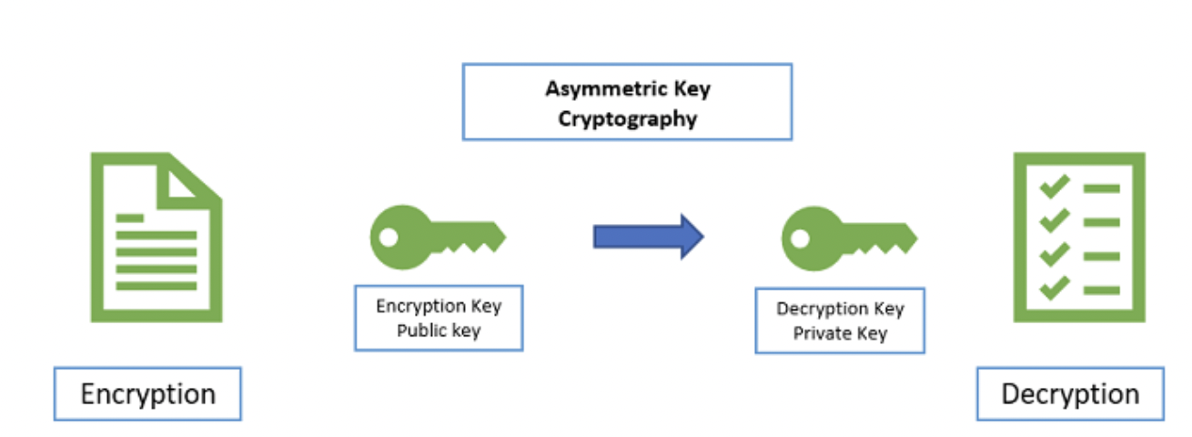
Asymmetric Encryption
Asymmetric Encryption uses two distinct yet related keys. One key, the Public Key, is used for encryption, and the other, the Private Key, is used for decryption. As implied in the name, the Private Key is intended to be private so that only the authenticated recipient can decrypt the message.

Slide 12
Encryption vs Decription online
http://practicalcryptography.com/ciphers/caesar-cipher/

