Slide 1

Network Operations and SomaliREN Services Mastery Workshop

Slide 2

Building Reliable, Scalable, and Secure Digital Infrastructure
Sharaf A. Roble, Network Administrator #SomaliREN

Slide 3

Welcome and Agenda
Why networking is crucial in ICT leadership
Key networking concepts and trends
Strategic insights for deploying, scaling, and managing networks effectively
Networking Overview
Network Administrator
Network Engineer
System Administrator
System Engineer
OSI TCP/IP Model

Slide 4
icebreaker questions
“In one word, what is the first thing that comes to mind when you hear the term ‘networking”
“Can you share one networking-related challenge your institution currently faces?”
"If you could redesign your university’s network infrastructure from scratch, what would be your top priority?“
"How do you think networks have changed in the last decade? What’s been the most significant development?“
Notes:
Q1
Purpose:
This question sets the stage for exploring diverse perspectives.
Activity: Write down responses on a board or slide to connect these thoughts to your presentation.
Q2
Purpose:
To identify real-world concerns and make your presentation more relatable.
Activity: Allow participants to share briefly, then highlight how the session will address similar challenges.
Q3
Purpose:
Helps identify key goals and encourages forward-thinking.
Activity: Lead into trends and strategies that align with their priorities.
Q4
Purpose:
Lead into a discussion about trends like cloud networking, IoT, and AI.
Activity: Use this to transition into Key Networking Concepts and Trends.

Slide 5
Why Networking is Critical in ICT Leadership
Networking as the Backbone of ICT Leadership
  Foundation for Digital Transformation: Networking enables seamless communication and efficient operations.
  Support for Academic Excellence: Facilitates research, learning, and collaboration.
    Example: High-speed internet connections in labs enable real-time simulations and data analysis.
  Scalability: Future-proofing networks for growth in student and staff needs.
    Example: Expanding Wi-Fi coverage to accommodate a growing number of devices during campus events.
  Security: Protecting sensitive academic and administrative data.
    Example: Implementing multi-layered firewalls to secure financial and student records.

Slide 6
Key Networking Concepts and Trends
The Pillars of Modern Networking
Key Concepts:
  LAN/WAN: Differentiating local and wide area networking.
  Routing and Switching: Ensuring efficient data flow.
  Network Protocols: TCP/IP as the foundation of connectivity.
  Example: Utilizing VLANs to segregate network traffic between faculty, students, and visitors.
Emerging Trends:
Software-Defined Networking (SDN)
Internet of Things (IoT) and its impact on bandwidth.
  Example: IoT devices like smart boards and security cameras integrated into campus networks.
Cloud-based networking and AI-driven optimization.
  Example: Using cloud platforms for remote learning and data storage.

Slide 7
Strategic Insights for ICT Leaders
Deploying, Scaling, and Managing Networks Effectively
Deployment:
  Conducting a thorough needs analysis.
    Example: Assessing bandwidth requirements for online classes and hybrid learning.
Aligning network design with organizational goals.
  Example: Prioritizing network upgrades for research departments.
Scaling:
  Building scalable architectures for future growth.
    Example: Adding modular switches to expand as student populations increase.
Leveraging cloud and hybrid solutions for elasticity.
  Example: Deploying virtual servers for managing surges in network demand during exams.
Notes:
Why is it a Strategic Insight?
Strategic Planning for Deployment
Deploying a network isn’t just about plugging in devices; it’s about understanding the university's long-term goals. For instance:
What are the academic, research, and administrative needs today and in the future?
What technologies can support these goals effectively?
The strategy here is to align the network infrastructure with the university's vision, avoiding wasteful or shortsighted investments.

Slide 8
Management
Proactive monitoring and maintenance.
  Example: Using network monitoring tools like SolarWinds to detect and resolve issues.
Implementing strong security policies and firewalls.
    Example: Enforcing strict access controls to protect sensitive data.

Slide 9
“Together, we can build networks that empower education and innovation.”
““Technology is best when it brings people together” – Matt Mullenweg”

Slide 10
Call to Action
Your Role as an ICT Leader
  How can you implement these insights in your organization?
  Q&A

Slide 11
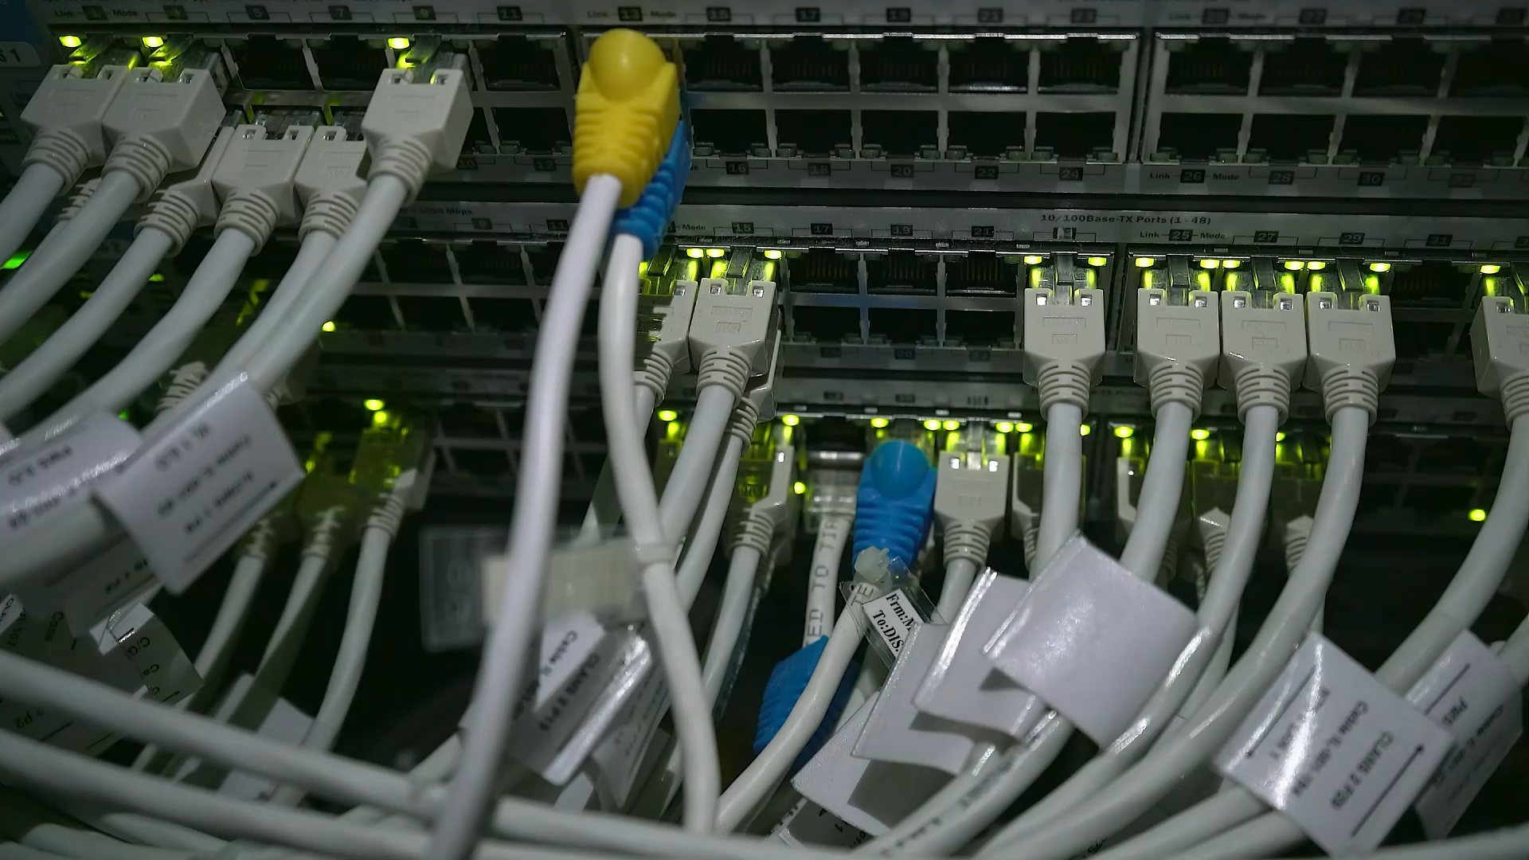
NETWORK OVERVIEW

Slide 12





ISP
C
C
SomaliREN
GOLIS
WAN
LAN
LAN
A
A
B
ISP
B
EAU BOSAASO
EAU GAROWE
SERVICES
BACKUP SERVER

Slide 13
OSI and TCP/IP Model

Slide 14

Sender Side
Receiver Side:
Google.com
Finally google.com has ben arrived
Layer 7 Application Layer
Initiates the HTTP/HTTPS request.
Layer 7 Application Layer
Delivers data to the end-user application.
Layer 6 Presentation layer
Encrypts data (TLS for HTTPS), formats the data for compatibility.
Layer 6 Presentation layer
Decrypts and converts data.
Layer 5 Session layer
Establishes the session for reliable communication.
Layer 5 Session layer
Agrees on session timing and synchronization.
Layer 4 Transport layer
Segments the data and assigns TCP/UDP ports.
Layer 4 Transport layer
Reconstructs data segments, manages flow control.
Layer 3 Network layer
Assigns source and destination IP addresses, routes packets.
Layer 3 Network layer
Reassembles packets and checks IP headers.
Layer 2 Data Link layer
Adds MAC addresses, creates frames.
Layer 2 Data Link layer
Verifies frames, removes the header.
Layer 1 Physical layer
Converts frames into bits for transmission over physical media.
Layer 1 Physical layer
Receives bits and reconstructs data.
Check errors, forward frames out

Slide 15

TCP three-way handshake
REQUEST: PC-A
Address 10.10.10.1
port 21 Transport TCP
will you Accept me
SYN
PC-A
PC-B
SYN ACK
RESPONSE: PC-A, it’s PC-B
Address 10.10.10.2
port 21 Transport TCP
Yes, let’s proceed.
ACK

Slide 16
Transport Layer
Transmission Control Protocol (TCP)
User Datagram Protocol (UDP)
Reliability
Segments data
Sequence Labeling
Connection-less
Used in, Live Streaming, Video Gaming etc.
Connection Oriented
1
2
3
DATA
DATA
DATA
DATA
DATA
DATA
DATA
DATA
DATA
DATA
DATA
DATA
4
5
6

Slide 17
What is the difference between Network admin, Network Engineer, System Admin, System Engineer

Slide 18
Network Administrator
Role: Primarily responsible for managing and maintaining an organization’s network infrastructure.
Key Responsibilities:
  Configure and manage network devices (routers, switches, firewalls).
  Monitor network performance and troubleshoot issues.
  Implement network security measures and policies.
  Focus: Day-to-day network operations and user support.

Slide 19
Network Engineer
Role: Focuses on the design and architecture of networking solutions.
Key Responsibilities:
  Design and implement complex network systems
  Analyze and optimize network performance.
  Plan for scalability and future network growth.
  Focus: Long-term strategy and planning of network infrastructures.

Slide 20
System Administrator
Role: Manages and maintains an organization’s servers and systems.
Key Responsibilities:
  Install, configure, and update server software and hardware.
  Monitor system performance and security.
  Manage user accounts and access permissions.
  Focus: Ensuring server uptime and performance for business applications.

Slide 21
System Engineer
Role: Involved in the overall design and integration of IT systems, often focusing on larger projects.
Key Responsibilities:
  Develop and design IT infrastructure and system solutions.
  Collaborate with various teams (software, hardware, and networking) for system integration.
  Analyze and improve system performance and reliability.
  Focus: Creating comprehensive solutions that meet business needs, integrating hardware and software components.

Slide 22

Question ?

