Slide 1
Network Operations
Intro to BGP

Slide 2
BGP Fundamentals
Border Gateway Protocol (BGP) is an EGP standardized path vector routing protocol that provides scalability, flexibility, and network stability. When BGP was created, the primary design consideration was for IPv4 inter-organization connectivity on public networks like the Internet and on private dedicated networks.

Slide 3
BGP Fundamentals Autonomous System Numbers
From the perspective of BGP, an autonomous system (AS) is a collection of routers under a single organization’s control, using one or more IGPs and common metrics.
An organization requiring connectivity to the internet must obtain an autonomous system number (ASN) from the Internet Assigned Numbers Authority (IANA).
RFC 4893 expanded the ASN field from 2 bytes to accommodate 4 bytes (32-bit range). This allows for 4,294,967,295 unique ASNs, providing quite an increase from the original 65,535 ASNs.
The IANA requires organizations or individuals requesting AS numbers to meet the following conditions:
Proof of a publicly allocated network range
Proof that Internet connectivity is provided through multiple connections
Demonstrated need for a unique routing policy from their providers.

Slide 4
BGP Fundamentals Autonomous System Numbers (Cont.)
Similar to IP Addresses, the AS number assignments include private address ranges that cannot be used for Internet traffic. These ranges are:
ASNs 64,512–65,535 are private ASNs in the 16-bit ASN range.
ASNs 4,200,000,000–4,294,967,294 are private ASNs within the extended 32-bit range.
Use only the ASN assigned by IANA, the ASN assigned by your service provider, or a private ASN. Using another organization’s ASN without permission could result in traffic loss and cause havoc on the internet.

Slide 5
BGP Fundamentals Path Attributes
BGP uses path attributes (PAs) associated with each network path. The PAs provide BGP with granularity and control of routing policies within BGP. The BGP prefix PAs are classified as follows:
Well-known mandatory
Well-known discretionary
Optional transitive
Optional non-transitive
Per RFC 4271, well-known attributes must be recognized by all BGP implementations. Well-known mandatory attributes must be included with every prefix advertisement; well-known discretionary attributes may or may not be included with a prefix advertisement.

Slide 6
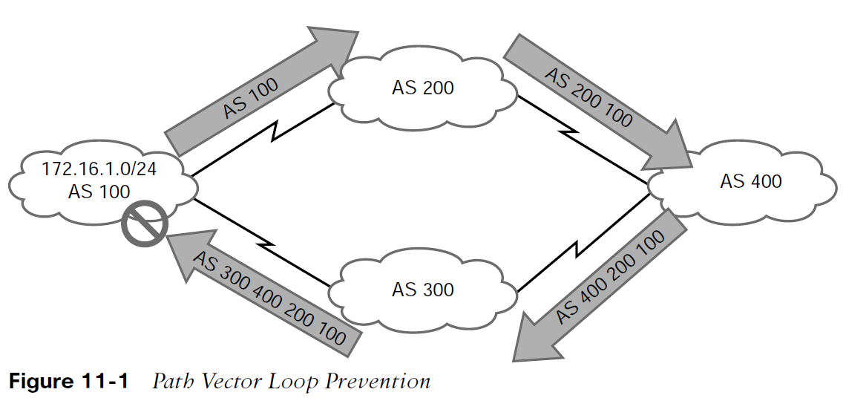
BGP Fundamentals Loop Prevention
BGP is a path vector routing protocol and does not contain a complete topology of the network, as link-state routing protocols do. BGP behaves like distance vector protocols, ensuring that a path is loop free.
The Loop Prevention Mechanism:
AS 100 advertises the 172.16.1.0/24 prefix to AS 200.
AS 200 advertises the prefix to AS 400, which then advertises the prefix to AS 300.
AS 300 advertises the prefix back to AS 100 with an AS_Path of 300 400 200 100. AS 100 sees itself in the AS_Path variable and discards the prefix.

Slide 7
BGP Fundamentals Address Families
RFC 2858 added Multi-Protocol BGP (MP-BGP) capability by adding an extension called the address family identifier (AFI).
An address family correlates to a specific network protocol, such as IPv4 or IPv6, and additional granularity is provided through a subsequent address-family identifier (SAFI) such as unicast or multicast.
MBGP achieves this separation by using the BGP path attributes (PAs) MP_REACH_NLRI and MP_UNREACH_NLRI to carry different reachability information for the different address families.
Every address family maintains a separate database and configuration for each protocol (address family + sub-address family) in BGP.
Some network engineers refer to Multiprotocol BGP as MP-BGP, and other network engineers use the term MBGP. Both terms refer to the same thing.

Slide 8
BGP Fundamentals Inter-Router Communication
BGP does not use hello packets to discover neighbors, as do IGP protocols, and it cannot discover neighbors dynamically. BGP neighbors are defined by IP address.
BGP uses TCP port 179 to communicate with other routers.
Most recent implementations of BGP set the do-not-fragment (DF) bit to prevent fragmentation and rely on path MTU discovery.
BGP uses TCP, so unlike IGPs, it can form adjacencies with routers that are multiple hops away.
A BGP session refers to the established adjacency between two BGP routers. Multi-hop sessions require that the router use an underlying route installed in the RIB (static or from any routing protocol) to establish the TCP session with the remote endpoint.

Slide 9
BGP Fundamentals Inter-Router Communication (Cont.)
BGP can be thought of as a control plane routing protocol or as an application because it allows for the exchange of routes with a peer that is multiple hops away.
A BGP session refers to the established adjacency between two BGP routers.
BGP neighbors connected to the same network use the ARP table to locate the IP address of the peer. Multi-hop BGP sessions require routing table information for finding the IP address of the peer.
A default route is not sufficient to establish a multi-hop BGP session.

Slide 10
BGP Fundamentals BGP Session Types
BGP sessions are categorized into two types:
Internal BGP (iBGP) - Sessions established with an iBGP router that are in the same AS or that participate in the same BGP confederation. iBGP prefixes are assigned an administrative distance (AD) of 200 upon installation in the router’s RIB.
External BGP (eBGP) - Sessions established with a BGP router that are in a different AS. eBGP prefixes are assigned an AD of 20 upon installation in the router’s RIB.

Slide 11
BGP Fundamentals BGP Session Types (Cont.)
iBGP
Service providers provide transit connectivity. Enterprises should not. Preventing an AS from becoming a transit AS by redistributing BGP routes into the IGP is not a viable solution for the following reasons:
Scalability - The internet has over 780,000 IPv4 network prefixes, IGPs cannot scale to that level of routes.
Custom routing - IGPs use metrics as the primary method of route selection. BGP uses multiple steps to identify the best path or to manipulate the path for a specific network prefix.
Path attributes - All of the BGP path attributes cannot be maintained within IGP protocols.
Establishing iBGP sessions between IGP routers in a full mesh allows for proper forwarding between autonomous systems.

Slide 12
BGP Fundamentals BGP Session Types (Cont.)
eBGP
eBGP is the core component of BGP on the internet. The difference in behavior for eBGP sessions and iBGP sessions are:
iBGP allows for multi-hop sessions. eBGP packets set the TTL to one, so packets are dropped if multi-hop connections are attempted.
The advertising router modifies the BGP next-hop address to the IP address sourcing the BGP connection.
The advertising router prepends its ASN to the existing AS_Path variable.
The receiving router verifies that the AS_Path variable does not contain an ASN that matches the local routers. BGP discards the NLRI if it fails the AS_Path loop prevention check.

Slide 13
BGP Fundamentals BGP Messages
Table 11-2 BGP Packet Types
TYPE | NAME | FUNCTIONAL OVERVIEW
1 | OPEN | Sets up and establishes BGP adjacency
2 | UPDATE | Advertises, updates, or withdraws routes
3 | NOTIFICATION | Indicates an error condition to a BGP neighbor
4 | KEEPALIVE | Ensures that BGP neighbors are still alive

Slide 14
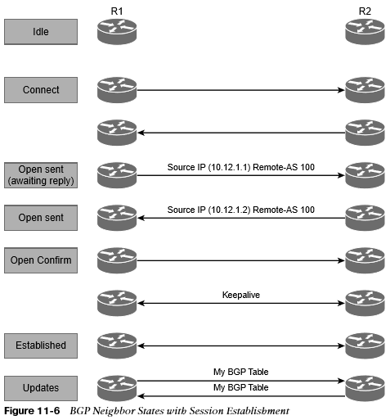
BGP Fundamentals BGP Neighbor States
The BGP session may report the following states:
Idle
Connect
Active
OpenSent
OpenConfirm
Established

Slide 15
BGP Fundamentals BGP Neighbor States (Cont.)
BGP forms a TCP session with neighbor routers called peers. BGP uses the finite-state machine (FSM) to maintain a table of all BGP peers and their operational status.
Idle - The first stage of the BGP FSM. BGP detects a start event and attempts to initiate a TCP session with the BGP peer.
Connect - BGP initiates the TCP connection. When the TCP handshake is completed, the ConnectRetryTimer is reset, an Open message is sent to the neighbor, and the state changes to OpenSent. During this stage, the router with the higher IP address manages the connection.
Active - BGP starts another TCP three-way handshake. If the connection is established an Open message is sent and the state moves to OpenSent.
OpenSent - If the OPEN message that is received by the originating router contains no errors, the connection state moves to OpenConfirm
OpenConfirm - In the OpenConfirm state, BGP waits for KEEPALIVE or NOTIFICATION messages. Upon receipt of a neighbor’s KEEPALIVE message, the state is moved to Established.
Established - BGP neighbors exchange routes using UPDATE messages.

Slide 16
Basic BGP Configuration
When configuring BGP, it is best to think of the configuration from a modular perspective. BGP router configuration requires the following components:
BGP session parameters
Address family initialization
Activate the address family on the BGP peer

Slide 17
Basic BGP Configuration BGP Router Configuration Components
BGP session parameters - BGP session parameters provide settings that involve estab- lishing communication to the remote BGP neighbor. Session settings include the ASN of the BGP peer, authentication, and keepalive timers.
Address family initialization - The address family is initialized under the BGP router configuration mode. Network advertisement and summarization occur within the address family.
Activate the address family on the BGP peer - In order for a session to initiate, one address family for a neighbor must be activated. The router’s IP address is added to the neighbor table, and BGP attempts to establish a BGP session or accepts a BGP session initiated from the peer router.

Slide 18
Basic BGP Configuration Modular Configuration
Steps to Configure Basic BGP are as follows:
Step 1. Initialize the BGP routing process with the global command router bgp as-number.
Step 2. (Optional) Statically define the BGP router ID (RID). The dynamic RID allocation logic uses the highest IP address of any of the up loopback interfaces.
Step 3. Identify the BGP neighbor’s IP address and autonomous system number with the BGP router configuration command neighbor ip-address remote-as as-number.
Step 4. Initialize the address family with the BGP router configuration command address-family afi safi.
Step 5. Activate the address family for the BGP neighbor with the BGP address family configuration command neighbor ip-address activate.

Slide 19
Basic BGP Configuration Configuring Basic BGP on IOS
R1 (Default IPv4 Address-Family Enabled)
router bgp 65100
neighbor 10.12.1.2 remote-as 65200
R2 (Default IPv4 Address-Family Disabled)
router bgp 65200
no bgp default ipv4-unicast
neighbor 10.12.1.1 remote-as 65100
!
address-family ipv4
neighbor 10.12.1.1 activate
exit address-family

Slide 20
Basic BGP Configuration Verification of BGP Sessions
The BGP session is verified with the command show bgp afi safi summary.
Earlier commands, such as show ip bgp summary, came out before MBGP and do not provide a structure for the current multiprotocol capabilities within BGP.

Slide 21
What is next?
Read a CCNA Certification Study Guide
Watch Tutorials
Use CCNA exam dumps to get useful structure insights like 9tut.com

