Slide 1
FileSender: Secure and Efficient Large File Transfers
An Open-Source Solution for Academic and Research Environments
Notes:
Question: Why do university teams need a specialized tool for sending large files?
Context: Discuss the challenges faced by university teams, such as limitations of email for large file transfers, the need for secure data sharing, and the frequency of collaboration on large projects.

Slide 2
Agenda for Presentation on FileSender
Introduction
2. Key Features
3. Detailed Features
4. Benefits
5. Security and Compliance
6. Use Cases
Community and Support
PRACTICE

Slide 3
Introduction
Brief Overview: FileSender is an open-source web application designed to securely send large files to other users.
Purpose: It addresses the limitations of traditional file transfer methods and ensures data security.

Slide 4
Key Features
Large File Transfers:
Explanation: FileSender is designed to handle very large files, often exceeding several gigabytes, making it ideal for transferring research data, high-resolution images, and video files.
Secure Transfers:
Explanation: Utilizes encryption and offers password protection to ensure that files are transferred securely and only accessible to intended recipients.
User Management:
Explanation: Supports user authentication and role-based access, it is integrated with SomaliREN Identity Federation (SIF).

Slide 5
Detailed Features
Customizable and Extensible:
Explanation: As an open-source solution, FileSender can be customized to fit specific institutional needs and workflows. It supports various plugins and extensions to enhance functionality.
Web-Based Interface:
Explanation: Accessible via any modern browser, FileSender does not require recipients to install additional software, making it user-friendly and accessible.
Notification System:
Explanation: Email notifications keep users informed about new file uploads, download completions, and file expiration, ensuring timely communication.

Slide 6
Benefits
Cost-Effective:
Explanation: Eliminates licensing costs associated with proprietary solutions, making it an affordable option for academic institutions.
Flexibility:
Explanation: Can be deployed on-premises or in the cloud, depending on the institution's preferences and requirements.
Collaboration:
Explanation: Facilitates collaboration by enabling easy sharing of large files among team members, partners, and external collaborators.

Slide 7
Security and Compliance
Encryption and Password Protection:
Explanation: Ensures files are securely transferred and accessible only to authorized users, protecting sensitive data.
Compliance with Data Transfer Regulations:
Explanation: Helps institutions comply with data protection regulations by providing secure and traceable file transfer methods.

Slide 8
Use Cases
Academic Research:
Explanation: Ideal for sharing large datasets, research papers, and project files.
Corporate Environments:
Explanation: Useful for sending large files in corporate settings where data security is crucial.
Media and Entertainment:
Explanation: Supports the transfer of high-resolution media files, making it suitable for media professionals.

Slide 9
How to access Filesender?

Slide 10
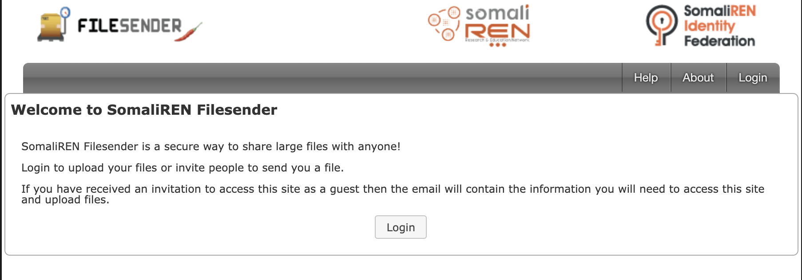
Login (https://filesender.somaliren.org.so/)

Slide 11
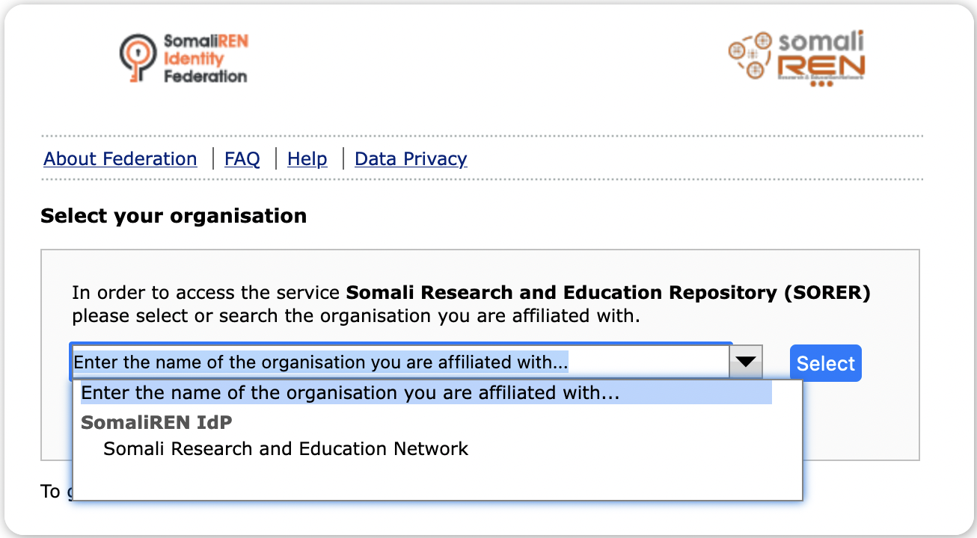
Login
Choose SomaliREN
Identity Provider

Slide 12
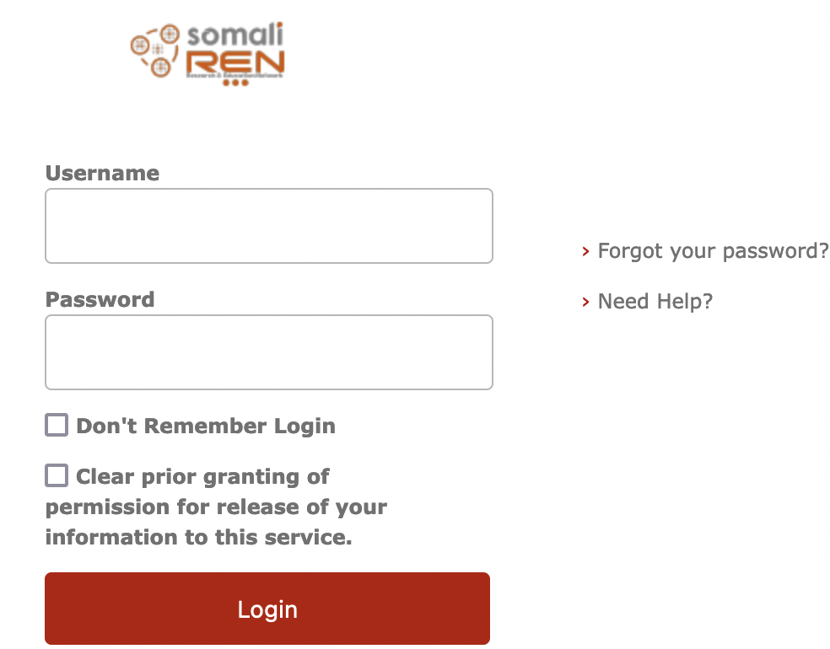
Login
Enter your username&
password
Click Login

Slide 13
Information to SP
Shows you the information the Service Provider (SP) will be provided by the Identity Provider (IdP)
Review and accept it

Slide 14
What if you don’t have an account on SIF? Contact us via services@somaliren.org

Slide 15
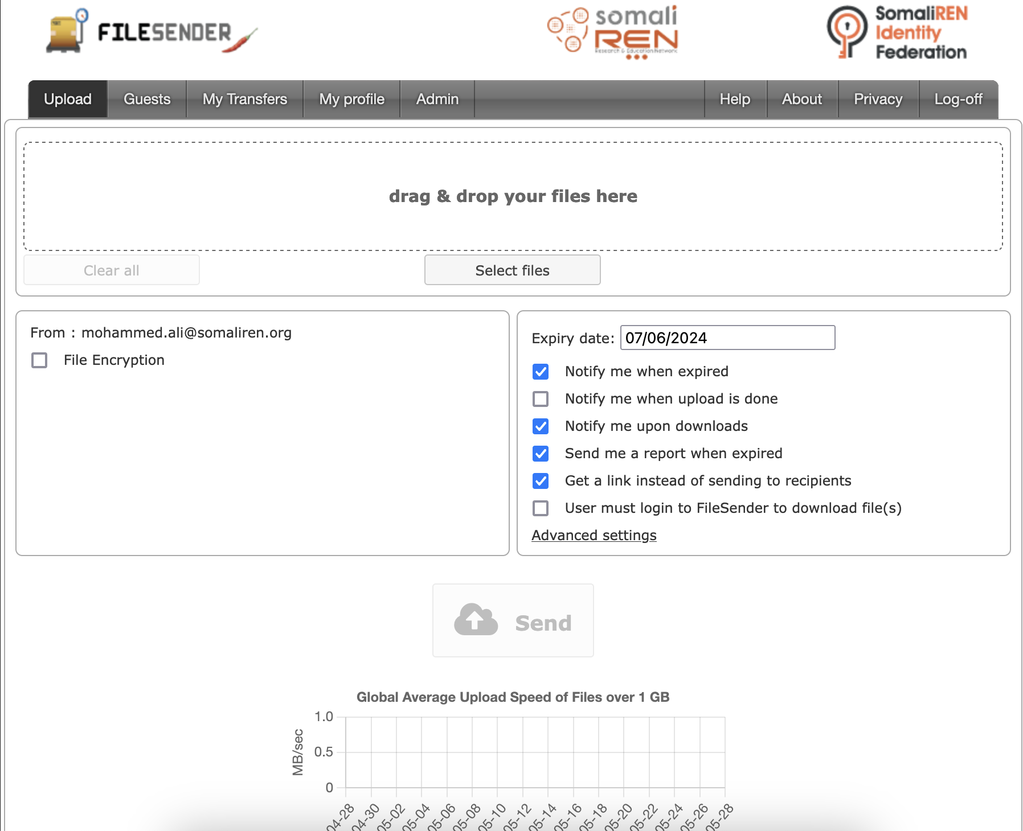
After a successful login (https://filesender.somaliren.org.so/)

Slide 16
Community and Support
Local Support:
SomaliREN Team: The SomaliREN team will always be on your side, providing local expertise, support, and guidance to ensure you get the most out of FileSender. Their commitment to supporting academic and research institutions in Somalia is unmatched.

