Slide 1
Network Operations
IP Services

Slide 2
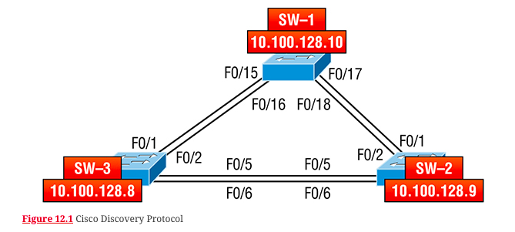
CDP and LLDP
Cisco Discovery Protocol (CDP) is a proprietary protocol designed by Cisco to help us collect information about locally attached devices. Using CDP, we can gather hardware and protocol information about neighbor devices—vital information for documenting and troubleshooting the network! Another dynamic discovery protocol is Link Layer Discovery Protocol (LLDP), but it’s not proprietary like CDP.

Slide 3
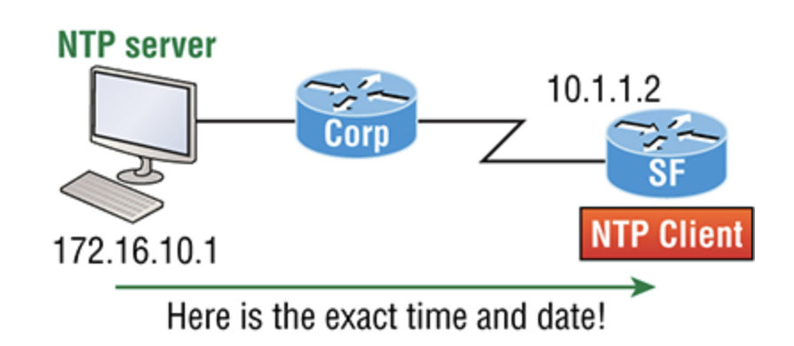
Network Time Protocol (NTP)
Network Time Protocol provides pretty much what it describes: time to all your network devices. More specifically, NTP synchronizes clocks of computer systems over packet-switched, variable-latency data networks.

Slide 4
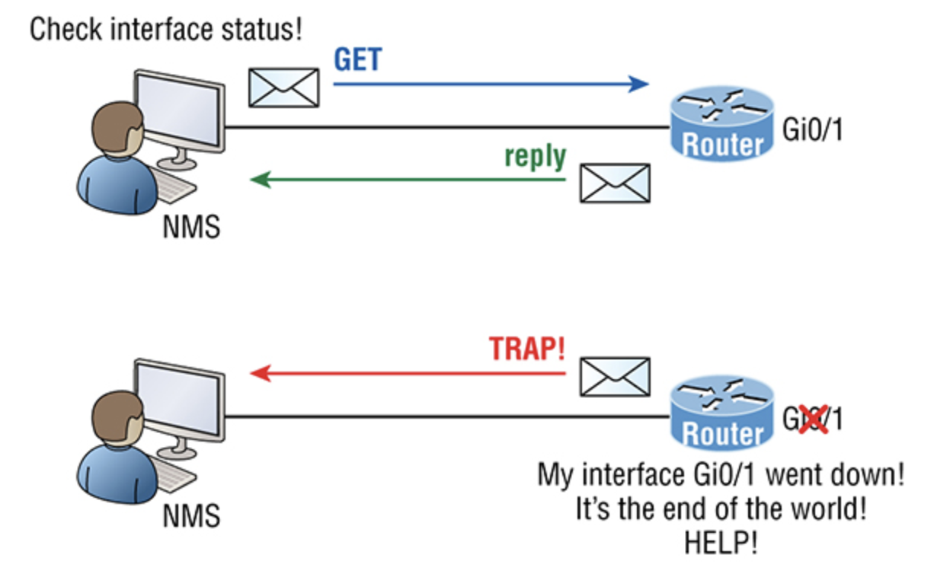
SNMP
SNMP is an Application layer protocol that provides a message format for agents on a variety of devices to communicate with network management stations (NMSs)

Slide 5
Management Information Base (MIB)
With so many kinds of devices and so much data that can be accessed, there needed to be a standard way to organize this deluge of data. It’s MIB to the rescue!
A management information base (MIB) is a collection of information that’s organized hierarchically that can be accessed by protocols like SNMP.
RFCs define some common public variables, but most organizations define their own private branches along with basic SNMP standards.
Organizational IDs (OIDs) are laid out as a tree with different levels assigned by different organizations. Top-level MIB OIDs belong to various standards organizations.

Slide 6
Syslog
Reading system messages from a switch or router’s internal buffer is a popular and efficient method of seeing what’s going on with your network at a particular time. But the best way is to log messages to a syslog server, which stores messages from you. It can even time-stamp and sequence them for you, plus it’s easy to set up and configure!

Slide 7
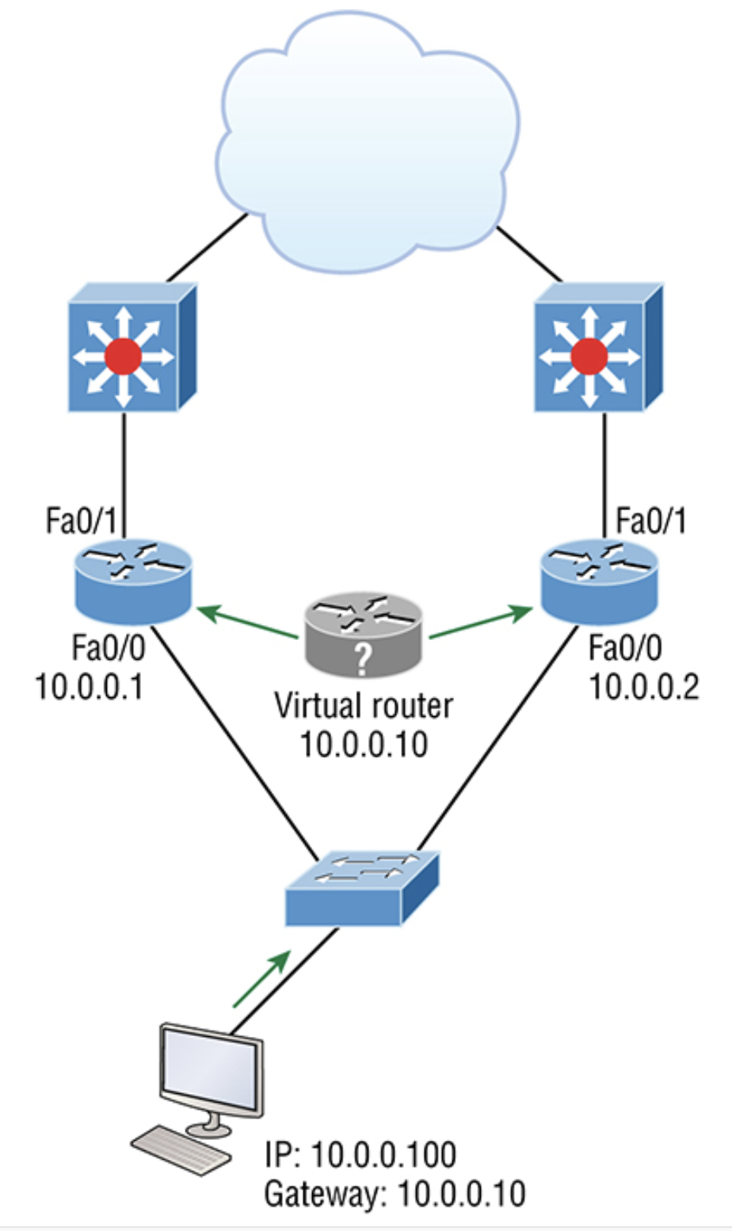
First Hop Redundancy Protocol (FHRP)
First hop redundancy protocols (FHRPs) work by giving you a way to configure more than one physical router to appear as if they were only a single logical one. This makes client configuration and communication easier because you can simply configure a single default gateway and the host machine can use its standard protocols to communicate.

Slide 8
FHRP
There are three important redundancy protocols:
Hot Standby Router Protocol (HSRP): HSRP has got to be Cisco’s favorite protocol ever! Don’t buy just one router; buy up to eight routers to provide the same service and keep seven as backup in case of failure!
Virtual Router Redundancy Protocol (VRRP): Also provides a redundant gateway for hosts on a local subnet, but again, not a load-balanced one. It’s an open standard protocol that functions almost identically to HSRP.
Gateway Load Balancing Protocol (GLBP): GLBP doesn’t stop at providing us with a redundant gateway, it’s a true load-balancing solution for routers. GLBP allows a maximum of four routers in each forwarding group.

Slide 9
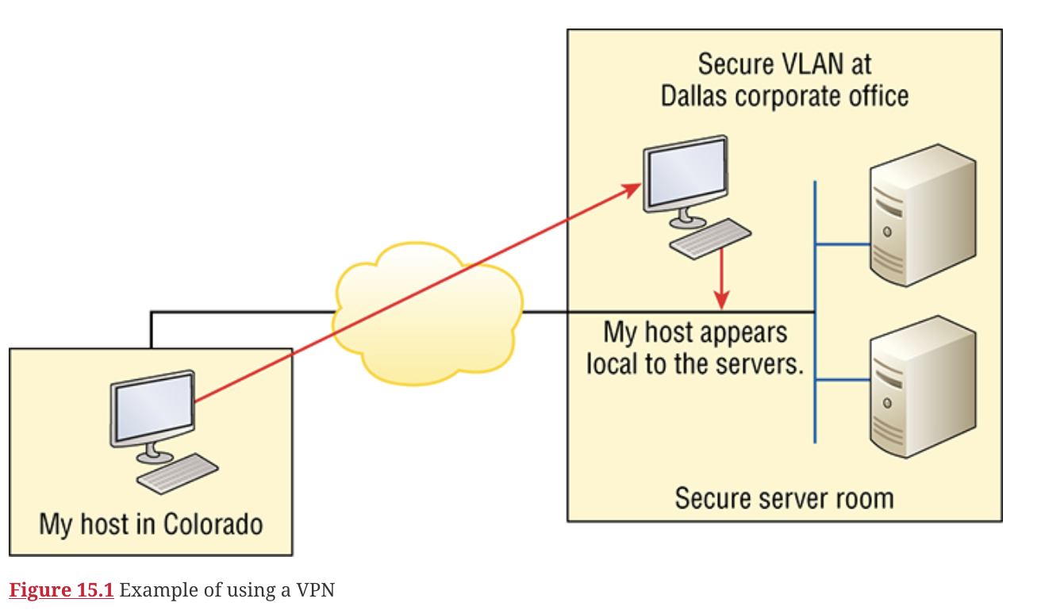
Virtual Private Networks
A virtual private network (VPN) allows the creation of ­private networks across the Internet, providing privacy and the tunneling of IP and non-TCP/IP protocols.
A VPN makes your local host part of the remote network by using the WAN link that connects you to the remote LAN. The VPN will make your host appear as though it’s actually local on the remote network. This means we gain access to the remote LAN’s resources, and that access is also very secure.

Slide 10
Quality of Service
Quality of service (QoS) provides the ability to assign a different priority to one or more types of traffic over others for different applications, data flows, or users so a certain level of performance can be guaranteed. QoS is used to manage contention for network resources for a better end-user experience.

Slide 11
IPv6
Why Do We Need IPv6?
Well, the short answer is because we need to communicate, and our current system isn’t really cutting it anymore.
IPv4 has only about 4.3 billion addresses available—in theory—and we know that we don’t even get to use most of those! Sure, the use of Classless Inter-Domain Routing (CIDR) and Network Address Translation (NAT) has helped to extend the inevitable dearth of addresses, but we will still run out of them, and it’s going to happen within a few years.

Slide 12
IPv6 Address Types
Unicast Packets addressed to a unicast address are delivered to a single interface.
Global unicast addresses (2000::/3) These are your typical publicly routable addresses and they’re the same as in IPv4. Global addresses start at 2000::/3.
Link-local addresses (FE80::/10) These are like the Automatic Private IP Address (APIPA) addresses that Microsoft uses to automatically provide addresses in IPv4 in that they’re not meant to be routed.
Unique local addresses (FC00::/7) These addresses are also intended for nonrouting purposes over the Internet, but they are nearly globally unique.

Slide 13
IPv6 Address Types
Multicast (FF00::/8) Again, as in IPv4, packets addressed to a multicast address are delivered to all interfaces tuned into the multicast address.
Anycast Like multicast addresses, an anycast address identifies multiple interfaces on multiple devices. But there’s a big difference: the anycast packet is delivered to only one device—actually, to the closest one it finds defined in terms of routing distance.

Slide 14
Virtualization
Virtualization Virtualization is a technology that allows a server to host multiple other computers as virtual machines. It does this by abstracting the host resources and sharing them with the guest machines.

Slide 15
Virtualization

Slide 16
Automation Components
Network automation comes in many forms, but generally, you can boil it down to being able to apply tasks in a predictable way with increased odds of a positive outcome. And what that means for us is that instead of tediously connecting to 200 devices, we can write a script that will apply the configuration to all of the devices for us.
There are almost endless options available, but we’ll focus on the main ones here:
Python
YAML

