Slide 1


Enhancing Academic Research with LimeSurvey
The Leading Open-Source Survey Tool for Education

Slide 2
What is LimeSurvey?
Overview: A powerful, open-source online survey application.
Key Feature: Create, publish, and analyze surveys with ease.
Accessibility: Available in over 80 languages, making it perfect for diverse academic environments.

Slide 3
Benefits of Using LimeSurvey at SomaliREN Member Universities
Cost-Effective: Completely free to use, reducing overhead costs for educational research.
Customizable: Adaptable to various academic needs with customizable templates and design flexibility.
Multilingual Support: Supports numerous languages, facilitating inclusive research across different linguistic groups.

Slide 4
Academic Applications
Course Evaluations: Easily gather feedback on courses and teaching methods.
Research Projects: Ideal for complex research designs, including thesis and dissertation surveys.
Student Surveys: Engage students in institutional decision-making processes through polls and surveys.

Slide 5
Advanced Features for Academic Research
Complex Question Types: Supports a variety of question formats including multiple-choice, open-ended, and scaled responses.
Conditional Logic: Tailor surveys based on responses, allowing for detailed and relevant question paths.
Data Analysis: Built-in tools for analyzing responses and exporting data for further analysis.

Slide 6
Enhancing Digital Learning at SomaliREN University Members with BigBlueButton
Discuss the importance of digital tools in modern education.

Slide 7
What is BigBlueButton?
BigBlueButton is an open-source video conferencing tool specifically designed to enhance online learning.
Key Point: Focus on educational collaboration, providing a suite of tools tailored for academic needs.

Slide 8
Key Features Beneficial for Academia
Real-Time Sharing
Audio/Video
Screen Sharing
Interactive Tools
Interactive Whiteboards
Polls and Quizzes:
Breakout Rooms:
Integration Friendly
Notes:
Audio/Video:
Deliver high-quality audio and video streams, crucial for clear communication and instruction delivery.
Screen Sharing:
Instructors can share their screens during lectures, making it easier to present PowerPoint slides, documents, and other educational materials directly.
Interactive Whiteboards: Allows instructors and students to annotate shared documents in real-time, enhancing explanations and note-taking.
Polls and Quizzes: Engage students actively during lectures with instant polls and quizzes, helping in assessing understanding and retention.
Breakout Rooms: Facilitate group projects and discussions by splitting the class into smaller, focused groups within the same virtual space.

Slide 9
Enhancing Student Engagement
Collaborative Learning
Emulate a traditional classroom's interaction digitally, enabling real-time collaboration and communication.
Accessibility Features
Includes features like closed captioning and session recordings, ensuring that all students, regardless of physical location or learning ability, can access and review lectures.

Slide 10
Benefits for Instructors
Comprehensive Teaching Tools
Equip educators with a full suite of tools to enhance lecture delivery, including multimedia support for a richer teaching experience.
Assessment and Feedback
Allows instructors to create and deliver tests and quizzes online, with capabilities to provide immediate feedback.

Slide 11
Cost-Effectiveness
Open Source
No costly licensing fees; fully customizable to meet the specific needs of the university.

Slide 12
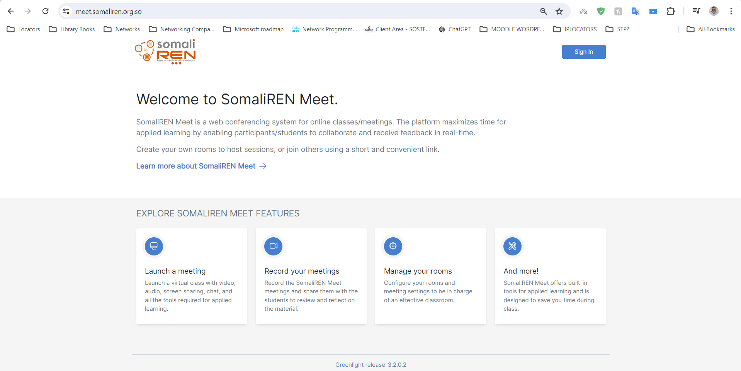
Login (https://meet.somaliren.org.so/)

Slide 13
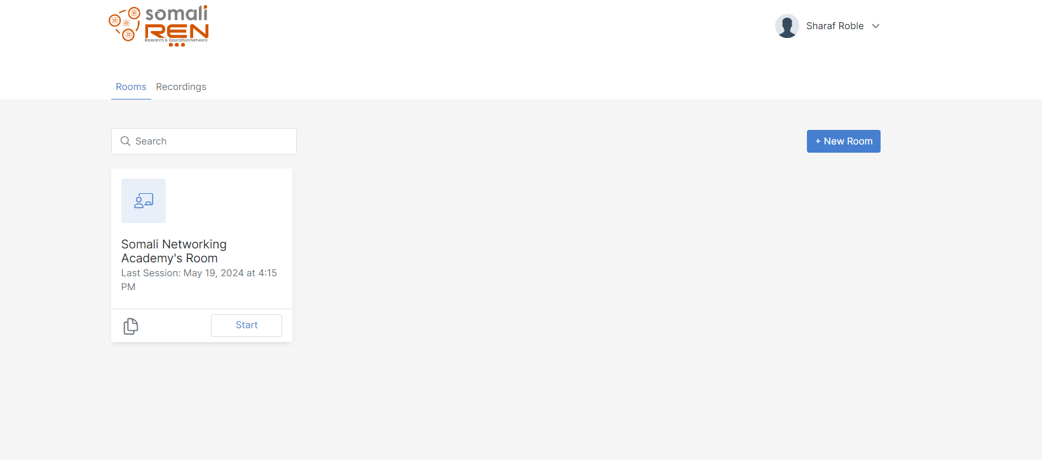
Here you can see Rooms you’ve created or you can create a new room

