Slide 1
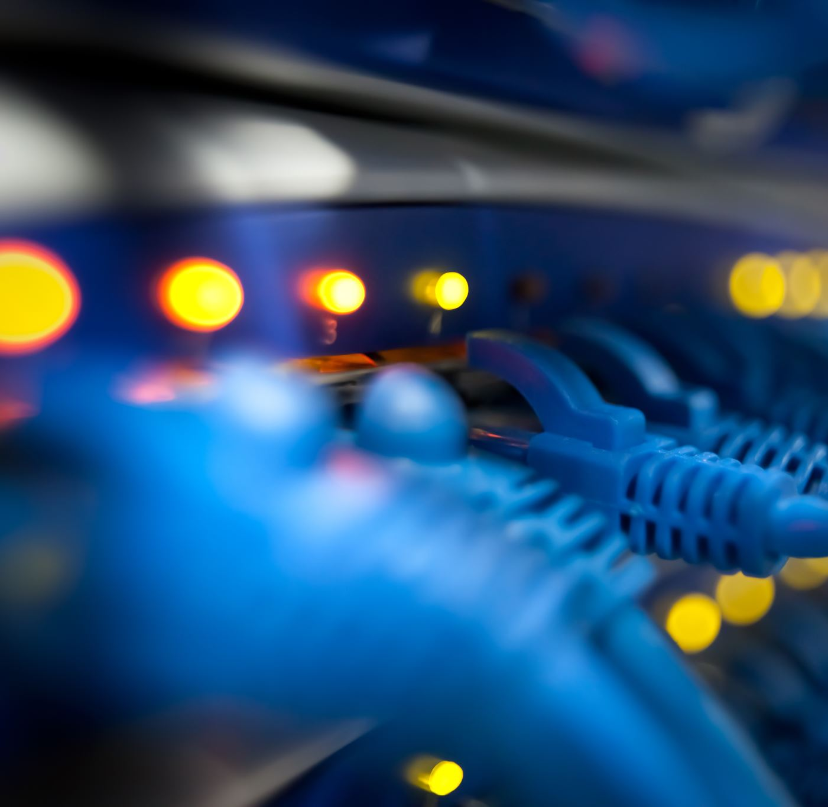
Network Operations
IP Address Management and Layer 2 Switching

Slide 2
The Role of IANA & ICANN in Managing IP Addresses
We'll talk about the roles of IANA (Internet Assigned Numbers Authority) and ICANN (Internet Corporation for Assigned Names and Numbers) in managing domain names and IP addresses and we will also learn how they help in keeping the Internet stable and secure.

Slide 3
Role of IANA
Internet Assigned Numbers Authority (IANA) is a non-profit organization responsible for coordinating the activities for the smooth functioning of the Internet. Since the internet is a global network, IANA undertakes the responsibility to allocate and maintain unique codes and numbering systems that are used in Internet protocols.
IANA performs the three main functions:
DNS
Number Resources (IP and Autonomous System (AS) numbers)
Protocol Assignments

Slide 4
Regional Internet Registry
An RIR is an organization that manages and controls Internet addresses in a specific region, usually a country and sometimes an entire continent. RIRs control assigning and distributing IP addresses and domain registrations.
There are five Regional Internet Registries:
The African Network Information Centre—AFRINIC
American Registry for Internet Numbers—ARIN (North America,)
Réseaux IP Européens Network Coordination Centre—RIPE NCC(Europe, the Middle East and Central Asia)
Asia-Pacific Network Information Centre—APNIC
Latin American and Caribbean Internet Address Registry—LACNIC

Slide 5
Role of ICANN
Internet Corporation for Assigned Names and Numbers (ICANN) is an internationally organized non-profit corporation whose major role is to keep the Internet stable, secure and interoperable.

Slide 6
Internet Society
The Internet Society (ISOC) is an international nonprofit organization that handles Internet standards, education and policy development. Founded in 1992, ISOC's mission is to ensure open Internet development by enhancing and supporting Internet use for organizations and individuals worldwide.

Slide 7
Layer 2 Switch
Three Switch Functions at Layer 2:
Address learning
Forward/filter decisions
Loop avoidance

Slide 8
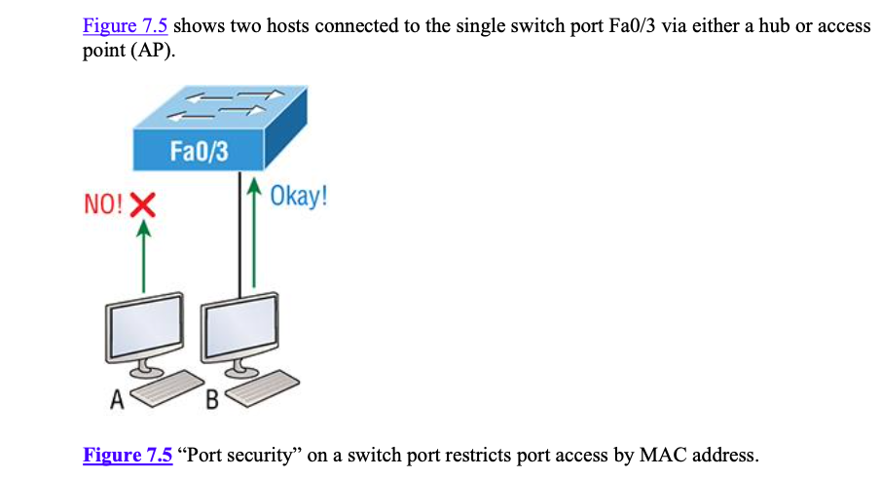
Port Security
It’s usually a bad idea to have your switches available for anyone to just plug into and play around with. We worry about wireless security, so why wouldn’t we demand switch security just as much, if not more?

Slide 9
Port Security
You can configure the device to take one of the following actions when a security violation occurs by using the switchport port-security command:
Protect: The protect violation mode drops packets with unknown source addresses until you remove enough secure MAC addresses to drop below the maximum value.
Restrict: The restrict violation mode also drops packets with unknown source addresses until you remove enough secure MAC addresses to drop below the maximum value. It also generates a log message, causes the security violation counter to increment, and sends an SNMP trap.
Shutdown: Shutdown is the default violation mode. The shutdown violation mode puts the interface into an error-disabled state immediately. The entire port is shut down.

Slide 10
DHCP
Dynamic Host Configuration Protocol (DHCP) assigns IP addresses to hosts. It allows for easier administration and works well in small to very large network environments. Many types of hardware can be used as a DHCP server, including a Cisco router.
Here’s a list of the most common types of information a DHCP server can provide:
IP address
Subnet mask
Domain name
Default gateway (routers)
DNS server address
WINS server address

Slide 11
DORA Process

Slide 12
DORA Process
This is the four-step process a client takes to receive an IP address from a DHCP server using what we call DORA or Discover, Offer, Request, Acknowledgment:
The DHCP client broadcasts a DHCP Discover message looking for a DHCP server (Port 67).
The DHCP server that received the DHCP Discover message sends a layer 2 unicast DHCP Offer message back to the host.
The client then broadcasts to the server a DHCP Request message asking for the offered IP address and possibly other information.
The server finalizes the exchange with a unicast DHCP Acknowledgment message.

Slide 13
DHCP Conflicts
A DHCP address conflict occurs when two hosts use the same IP address.
So during IP address assignment, a DHCP server checks for conflicts using the Ping program to test the availability of the address before it’s assigned from the pool. If no host replies, then the DHCP server assumes that the IP address is not already allocated. This helps the server know that it’s providing a good address, but what about the host?
A host uses something called a gratuitous ARP to help avoid a possible duplicate address. The DHCP client sends an ARP broadcast out on the local LAN or VLAN using its newly assigned address to solve conflicts before they occur. So, if an IP address conflict is detected, the address is removed from the DHCP pool (scope)
It is important to remember that the address will not be assigned to a host until the administrator resolves the conflict by hand!

Slide 14
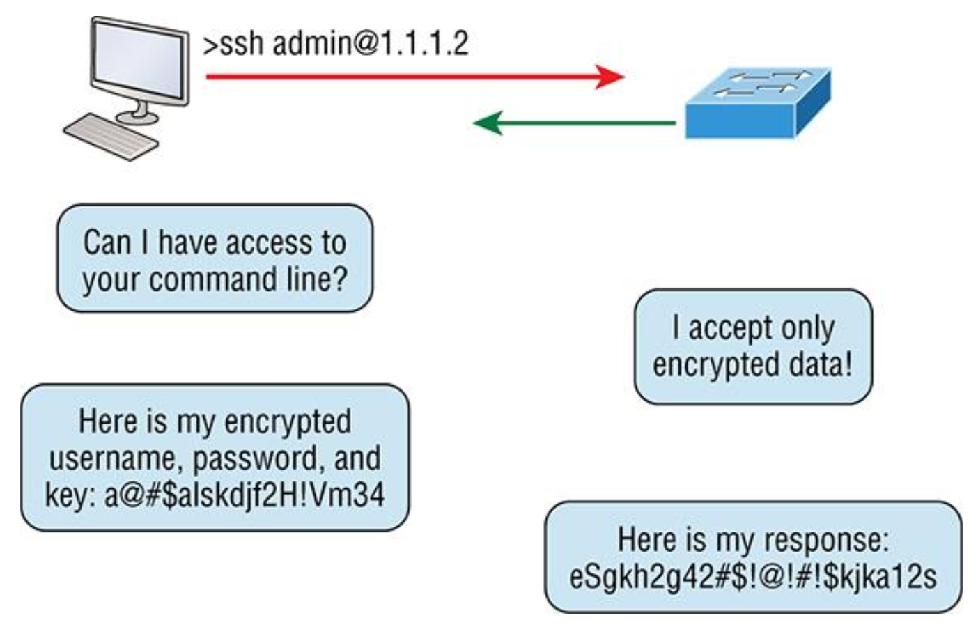
Secure Shell (SSH)
Secure Shell (SSH) protocol sets up a secure session that’s similar to Telnet over a standard TCP/IP connection.

