Slide 1



Network Infrastructure
Workshop
IP Routing

Slide 2

IP Routing
IP routing is basically the process of moving packets from one network to another network using routers.

Slide 3

Do you understand the difference between a routing protocol and a routed protocol?

Slide 4
IP Routing
Routers use routing protocols to dynamically find all networks within the greater internetwork and to ensure that all routers have the same routing table. Routing protocols are also employed to determine the best path a packet should take through an internetwork to get to its destination most efficiently. RIP, RIPv2, EIGRP, and OSPF are great examples of the most common routing protocols.

Slide 5
IP Routing
Once all routers know about all networks, a routed protocol can be used to send user data (packets) through the established enterprise. Routed protocols are assigned to an interface and determine the method of packet delivery. Examples of routed protocols are IP and IPv6.

Slide 6
IP Routing
The term routing refers to taking a packet from one device and sending it through the internetwork to another device on a different network.
Routers don’t really care about hosts—they only care about networks and the best path to each one of them. The logical network address of the destination host is key to getting packets through a routed network.

Slide 7
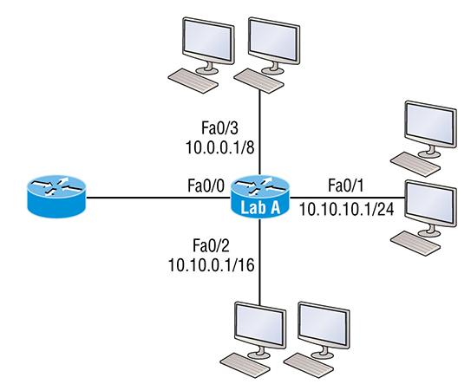
Here’s an important list of the minimum factors a router must know to be able to effectively route packets:
  Destination address
  Neighbor routers from which it can learn about remote networks
  Possible routes to all remote networks
  The best route to each remote network
  How to maintain and verify routing information

Slide 8
Static Routing
Static routing is the process that ensues when you manually add routes in each router’s routing table.

Slide 9
Static Routing
ip route [destination_network] [mask] [next-hop_address or exitinterface] [administrative_distance] [permanent]
This list describes each command in the string:
  ip route: The command used to create the static route.
  destination_network: The network you’re placing in the routing table.
  Mask: The subnet mask being used on the network.
  next-hop_address: This is the IP address of the next-hop router
  Exitinterface: Used in place of the next-hop address if you want, and shows up as a directly connected route.
  administrative_ distance By default, static routes have an administrative distance of 1 or 0 if you use an exit interface instead of a next-hop address.
  Permanent: Choosing the permanent option keeps the entry in the routing table no matter what happens.

Slide 10
Static Routing
R1(config)#do sho ip route
S 192.168.10.0/24 [150/0] via 172.16.10.5
172.16.0.0/30 is subnetted, 3 subnets
C 172.16.10.4 is directly connected, Serial0/0/1
L 172.16.10.6/32 is directly connected, Serial0/0/1
S 172.16.10.0 [150/0] via 172.16.10.5
C 192.168.20.0/24 is directly connected, FastEthernet0/0
L 192.168.20.1/32 is directly connected, FastEthernet0/0
10.0.0.0/24 is subnetted, 1 subnets
S 10.10.10.0 [150/0] via 172.16.10.5

Slide 11
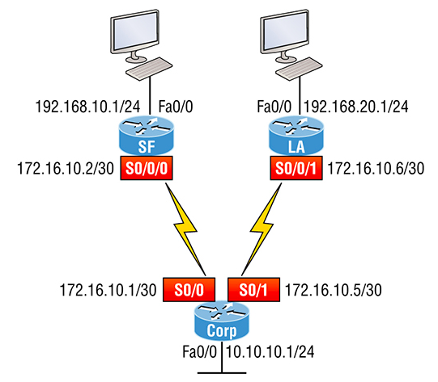
Default Route
A stub indicates that the networks in this design have only one way out to reach all other networks, which means that instead of creating multiple static routes, we can just use a single default route. This default route is used by IP to forward any packet with a destination not found in the routing table, which is why it is also called a gateway of last resort.

Slide 12
R1(config)#do sho ip route
[output cut]
Gateway of last resort is 172.16.10.5 to network 0.0.0.0
172.16.0.0/30 is subnetted, 1 subnets
C 172.16.10.4 is directly connected, Serial0/0/1
L 172.16.10.6/32 is directly connected, Serial0/0/1
C 192.168.20.0/24 is directly connected, FastEthernet0/0
L 192.168.20.0/32 is directly connected, FastEthernet0/0
S* 0.0.0.0/0 [1/0] via 172.16.10.5

