Slide 1



Network Infrastructure
Workshop
OSPF

Slide 2
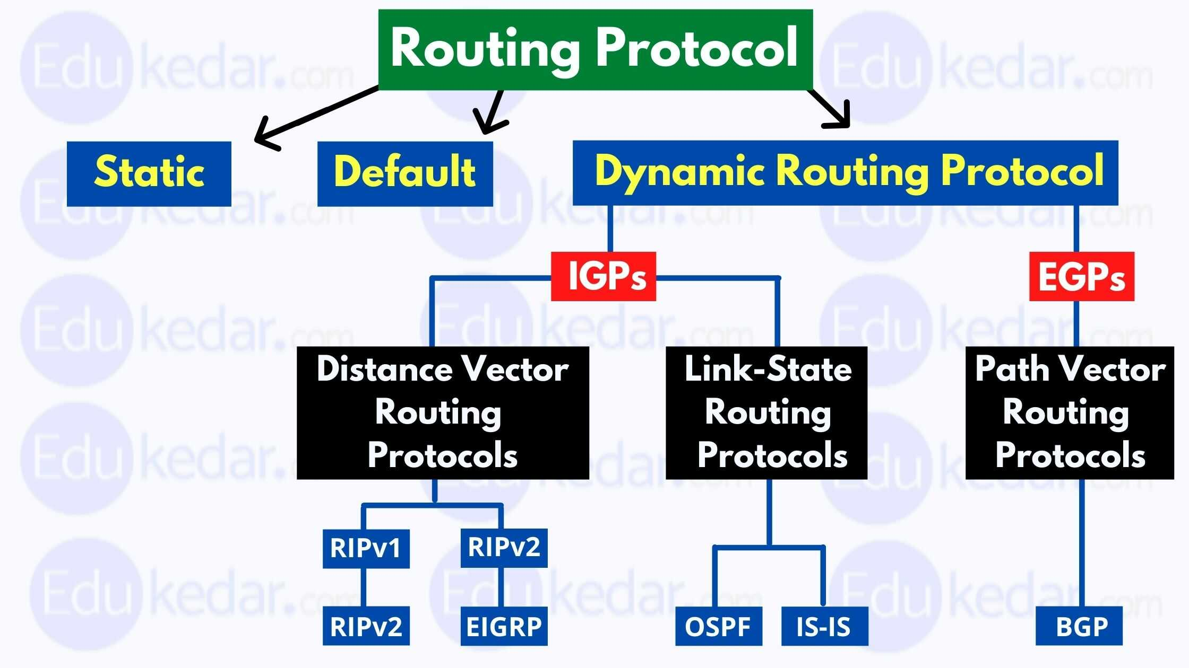

Slide 3
OSPF
Here are three of the biggest reasons to implement OSPF in a way that makes full use of its intentional, hierarchical design:
  To decrease routing overhead
  To speed up convergence
  To confine network instability to single areas of the network

Slide 4
OSPF Operation
OSPF operation is basically divided into these three categories:
  Neighbor and adjacency initialization
  LSA flooding
  SPF tree calculation

Slide 5
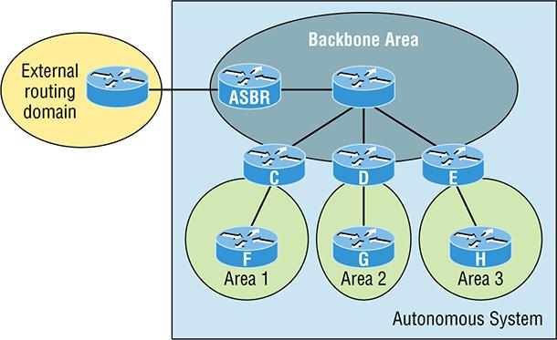
OSPF Basics

Slide 6
OSPF Terminology
Link A link is a network or router interface assigned to any given network.
Router ID The router ID (RID) is an IP address used to identify the router.
Neighbor Neighbors are two or more routers that have an interface on a common network
Adjacency An adjacency is a relationship between two OSPF routers that permits the direct exchange of route updates.
Designated router A designated router (DR) is elected whenever OSPF routers are connected to the same broadcast network

Slide 7
Cont…
Backup designated router A backup designated router (BDR) is a hot standby for the DR on broadcast, or multi-access, links.
Hello protocol The OSPF Hello protocol provides dynamic neighbor discovery and maintains neighbor relationships.
Neighborship database The neighborship database is a list of all OSPF routers for which Hello packets have been seen.
Topological database The topological database contains information from all of the Link State Advertisement packets that have been received for an area.

Slide 8
Wildcard
Example 1: 192.168.10.0/24 will be:
  192.168.10.0 0.0.0.255
Example2: 192.168.5.0/27 will be:
  192.168.5.0 0.0.0.31
Example3: 192.168.3.0/30 will be:
  192.168.3.0 0.0.0.3

